Slide 1


TIME & Tech Tips & Tricks
September 2024

Slide 2
Welcome
Sarah Cook
Senior Training Officer
TIME & Technical Unit
Ben Brandner
Training Officer
TIME & Technical Unit
https://www.doj.state.wi.us/

Slide 3
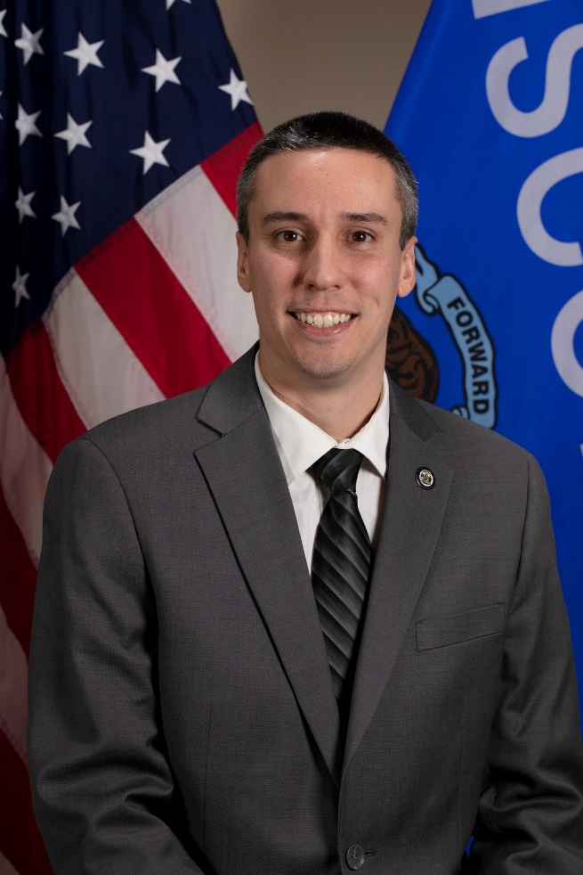
TIME & Tech Manager
Craig Thering
Craig returned to the TIME and Technical Unit in February 2023 as the TIME and Technical Manager. Craig began his career with CIB in 2013 with the Firearms Unit and then in 2014, he joined the TIME and Technical Unit as a Program and Policy Analyst where he spent six years helping to keep the TIME System running. In December 2020, Craig accepted a new position as a Criminal History Unit Manager, working to ensure the criminal history repository was maintained in accordance with Wisconsin State Statute 165.83. Craig is excited to be back in the TIME and Technical Unit and welcomes any feedback or suggestions on how we can improve the TIME System.
https://www.doj.state.wi.us/
Notes:
Welcome and provide brief intros on staff

Slide 4
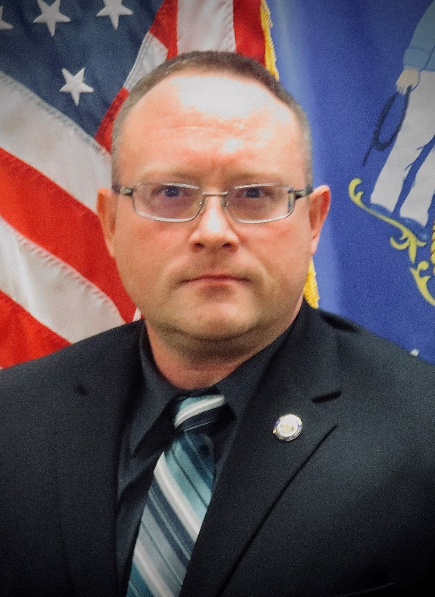
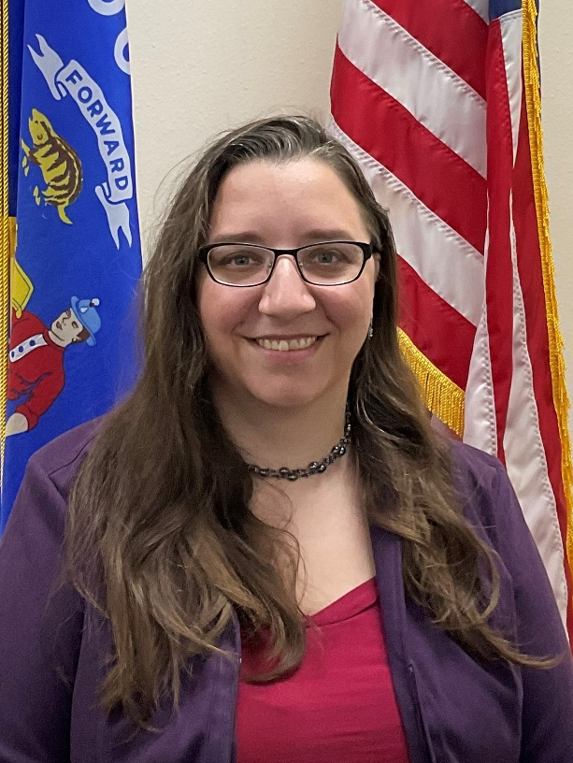
Program & Policy Analysts (PPAs)
Zach Polachek
Jeanette Devereaux-Weber
Zach is the Program & Policy Analyst-Advanced for the Crime Information Bureau at the Wisconsin Department of Justice. Zach started with WI DOJ in 2012 in the Firearms Unit and then transferred to the TIME & Tech Unit in 2015 as Program & Policy Analyst. Zach has been in the TIME & Tech Unit for 8 ½ years and is Level 1 FBI Certified Cyber Investigator.
Jeanette Devereaux-Weber has been a Program & Policy Analyst for the TIME & Technical Unit since 2019. She started her WI DOJ career in the Criminal History Unit as a Criminal History Records Specialist in 2012.
https://www.doj.state.wi.us/

Slide 5
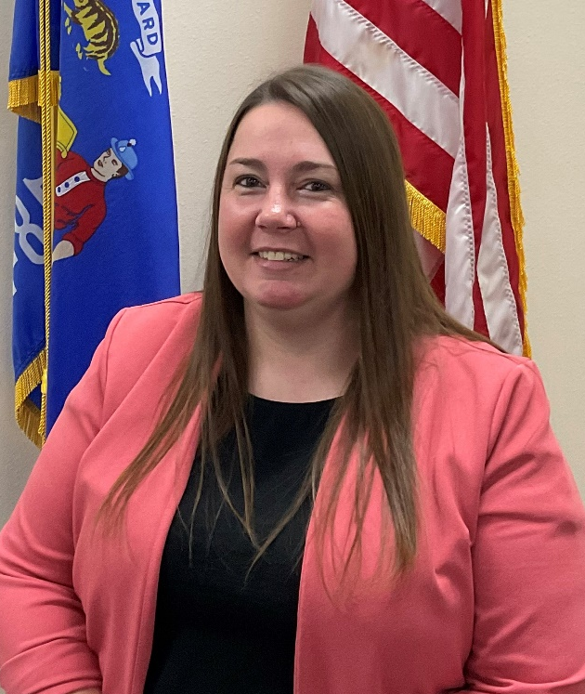
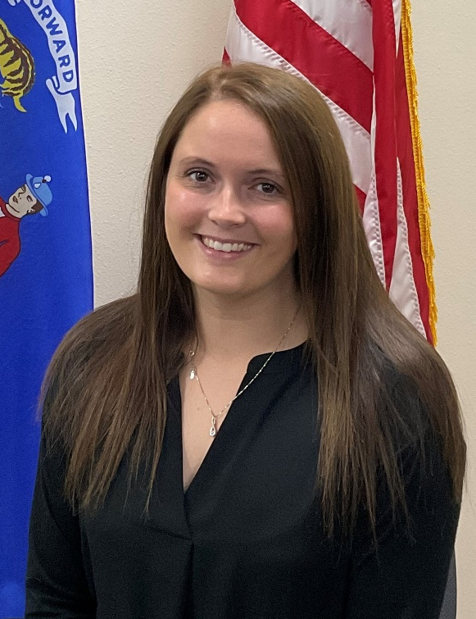
Program & Policy Analysts (PPAs) continued
Jennifer Virgin
Megan Smaby
Jenn joined the TIME and Tech unit as a Program and Policy Analyst in August of 2023. She started in CIB in 2017 as a member of the Firearms Unit. In March of 2018 she transferred to the Department of Revenue. Jenn returned to the Firearms Unit in January 2019 as a JPA Senior. In October 2021, Jenn was promoted to JPA Advanced. She has helped update training manuals, trained new hires, and has been a resource for other team members.
Megan joined the TIME and Tech unit as a Program and Policy Analyst in August of 2023. She started in CIB in 2016 as an LTE for the Firearms Unit. She spent 7 years conducting background checks for Wisconsin Concealed Carry licenses, HR218 certifications, and handgun purchases. In addition, she assisted law enforcement agencies in completing their firearm return checks.
https://www.doj.state.wi.us/

Slide 6
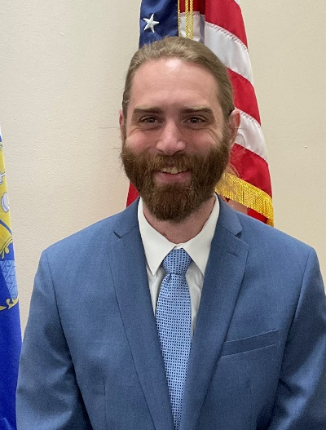
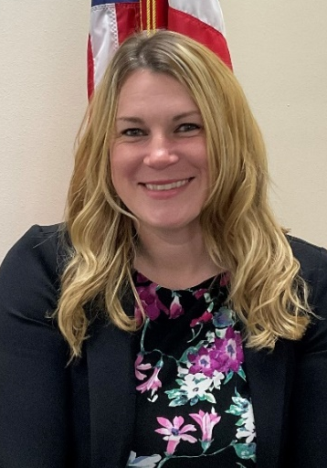
Trainers
Ben Brandner
Sarah Cook
Ben Brandner is a Training Officer with the Wisconsin Department of Justice. Ben joined the Wisconsin Department of Justice as Justice Program Associate in 2015. He has been with the TIME & Tech unit since 2021. Ben previously worked in the hospitality industry as a food safety trainer
Sarah Cook is the Senior Training Officer with the Wisconsin Department of Justice and has been with the unit since 2021. Prior to that, Sarah worked for the Waukesha County Communications Center (911 dispatch center) as a dispatcher for over 14 years. She trained new hires both on the job and in the classroom for 11 of those years.
https://www.doj.state.wi.us/

Slide 7
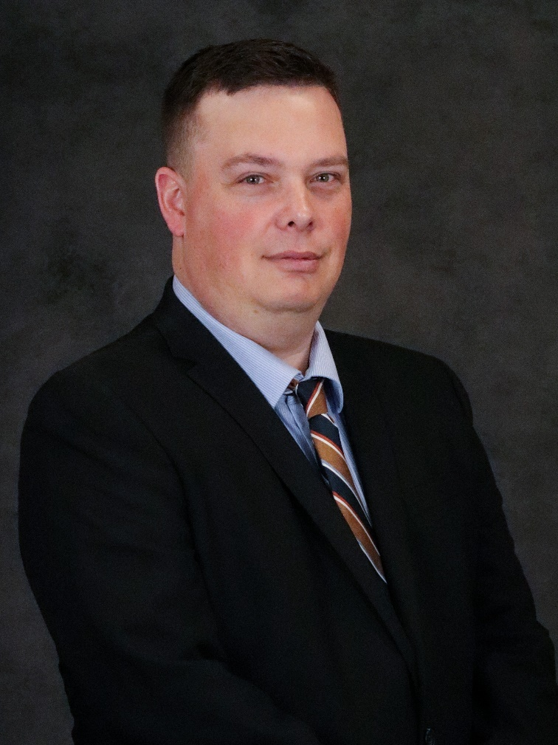
Trainer Recent Addition
Matthew Woodrum
Matthew has joined CIB as the newest training officer just this week. Matthew previously worked at the Beloit Police Department as the Records Supervisor, and he was a member of the Command Staff. Matthew also spent 8 years at the Rock County Communications Center ( 911 dispatch center). While at 911 he was an APCO certified training officer, a member of the Critical Response Team, and an acting supervisor.
https://www.doj.state.wi.us/

Slide 8

Discussion Topic: Agency Roles
What is a TAC (TIME Agency Coordinator) and what are the responsibilities of the TAC?
What is a TRAIN Administrator? Is it the same as a TAC?
Who performs Validations?
What is a LASO (Local Agency Security Officer)?
https://www.doj.state.wi.us/
Notes:
B
TIME Agency Coordinator (TAC):
The TAC will act as the primary liaison between their agency and the Crime Information Bureau (CIB), regularly communicating with CIB, participating in sponsored meetings, and providing feedback and recommendations for system improvement. The TAC is normally TIME System certified. This individual(s) must attend TAC training within one year from the date of designation. Please click here for a list of responsibilities and TAC training information: https://wilenet.widoj.gov/cib/time-system-training-materials-manuals-forms, scroll down to “Additional Training Materials”. You will find TAC Responsibilities as well as some useful forms and handouts. Please keep in mind that just because a person may have attended TAC training, they are not officially designated as the agency’s TAC until the current TAC, TRAIN Admin or someone of administrative status at the agency notifies us at CIB that they will be taking over the responsibilities or assisting with them. Please include the email address of the new designee in the notification e-mail.
Each agency is required to have at least one TAC. Agencies are encouraged to have more than one TAC.
TRAIN Administrator:
The TRAIN Administrator is responsible for requesting personnel be added or removed from their agency’s roster, registering users for applicable TIME System training, and keeping track of when their agency’s users’ certifications expire, and they have the ability to run certification reports that show training completed, certification level obtained, and certification expiration dates. For step-by-step directions please click on this link https://wilenet.widoj.gov/cib/time-system-training-materials-manuals-forms, scroll down to “Additional Training Materials”, then select “Train Handout.”
TRAIN Administrators can request to add/remove users from rosters, sign them up for classes and request software rights, but that’s about it.
Validation Officer:
Validation obliges the ORI to confirm the record is complete, accurate and still outstanding or active. Validation is accomplished by reviewing the original entry and current supporting documents. Recent consultation with any appropriate complainant, victim, prosecutor, court, motor vehicle registry files, or other appropriate source or individual also is required with respect to the Warrant/Wanted, Missing Person, Person with Information, Protection Order, Identity Theft, Gang Member, Vehicle, Gun, Boat, Security and Part Files. In the event the ORI is unsuccessful in its attempts to contact the victim, complainant, etc., the entering authority must make a determination based on the best information and knowledge available whether or not to retain the original entry in the file.
Are records entered under your agency’s ORI? If so, those records are required to be validated. In some cases, an offsite dispatch center will enter and validate the records and in some cases, the offsite dispatch center will enter the records, but the ORI will still validate their own records. Your agency may also enter and validate their own records. Validation class is currently only available In-Person, but it is not required. Whomever is performing Validation must have access to eTIME for the ORI and they must have Validation rights. If another agency handles your validation, then you at least need a copy of their Validation Policy. Your agency can have many Validation Officers.
LASO Training (Local Agency Security Officer)
LASO training shall be required prior to assuming duties but no later than six months after initial assignment, and annually thereafter. At a minimum, the following topics shall be addressed as enhanced security awareness training for a LASO:
1. The roles and responsibilities listed in CJIS Security Policy Section 3.2.9.
2. Additional state/local/tribal/federal agency LASO roles and responsibilities.
3. Summary of audit findings from previous state audits of local agencies.
4. Findings from the last FBI CJIS Division audit of the CSA.
5. Most recent changes to the CJIS Security Policy.
This can be someone who handles IT support for the agency or someone in the agency that has some technical knowledge. In cases of smaller agencies, sometimes the TAC is also the LASO. This individual is responsible for understanding the technical aspects of the CJIS Security Policy and helps the TAC make sure the agency is in compliance. Each agency is required to have a LASO and training is required annually. The individual does not have to work for the agency, but they do need to be an authorized user (fingerprint background check, security awareness training, authorized user) and they must complete the LASO training from WILENET annually and sign the certification page.

Slide 9
Discussion Topic: VPF
Question
Does your agency utilize the Violent Person File?
How many people do you think are eligible to for entry to the VPF?
How many entries do you think have actually been made to the VPF in WI?
https://www.doj.state.wi.us/
Notes:
S
Give a brief overview of what the Violent Person File is.
See if people can guess how many people in WI fit the criteria to be entered. After asking them that, let them know over based on statistics from CHU, the number of eligible people is in the thousands, upward of 10,000 and that’s only for one of the 4 criteria (arrest offenses).
What percent of those people are entered? Give the agencies a chance to respond.
Only about 47 WI agencies have entries into the VPF. WI has a total of about 150 Violent Person entries.

Slide 10
Violent Person File
What is it?
What criteria must be met in order to utilize this file type?
  Offender has been convicted for assault or murder/homicide of a law enforcement officer, fleeing, resisting arrest, or any such statute which involves violence against law enforcement.
  Offender has been convicted of a violent offense against a person to include homicide and attempted homicide.
  Offender has been convicted of a violent offense against a person where a firearm or weapon was used.
  A law enforcement agency, based on its official investigatory duties, reasonably believes that the individual has seriously expressed his or her intent to commit an act of unlawful violence against a member of the law enforcement or criminal justice community.
  Which agencies can enter information into the file?
https://www.doj.state.wi.us/
Notes:
S
The VPF file was designed to alert law enforcement officers that an individual they are encountering may have the propensity for violence against law enforcement.
Must meet one of the 4 criteria for entry
Perhaps the individual does not have any warrants out for their arrest and they are not on Probation; but they do have a Criminal History. If an officer on a traffic stop requests a name be run, that criminal history won’t automatically come back unless a Criminal History of the individual is queried. The Violent Person entry will come back on a name query and alert the officer to the person’s propensity for violence before getting to the point of querying a criminal history.
Any agency coming into contact with an individual who meets one of the listed criteria. It does not have to be the agency in which the convicted offense occurred. If a user runs a criminal history and sees any of the convictions listed from the criteria or if they have documentation of the threat that the individual made, that agency may enter a violent person record. It will be an internal agency decision as to whom in the agency gives permission to enter it (dispatchers locating it on a criminal history or officers prompting it after an interaction, etc.)
We would recommend at least a procedure in place that everyone can reference to make sure this file type is being utilized correctly. A Policy will address any of those concerns that you would have internally about who should be making the decisions to enter the records and whether or not you choose to use social media posts for documentation of threats, etc. But as the NCIC operating manual states, VPF should be utilized if the individual meets one of the 4 criteria and you have documentation. There’s no indication in the NCIC manual that says you have to have the policy first, but based on all of the internal decisions your agency would need to make, we would suggest that you get one in place as soon as possible. If you encounter a person that meets the criteria before your policy is in place, you should be able to enter them if you have proper documentation.
Example: John Smith commits a violent crime with a weapon down in southeast WI. He is convicted, completes his sentence and is released. Once released, he moves up to northern WI. If officers encounter John on a traffic stop, how would they know he has a propensity for violence outside of running a criminal history? The Violent Person file makes it possible that upon query of name/dob of an individual on a regular driver/wanted status, the violent person entry is seen, so now officers on this traffic stop would know to potentially have a back up squad or to be on higher alert when dealing with this individual.
Another example: Linda Jones lives in Sheboygan and has made serious threats to harm the next police officer that makes contact with her. She has not been convicted of anything at this time, but she frequently travels throughout the state. How would Eau Claire PD know when they make contact with her on a traffic stop that she has made these threats? This meets one of the 4 criteria to add her to the Violent Person file and when her name and dob are queried by the officers in Eau Claire, they would see the NCIC hit for the VPF.
3rd example will be mentioned in a later slide: West Bend PD has an initial encounter with a person and they find an out of state conviction on criminal history that meets one of the 3 conviction criteria, West Bend can enter the person into the VPF.

Slide 11
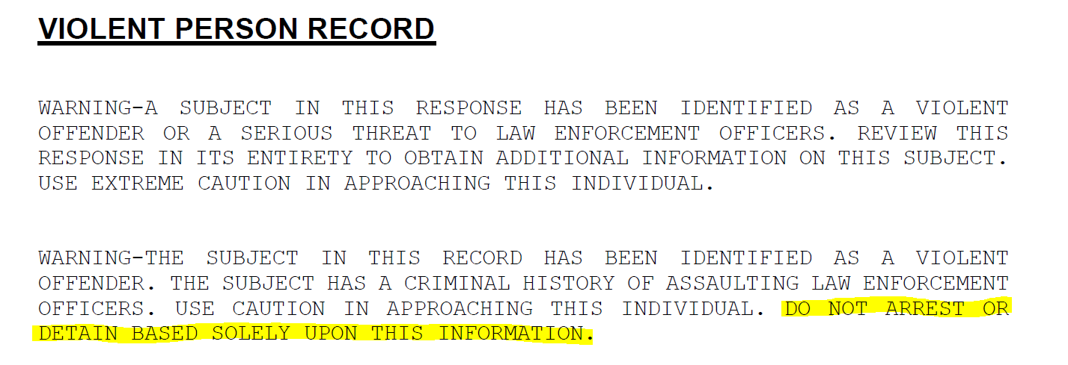
Violent Person File (Continued)
https://www.doj.state.wi.us/
Notes:
This file type was created with officer safety in mind.
Who can authorize the use of this file type? Anyone with entry capability can enter it; however, it will be up to the agency decide the process on entry. It must meet one of the 4 criteria. The main concern is getting it entered and utilizing the file.
Example: West Bend PD has an initial encounter with a person and they find an out of state conviction on criminal history that meets one of the 3 conviction criteria, West Bend can enter the person into the VPF.
Retention Period – Indefinite – some agencies may use an internal RMS to flag or track these individuals, but the use of this file type would allow for officers all over the country, who do not share an RMS to be made aware of the safety issues involved with this individual.

Slide 12
Discussion Topic: Supervised Release File
Question
Does your agency utilize the Supervised Release File?
https://www.doj.state.wi.us/
Notes:
B

Slide 13
Supervised Release File
New Portal Forms (enter, modify and cancel Supervised release)
What is it?
What is required?
What situations can it be used for?
Retention Period
https://www.doj.state.wi.us/
Notes:
If you have logged into Portal XL recently, you may have noticed some forms available within the “Supervised Release” folder. You may be thinking that these forms will only apply to Department of Corrections for Probation and Parole, but there are other criteria for entry into this file.
Agencies can use this as a way to track individuals who are out on a court release and may have bail release conditions. This record would indicate to officers in the field that the individual has an open case and then would prompt the officers to further investigate whether or not the individual is violating terms of their Supervised Release.
Agencies must have documentation (electronic or hard copy) on file to support a supervised release entry. Local, state, and federal supervision officers may enter records in NCIC for subjects who are put under specific restrictions during their probation, parole, supervised release sentence, or pre-trial sentencing. The court shall order as an explicit condition of a sentence of probation or supervised release "that the defendant not commit another local, state, or federal crime during the term of supervision" (Title 28, U.S.C., Sections 3563 and 3583).
Agencies can use this file type to enter individuals who are on home monitoring or on supervised release until their trial dates.
Please take note that the End Date of Probation / Parole is a required field, so even if the individual is not actually on Probation at the time, that field will need to be filled in with whatever day the Supervised Release would end.

Slide 14
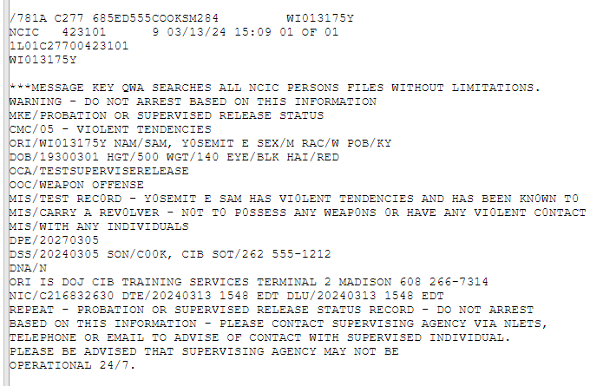

Supervised Release Return in Portal XL
https://www.doj.state.wi.us/
Notes:
NCIC response
Informational only to assist with officer safety as well as providing them with the knowledge of conditions of release for a subject
Supervisor’s Name and Phone # has to be entered a certain way
SON = Supervising Officer’s Name: Enter the name of the supervising officer. The name may include alphabetics, numerics, a comma, hyphens, and spaces; the comma must follow the last name; there can be no more than one space after the comma. The hyphen cannot be in the first position or directly precede the comma.
SOT = Supervising Officer’s Telephone: Enter the telephone number of the supervising officer. Must be three numerics, a space, three numerics, a hyphen, followed by four numerics.

Slide 15
Discussion Topic: Missing Child Alerts
Question
Has your agency heard of the updates reference Missing Child Alerts?
https://www.doj.state.wi.us/
Notes:
S

Slide 16
Missing Child Alerts
MISSING CHILD ALERT
The Missing Child Alert shall be utilized when the criteria for an AMBER Alert are not met but all the following criteria are met:
The person at risk has not attained the age of 18 years, AND the person is believed to be incapable of returning home without assistance due to a physical or mental condition or disability.
The individual’s location is unknown.
Their situation does not qualify for another alert (Amber Alert) OR the person has not attained the age of 10 years.
There is sufficient information available to disseminate to the public that could assist in locating the missing child.
The missing child has been entered into NCIC.
https://www.doj.state.wi.us/
Notes:
Per email from Brian K:
The state of WI, DOJ and DCI are rolling out a new broadcast for missing children. What WI did legislation-wise was rewrite the law used for the existing Silver Alert and expand the definition of a “person at risk.” The new definition includes children (because there are holes in the Amber Alert criteria and not all missing children meet the requirements for an Amber Alert). This new definition is an attempt to address those holes. If you want to read the law and how they reworded it, it can be found in 2023 Wisconsin Act 272.
Statute requires that the Wisconsin Crime Alert Network (WCAN) be utilized when issuing a Missing Child Alert; and it is strongly recommended that a statewide message be sent. Missing Child Alert requests should be sent to the Wisconsin Department of Justice Division of Criminal Investigation (DCI). Please contact Wisconsin State Patrol to initiate a Missing Child Alert. Email CIBTrain@doj.state.wi.us for the phone number.
To Request a Missing Child Alert:
Call the Wisconsin State Patrol Traffic Management Center, you will provide your agency contact information. (See WILEnet)
A DCI Staff on-call person will contact your agency to discuss the request.
There are no forms to fill out prior to contacting State Patrol.
If the Missing Child Alert has been approved a Wireless Emergency Alert (WEA) will be issued up to a maximum of 5 miles radius from the last know location, and only between the hours of 8am-9pm.

Slide 17
Discussion Topic: Locates
Question
Does your agency place locates?
Are locates required?
Who is supposed to place the locate?
https://www.doj.state.wi.us/
Notes:
B
The purpose of a locate message is to indicate (until the originating agency clears the record) that the wanted person has been apprehended or the property has been located. If the locating agency intends to hold the wanted person on local charges, the locate transaction should indicate detention by placing DETN in the Extradition Field. In the Missing Person File, a locate message indicates the whereabouts of the missing person has been determined and retires the record from the file.
A locate message must be transmitted when an agency other than the originating agency of the record finds the missing person, apprehends the wanted person, or recovers the property on file in NCIC.
The only exceptions to placing a locate message occur when the hit contains a no extradition indication or an extradition limitation indication and the agency finding the person is outside the geographical area of extradition. In such a case, the record should not be located. All records on file for the found missing person, apprehended wanted person, or recovered property must be located to ensure that they are in the correct status.
A locate message cannot be used by the agency that placed the record in NCIC unless the apprehending agency incorrectly places a locate on a wanted person record or fails to place a locate on a wanted person record. In that case, the ORI of record may place a locate on its own record with the requirement that they place a detainer on that record. Locate messages and acknowledgments are further explained in the Locate section of each NCIC file chapter.
Send a hit request to the entering agency.
After the entering agency responds and confirms that the warrant is valid, you can place your locate at any time. (Make sure it is within the geo restrictions / extradition limitations before confirmation).
Form 1729 is the appropriate form to use for locates.

Slide 18
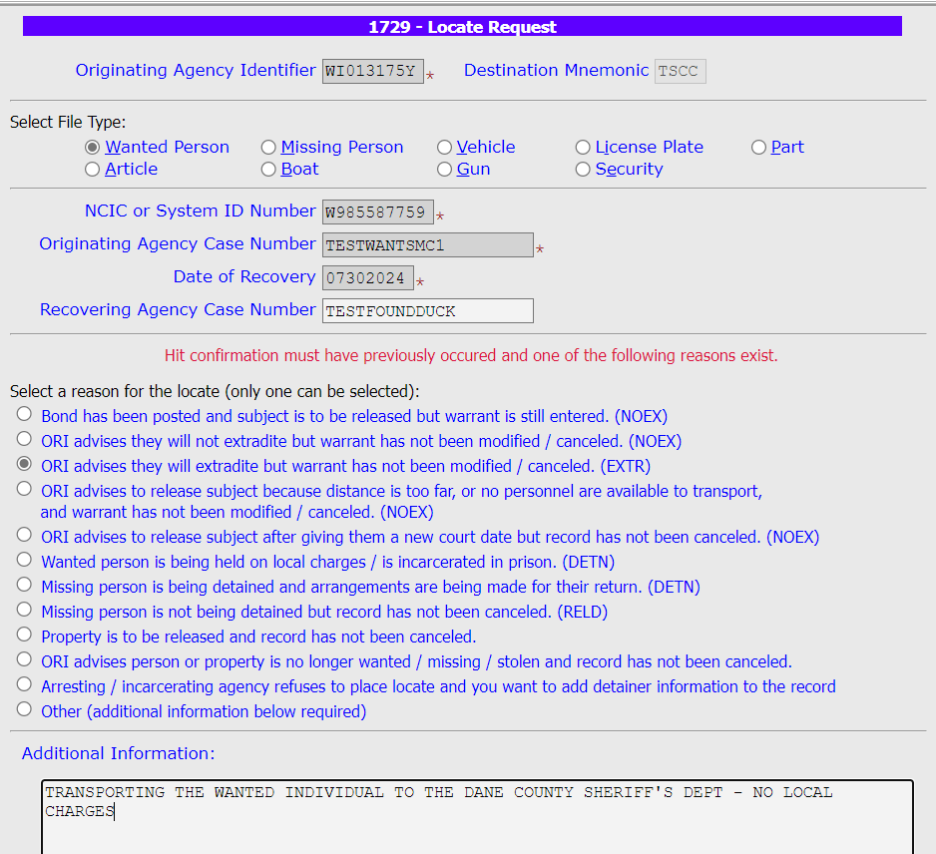
Locates
https://www.doj.state.wi.us/
Notes:
(NOTE: The additional information section is not required and can be left blank. If the reason for the locate changes after the locate is submitted, a new one does not need to be submitted.)
A locate must be placed prior to a detainer being appended to a warrant. In that case, the warrant should not be cancelled (to allow for the detainer to be placed)
If the ORI fails to cancel the NCIC record, a Located wanted person record will purge within five days, and a Located property record will purge within ten days. A locate applied to a missing person record indicates the location of the missing person has been determined and immediately purges the record from the file. If a CIB record is being located, TSCC will contact the ORI and explain why the locate is being placed against the record.
It is recommended that a locate be placed against a CIB record after hit confirmation has taken place. ALWAYS place a locate after going through hit confirmation on an NCIC hit.

Slide 19
Portal XL Hit Confirmations & Terminals
Question
Does your agency want things like hit confirmations to go to more than one terminal/PSN?
CIBPSN@doj.state.wi.us can assist
https://www.doj.state.wi.us/
Notes:
S
(Without the use of a message reroute or station copy). It can be hit confirmation requests or responses or any admin messages that are addressed to an ORI.
If this is something you want, contact CIBPSN to set up a list group for your main ORIs.

Slide 20

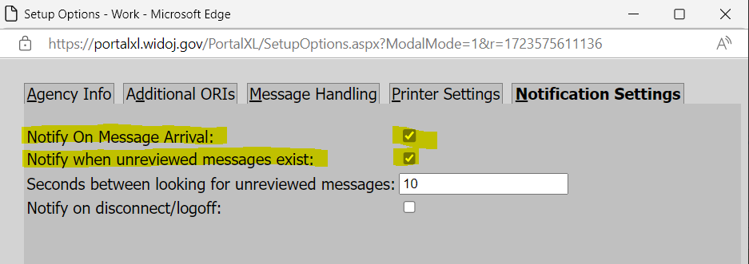
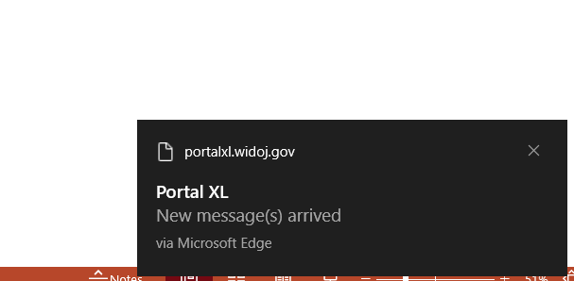
Portal XL Administrative Functions
Portal Notifications: Level 9 users can click on Options, then choose the “Notification Settings” tab. Select the boxes for which you want the notifications turned on.
https://www.doj.state.wi.us/
Notes:
An example of the message notification is on the lower right side of the screen. It will continuously provide a sound until the message is reviewed and it will keep popping up until reviewed unless the second box is left unchecked. The settings are currently set to check every 10 seconds, so that time frame could be extended.

Slide 21
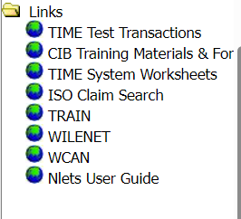
Portal XL Links
Is there anything else your agency would like to see added in the links?
https://www.doj.state.wi.us/
Notes:
Discuss the available Portal links: TIME Test Transactions, CIB Training Materials, TIME System Worksheets, ISO Claim Search, TRAIN, WILENET, WCAN and possibly the Nlets User Guide

Slide 22
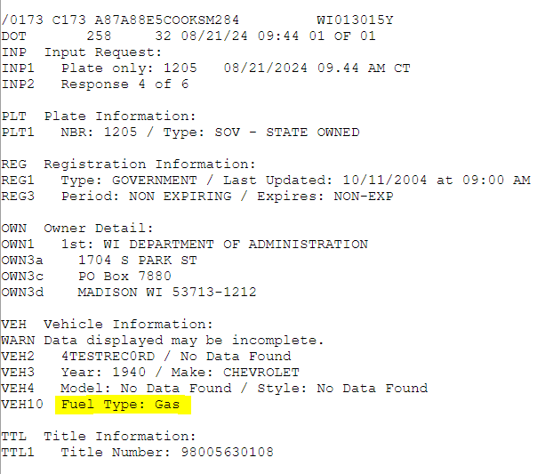
Coming Soon– Fuel Types for DOT Responses
Potential Fuel Types
Gas Hybrid
Convertible
Diesel
Electric
Ethanol fuel
H Fuel Cell
LNG
Methanol Gas
Comp Nat Gas
Propane
Unknown
Gas and Oil Mix
Diesel Hybrid
https://www.doj.state.wi.us/
Notes:
B
The two main reasons for adding this are:
The return will provide info to first responders in cases where there is a crash depending on the fuel type, will determine how to approach the situation (incase of fire/explosions/fumes/ etc.)
Wisconsin DMV Official Government Site - Display of license plates and validation stickers (wisconsindot.gov) state law requires electric and hybrid vehicles to display that EV sticker. So, if an officer comes across someone without the sticker and the DOT response lists the vehicle as an EV or hybrid, they can inform/warn/cite them for not displaying the sticker.
eTIME and MACHbot will not have the changes yet.

Slide 23
Discussion Topic: RISC
Questions
What is the Repository for Individuals of Special Concern (RISC)?
Does your agency have access to it?
https://www.doj.state.wi.us/
Notes:
B

Slide 24
Repository for Individuals of Special Concern (RISC)
What is RISC?
  Rapid search of fingerprint records to quickly assess threat level of any subject encountered during law enforcement activities
Mobile ID device required to use it (agencies must procure their own devices) as well as coordination with CIB
WI requires just 2 fingerprints (specifically R and L index fingers)
Red, Yellow or Green flags
Responses include population from the following files:
  Wanted Persons (including Immigration Violator File),
  National Sexual Offender Registry
  Threat Screening Center Subjects
  National Security Information Subjects
  Violent Person File (in the future)
https://www.doj.state.wi.us/
Notes:
Current RISC responses include the Red/Yellow/Green flag, the category of hit, the Master Name, the Universal Control Number (UCN), and limited NCIC information with the ability to request rap sheets and photos.
RED = Highly probable candidate
YELLOW = Possible candidate
GREEN = No candidate in the RISC
Went live July 2024. 5 agencies connected to date.
Possible grant in 2025

Slide 25
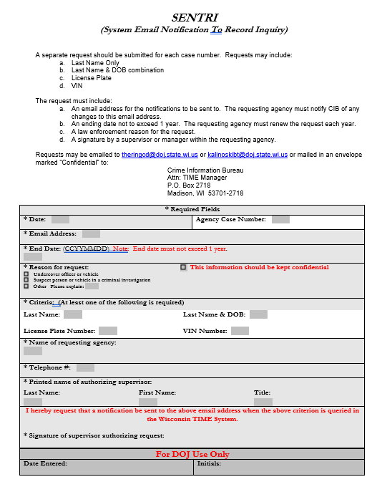
SENTRI Form
https://www.doj.state.wi.us/
Notes:
S
System Email Notification to Record Inquiry
If this information is queried by a Wisconsin agency you will be notified by email with the information pertaining to who ran the query, date, time and the agency name. This email notification occurs the day after the original inquiry of the TIME System as our logs for the day are created after midnight, so the current day’s information is not logged yet.

Slide 26
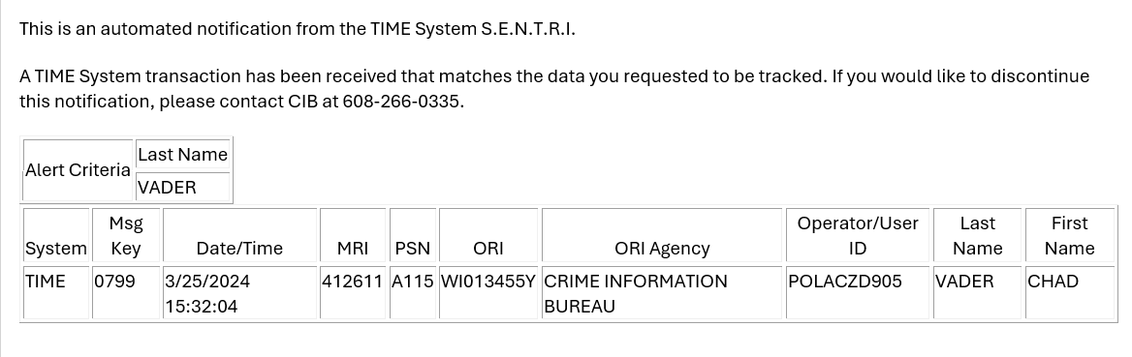
SENTRI Notification
https://www.doj.state.wi.us/
Notes:
System Email Notification to Record Inquiry
Here is an example of the automated notification that you will receive.

Slide 27
Advanced Certification - Project
Grading Changes
70% or better on each individual project (6 projects in total)
Questions
How are your users doing on the Advanced TIME System Project?
What are some of the biggest struggles we are seeing at DOJ?
https://www.doj.state.wi.us/
Notes:
S
CIB changed the grading system for Advanced TIME System Projects. Rather than expecting everyone to receive an overall score of 70% or better, we require each person to receive a 70% or better on each individual project. If they receive an overall score over 70%, but fail some individual projects, CIB will email the TAC and have them re-register the users for appropriate modules and re-do the individual projects that they failed.
We do expect people to go through the modules again to make sure they are learning the material.
If someone fails the redo, we will advise the TAC that the individual should attend an In-Person Advanced class to give them an opportunity to learn the material in a different way.

Slide 28
Advanced Projects Struggles
Not reviewing the Advanced handout along with taking online modules
Lack of proper queries before entry
Utilizing invalid source documentation (another agency’s entry cannot be used for documentation)
Not including all print outs (including echo and field edit successful messages)
Project is out of order
https://www.doj.state.wi.us/

Slide 29
Resources: Nlets User Guide
Nlets User Guide
https://service.nlets.org/support/home allows you to access the Nlets Website, Nlets Secure File Transfer, Message Key Maps and the Nlets User Guide
Provides information on different types of transactions (Alarm Exchange, Driver History, Driver License, HELP, Hit Confirmation, LEO Flying Armed, State Warrant, Vehicle Registration)
General Information, Legacy Text Examples
https://www.doj.state.wi.us/
Notes:
B
International Justice and Public Safety Network – (essentially an operating switch to share information from law enforcement databases between states)

Slide 30
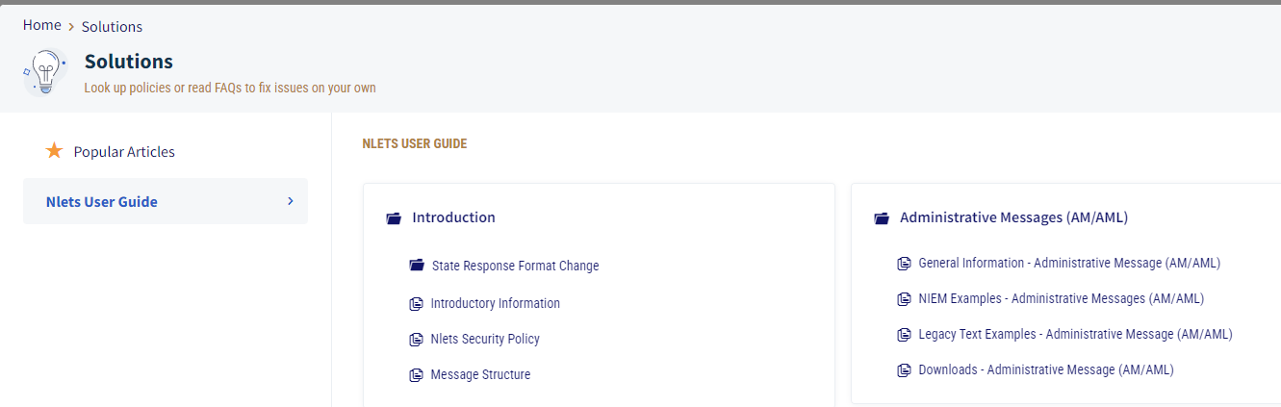
Resources: Nlets User Guide
https://www.doj.state.wi.us/

Slide 31
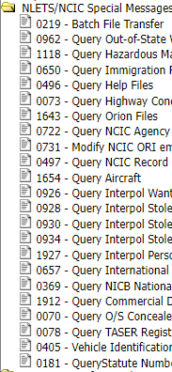
NCIC and NLETS Special Messages
Portal XL offers various Special Messages to NCIC and NLETS
Query VIN (VIN Decode)
Query Help Files
Query Statute Number (offense code)
And many more
Notes:
B

Slide 32
Mobile Device Lookup (MDQ)
CIB is going to be adding MDQ (Mobile Device Lookup) in the future (potentially later this year)
  Provides Nlets users with information about a mobile phone based on IMEI
  IMEI (International Mobile Equipment Identification) is a unique number
  Leveraged by NMPR (Recipero National Mobile Property Register)
  Provides status and historical information about a mobile device based on the IMEI
  It is an investigative tool for officers and has already aided in investigations
https://www.doj.state.wi.us/
Notes:
S
IMEI is similar to a VIN for a vehicle and can be found in mobile device settings
The NMPR provides a single location for an investigating officer to obtain an immediate history report about an item of serial numbered property.
A simple search from a smartphone, tablet or computer gives law enforcement staff real-time visibility of a mobile device's life history. The search results provide actionable information, speeding up the gathering of intelligence, whilst reducing the resources required for the investigation of cell phone and mobile device-related crimes.
Use Case from Nlets: While investigating a crime scene at which several suspects had been arrested on charges of distributing narcotics, investigators discovered multiple high-end mobile phones. Suspecting the phones might be involved in illegal activity, investigators gathered the IMEI numbers from the phones and sent MDQ messages to Nlets. The returned MDR messages revealed the phones were all recently reported stolen from a local retailer, allowing investigators to link the suspects to the theft and add robbery to their charges.

Slide 33
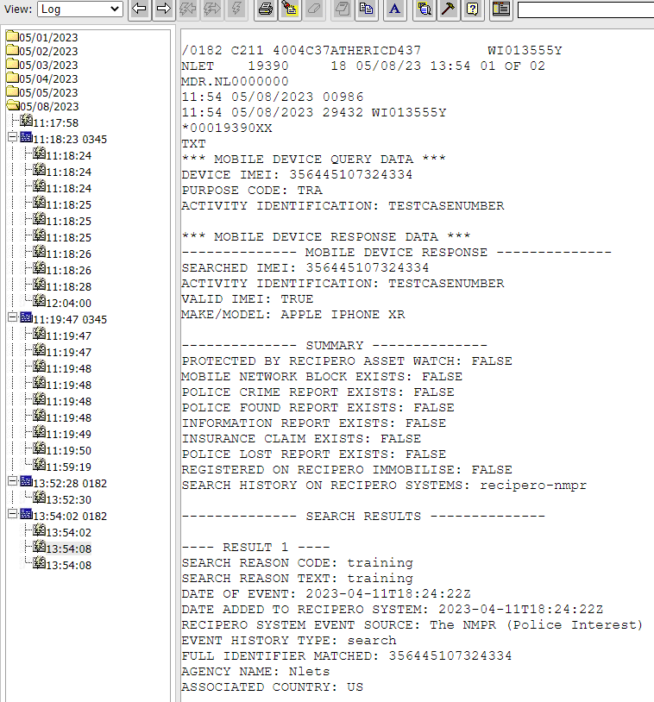
Mobile Device Lookup (MDQ)
https://www.doj.state.wi.us/
Notes:
Still in development phase, need PsPortals to create a form.

Slide 34
CJIS Security Policy Updates
Version 5.9.5 Published July 2024
Sunset date for Basic Password Standards (IA-5(1)(a)(5)
Security Control Priority and Implementation
New Section on Configuration Management (5.7)
https://www.doj.state.wi.us/
Notes:
B
Personnel Security & Mobile Devices still need to be modernized – suspected release 2025
Existing 2, 3 and 4 should already be in place at your agency
New Priority 2, 3 and 4 are Zero Cycle = October 1st, 2027
Configuration Management has to do with the setups at your agency

Slide 35
Authorized User Background Checks
Updates to Identity Proofing
What types of identification does your agency collect during background checks?
CJIS Security Policy strict requirements for access to CJI
Birth certificates and Social Security Cards = Weak forms of identification (not acceptable)
Utilize the CJIS Security Policy Figure 7 (Notional Strengths of Evidence Types)
https://www.doj.state.wi.us/
Notes:
S
The CSP SHALL collect the following from the applicant:
One piece of SUPERIOR or STRONG evidence if the evidence’s issuing source, during its identity proofing event, confirmed the claimed identity by collecting two or more forms of SUPERIOR or STRONG evidence and the CSP validates the evidence directly with the issuing source; OR
2. Two pieces of STRONG evidence; OR
3. One piece of STRONG evidence plus two pieces of FAIR evidence

Slide 36
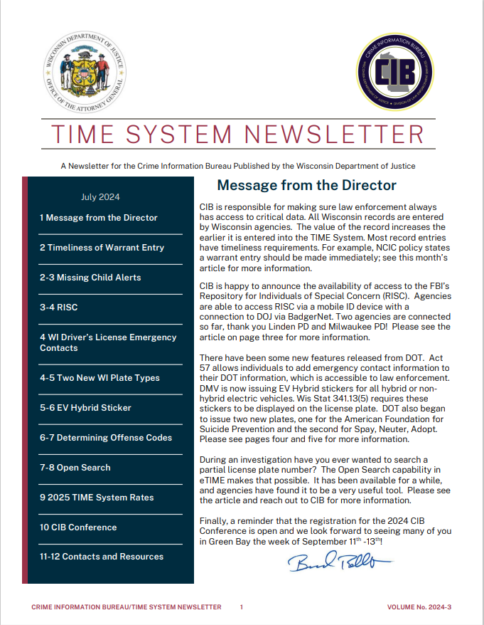
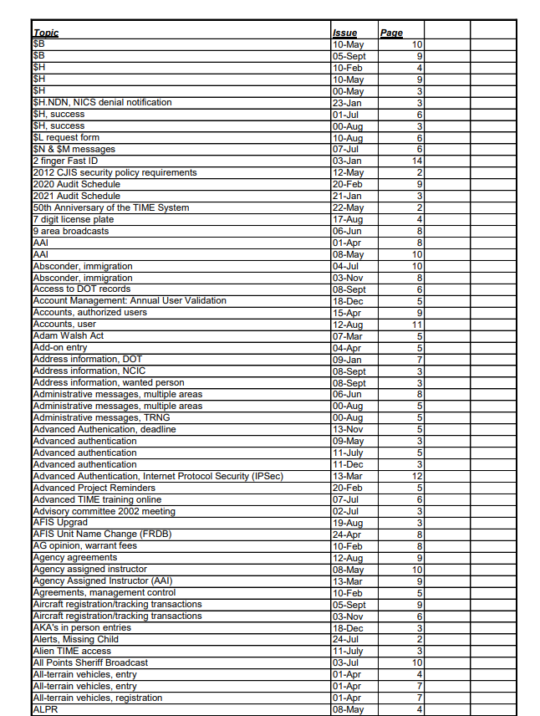
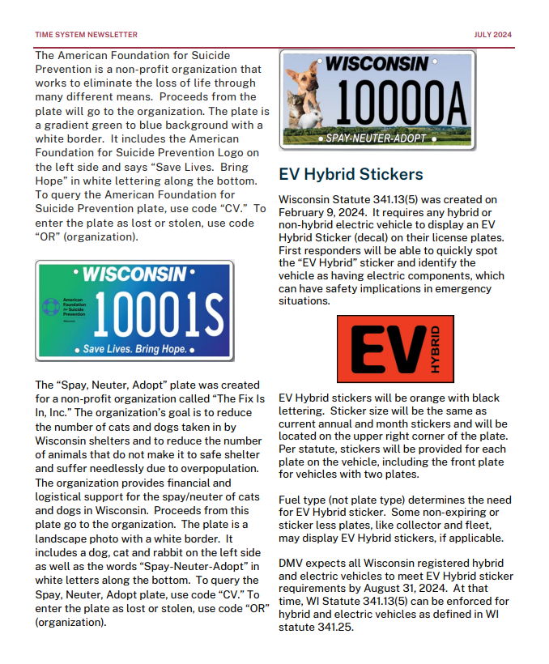
Newsletter
https://www.doj.state.wi.us/
Notes:
S
Are there any topics you want to see added to the newsletter?
Produced routinely
Available online
INFO broadcast & emailed (based on WILEnet listserv) when available
Newsletter index- article topic are indexed for quick retrieval

Slide 37

Questions?
CIBTRAIN@DOJ.STATE.WI.US
CIBPSN@DOJ.STATE.WI.US
ETIME@DOJ.STATE.WI.US
TIMEBILLING@DOJ.STATE.WI.US
CIBAUDIT@DOJ.STATE.WI.US
https://www.doj.state.wi.us/
Notes:
S and B
Portal XL demo (forms 0405, 0181, etc.)
WILENET resources

Slide 38
Thank You!

