Slide 1

TIME Agency Coordinator (TAC) – Refresher
CIB Conference September 18, 2025

Slide 2
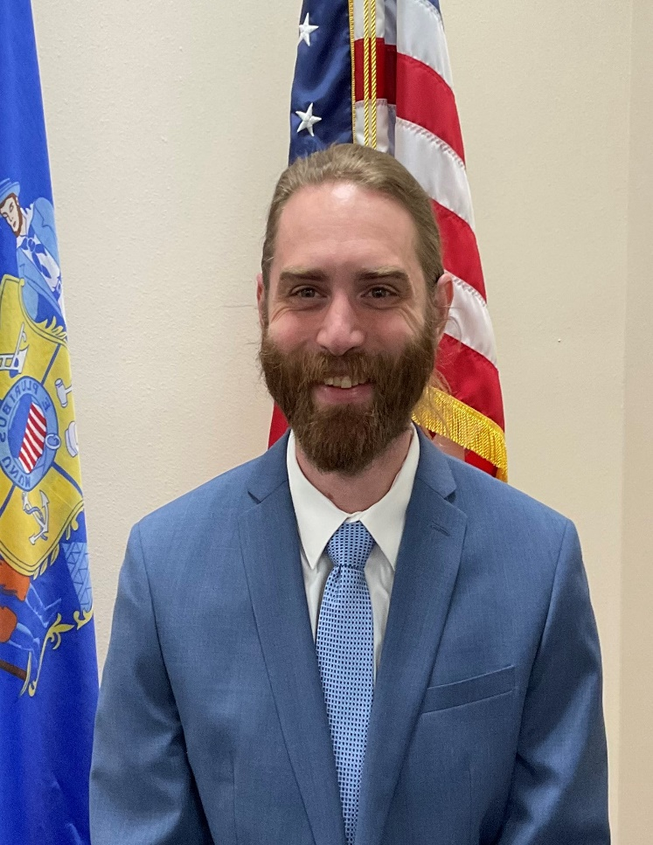
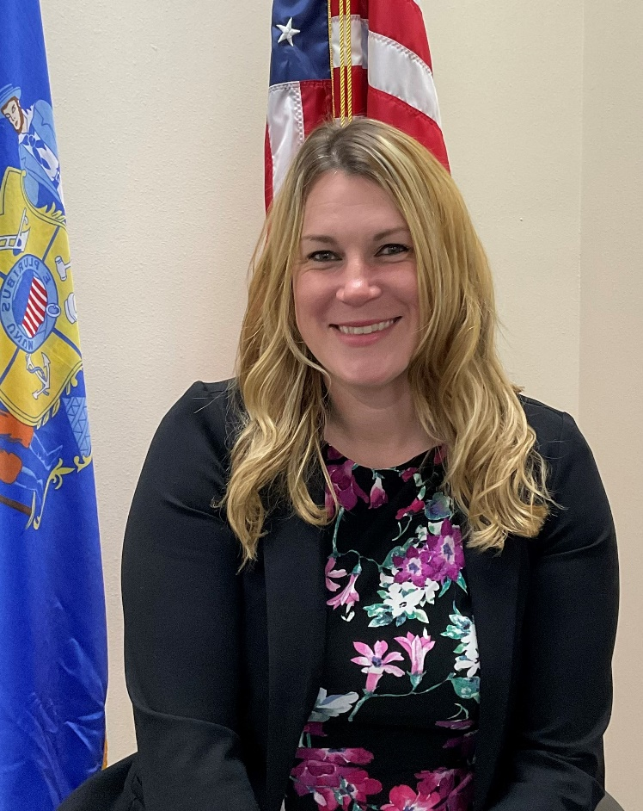
Instructors
Ben Brandner
Sarah Cook
Ben Brandner is a training officer with the Wisconsin Department of Justice. Ben joined the Wisconsin Department of Justice as Justice Program Associate in 2015. Prior to his time at the Wisconsin Department of Justice Ben worked in the hospitality industry as a food safety trainer. Ben is looking forward to bringing excitement his training sessions.
Sarah Cook is a Senior training officer with the Wisconsin Department of Justice. She is originally from Waukesha, WI. Sarah joined DOJ in September of 2021 and was made Senior Trainer in March of 2024. Previously, Sarah worked for the Waukesha County Communications Center (911 dispatch center) as a dispatcher for over 14 years and spent most of that time as a trainer.
https://www.wisdoj.gov/
Notes:
Welcome all learners. Allow the present training staff and course instructors to introduce themselves. Introduce non-present training staff as well.
Request to hold questions until the end

Slide 3
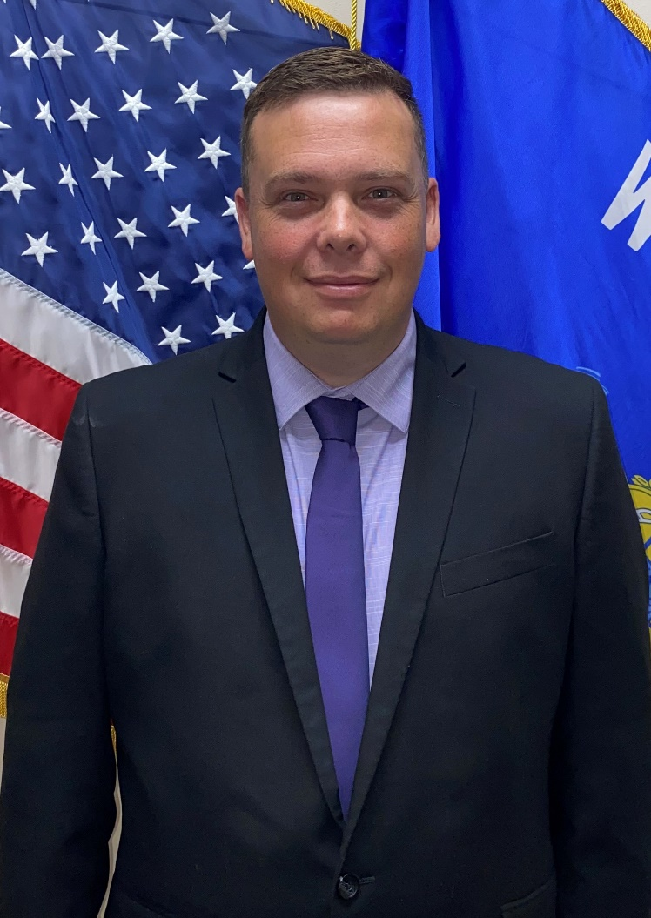
Instructors (continued)
Matthew Woodrum
Matthew joined CIB as the newest training officer in September of 2024. Matthew previously worked at the Beloit Police Department as the Records Supervisor, and he was a member of the Command Staff. Matthew also spent 8 years at the Rock County Communications Center ( 911 dispatch center). While at 911 he was an APCO certified training officer, a member of the Community Response Team, and an acting supervisor.
https://www.wisdoj.gov/

Slide 4
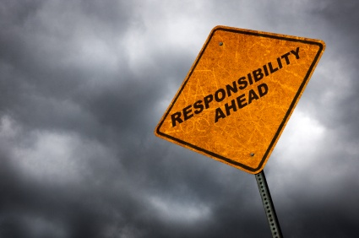
TAC Responsibilities
https://www.wisdoj.gov/
Notes:
TAC is responsible for compliance with state and CJIS policy regulations
Uploaded TAC responsibilities to app

Slide 5
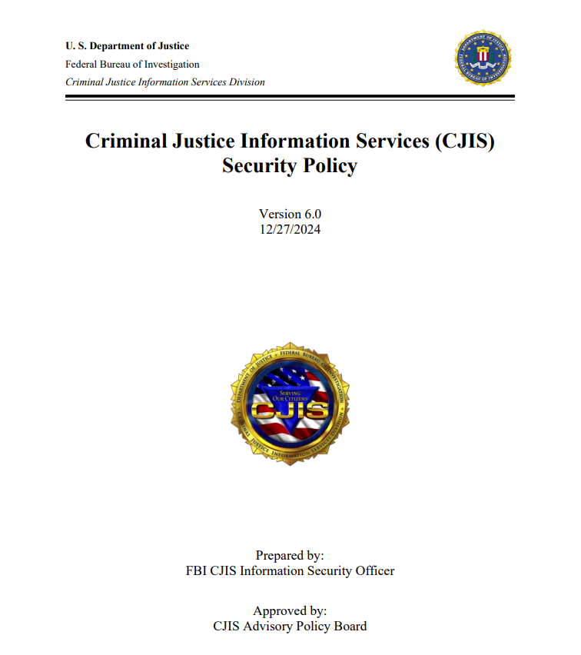
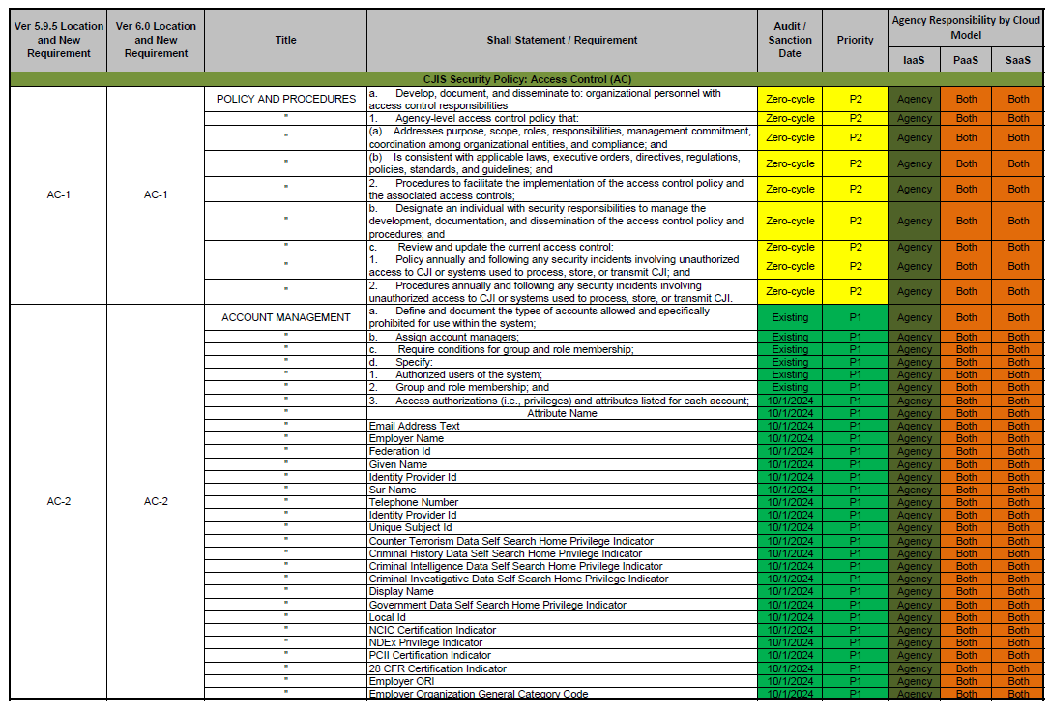
CJIS Security Policy
https://www.fbi.gov/services/cjis/cjis-security-policy-resource-center
https://www.wisdoj.gov/
Notes:
Fbi.gov/cjis is the website to access the CJIS Security Policy and Requirements Companion Document (quick reference of priorities and sanction dates for controls)
Technical Resource document available on WILENET – uploaded to app
Most recent version released December 27th, 2024 (Version 6.0)
Highlights
MFA for all accounts
Sunset for FIPS (Federal Information Processing Standard) 140-2

Slide 6
Authorized Personnel
What is an authorized user?
Physical access
Logical access
https://www.wisdoj.gov/
Notes:
Unescorted Access can be physical access: cleaning/maintenance staff or people from city/county that have keys or keycard access.
Unescorted Access can be logical access: IT or vendors who have credentials or access to your computers/servers/network (these can also be physical access to servers, etc.).

Slide 7

Authorized Personnel
Fingerprint-based Background Check
    LEAP vs LESB
Privacy Statement & Challenge Notice
WORCS (Wisconsin Online Record Check System
Variances (Only Felony convictions)
Security Awareness
Authorized User List
https://www.wisdoj.gov/
Notes:
(Item #1 from TAC responsibilities)
Anyone who has unescorted access to criminal justice information must have completed fingerprint-based background check
Review L2 Fingerprint document (which is available on WILENET) and includes requirements, the reason for fingerprinting, LESB / LEAP codes, Privacy Statement and Challenge Notice and WORCS page - uploaded on the app
Three requirements to be an Authorized User.
Requirement #1: Fingerprints
For All Agencies: results posted to WORCS (will discuss in further detail later today)
Name based background check via CIB’s online record check website is required (WORCS)
Results of background check are posted to online record check website
Agencies should routinely check website results
If a Cloud Provider is utilized by agency: if the cloud provider personnel do not and will not have access to the encryption keys, then no background check is required.
Disqualifiers for access:
-waiver required from CSO if someone has been convicted of a felony and agency still wants them to have access to TIME System
-Waiver called a “variance” and should only be requested if the agency will give access/hire the person – email to cibtrain to get that process started
Privacy Statement and Challenge Notice: all prospective personnel that are fingerprinted should be given a copy of the Privacy Statement and Challenge Notice to ensure applicants have the right to challenge a record.
Requirement #2: Security Awareness Training
Anyone who has unescorted access to criminal justice information must complete security awareness training
Examples: Janitor, Clerk, Jailer, DA, Sheriff, IT
Review L3 All Security handout and L4 Physical Access only
If a user will be TIME System certified, the Security Awareness Training is included in the TIME System certification and doesn’t need to be taken separately. (This only applies as long as we are using TRAIN – once we switch to Acadis, the Security Awareness will have been extracted from the modules and recerts and will have to be taken on its own.)
Requirement #3: Authorized User List
Anyone who has unescorted access to CJI must appear on the agency’s authorized user list. This is different than the TRAIN roster.

Slide 8
Handling of CJI
Secure Storage: Where are you keeping your documents and equipment that contain CJI? Who has access to those items?
Transport of CJI: Do documents or equipment that contain CJI ever leave your physically secure location? If so, are you documenting the activities associated with the removal?
Destruction/disposal: How are your documents and equipment that contain CJI being destroyed? Does the method of destruction meet the CJIS requirements? Is an authorized user witnessing the destruction / disposal?
https://www.wisdoj.gov/
Notes:
(Items 14 & 15 from TAC responsibilities document)
Secure storage location accessible only to authorized personnel
Transport by authorized personnel: when CJI is removed from physically secure location, agency must document activities associated with the transport and maintain accountability for the CJI in transit (physical and digital)
Destruction/disposal
Physical media (printouts): must be shredded with cross-cut shredder or incinerated by authorized personnel when no longer needed for investigative or security purposes
Digital media (hard drives, flash drives, servers, etc.): must be sanitized or degaussed using approved sanitizing software that ensure a minimum 3-pass wipe. Inoperable digital media must be destroyed
Disposal witnessed or performed by authorized personnel
Electronic media (hard drive, flash drive, etc.): personally owned digital media devices prohibited; digital media devices with no identifiable owner prohibited
Media Protection Policy: agency must have one (not county or whole city or IT) and must review/update it once per year AND following any security incidents involving system media

Slide 9

Dissemination of CJI
Primary vs. Secondary dissemination
Public Records Requests
Social Engineering
https://www.wisdoj.gov/
Notes:
(Items 16 & 17 from TAC responsibilities)
Secondary dissemination rules vary for each file
Internet email transmission FIPS 140-3 Standard for both receiver and sender.
Voice transmission by cell, police radio allowed if immediate need for info. In situation affecting officer/public safety or for further investigation.
Fax-must be in a secure location and receiver is aware of document being faxed.
Public records-If a request is sent, the agency will be notified, in case of an active investigation. See Department Policy for public records requests.
Correct ORI must be used in each transaction, if you have access to more than one ORI – Only level 9 Portal XL users will be able to add ORIs to drop down lists in Portal XL.
Social engineering-examples of manipulation to request info. Re: TIME System

Slide 10
Security Incidents & Incident Response (IR)
What is a security incident?
Who do I contact?
cibtrain@doj.state.wi.us
TIME System Control Center (TSCC)
Available 24/7
608-266-7633
https://www.wisdoj.gov/
Notes:
(Item 18 from TAC responsibilities) - Provide a copy of the Security Incident Flyer – uploaded in app
What is a security incident-breach of security
How to report a security incident
What to do in event of a security incident-follow dept. policy (a security incident policy is required). Policy and procedures must be reviewed / updated annually or after a security incident.
Document incident
Retain evidence
Report incident to CIB
Security incident flyer
Give examples…keystroke loggers, virus from email attachments (Badger Sheriff Association), equipment (Lafayette Co), Russian access through remote access (weak passwords)

Slide 11
LASO (Local Agency Security Officer)
What is a LASO?
Who can be a LASO?
What is required of a LASO?
Training and Recertification
https://www.wisdoj.gov/
Notes:
(Item #23 from TAC Responsibilities)
A LASO is a Local Agency Security Officer and is often the TAC from an agency or an IT person. The LASO has to appear on the agency’s authorized user list (meaning they went through a fingerprint-based background check, completed security awareness and is considered an authorized user for the agency)
LASOs must be able to identify users and know who is using the agency hardware, software, firmware and makes sure no unauthorized personnel have access.
LASOs need to understand the agency’s network and security measures in order to protect CJI. So, they need to be able to identify and document equipment (maintain network diagram).
LASOs need to ensure personnel security requirements are being met (background checks being done, privacy statements and challenge notice provided)
LASOs need to make sure security measures are in place (both physical and logical – signs at entrances or identifying/escorting visitors)
LASOs need to ensure compliance with the most current version of the CJIS Security Policy
LASOs are involved with answering audit questions and also need to ensure that CIB is notified of any security incidents.
LASO training is required annually (available on WILENET currently)
This person may also be referred to in the CJIS Security Policy as:
Organizational Personnel with Security Responsibilities: Personnel with the responsibility to ensure the confidentiality, integrity, and availability of CJI and the implementation of technology in a manner compliant with the CJISSECPOL.

Slide 12
Adding & Removing Users
TACs and/or TRAIN Administrators are responsible for notifying CIB when your agency needs to add or remove users from the roster
What does CIB need to add a user to a roster?
Email to cibtrain@doj.state.wi.us including full legal name of individual(s), any former name(s) and any previous agencies
Also include level of Portal access that the user needs (1 = standard, 4 = printer settings, 9 = admin/all settings)
TAC must call TSCC for default password – do NOT email it to the user
Removing users in a timely manner
https://www.wisdoj.gov/
Notes:
Uploaded doc to app
Document with details we need
First, Middle and Last name
Any former names
Former agencies
Portal level access if necessary
That’s it – we don’t need anything else – don’t send us their DOB, Credential ID, etc.
We want to avoid creating duplicate accounts, so that’s why we ask for this specific information. We want to make sure the TRAIN user follows the same individual through their life cycle working in the TIME System.
After adding a brand new user, TACs need to be the ones to call TSCC for the temporary password. Do not have the user call on their own. TSCC will not be able to assist them. TAC also must not email the default password to the user.
Requirements in CJIS security policy require account to be deactivated within one week AC-2 (3)
Review roster annually
You will be following the requirements of the CJIS Security Policy by removing users in a timely manner – within one week of the user’s exit

Slide 13
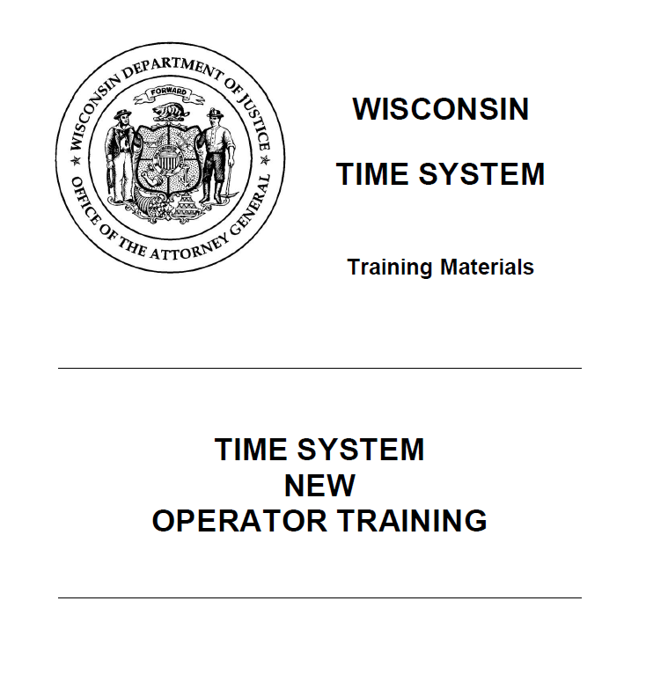
New Operator Handout
Recommended for all new TIME System operators or for a refresher
Available on public side of Wilenet: www.wilenet.widoj.gov
https://www.wisdoj.gov/
Notes:
New Operator Handout-good intro to TIME SYSTEM handout – remind people this can be found on WILENET
Review CIB programs
Training policies
Data Files available
Statutes/laws
Probable cause-CI and NCIC hit alone is NOT PROBABLE CAUSE TO ARREST!

Slide 14
eTIME Registration
eTIME Registration is a process!
Assign eTIME Operator Online Agreement in TRAIN
Once completed/synced, register via secure side of Wilenet (individual does not have to have a WILENET account, but someone at the agency will need to log in)
Wait for two emails: first registration received, second activated!
Set up Multi-factor Authentication (MFA)
https://www.wisdoj.gov/
Notes:
Show step by step registration for etime on TRAIN
Uploaded to app
Additional capabilities available upon request to cibtrain or etime email addresses can include:
open search query
online validation
ALPR (Auto Lic Plate Reader) extract file
If you get to a point on WILENET where you are asked to put in your credential ID, you are in the wrong place to register for eTIME. Someone with a WILENET log in needs to log into the secure side of WILENET first before anyone can register for eTIME.

Slide 15

Training Requirements
TIME System Certifications
Local Agency Security Officer (LASO)
Security Awareness Training
(eTIME, MDC, Basic, Advanced)
Validation
TIME Agency Coordinator (TAC)
In-Service (optional, but strongly recommended)
https://www.wisdoj.gov/
Notes:
Security Awareness / or LASO have to be completed before access to CJI or assuming the LASO role
Within 6 months of employment or assignment all personnel must be certified
Security Awareness training is NOW required annually as part of the CJIS Security Policy.
Once we switch to Acadis, Security Awareness training will have been extracted from Module 1 and the recertification exams, so it will be required to be taken every year and not included as part of any other training.

Slide 16
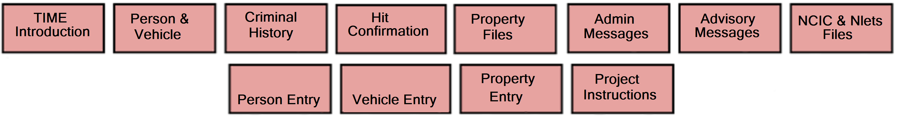
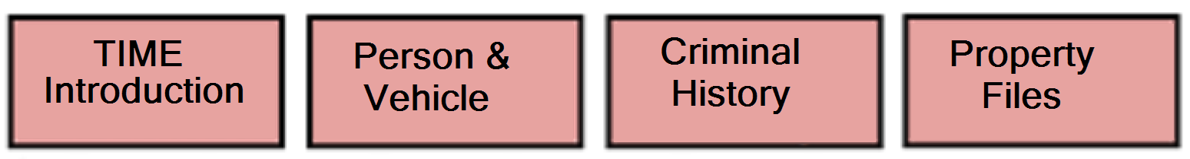
Certification Levels (Hierarchy)
Advanced Certification
Basic Certification
MDC Certification
eTIME Certification
https://www.wisdoj.gov/
Notes:
Uploaded infographic to app:
Advanced: Record entry operators; Basic Certification required prior to taking entry modules or the Advanced class
Computer based: Modules: Person Entry, Vehicle Entry, Other Property Entry and an Advanced Project to be submitted to CIB. Once the test has been graded, results will be sent to the TAC and the TAC is required to discuss results and deficiencies with the operator.
Classroom: 2 day, no test, Advanced Project to be graded by CIB. Preregister just like Basic.
Review L11 (Advanced Evaluation Form)
_____________________________________________________________
Basic: Users need access to PXL and need to be able have access ot Advisory Messages as well as special NCIC / Nlets files. Computer (Modules 1-8) or classroom training (we currently do not have any Basic classes scheduled for 2025 due to lack of interest). Your agency could request the class and with a minimum of 10 attendees, we may still be able to accommodate your agency by hosting an additional training.
Classroom: 2 days class with 1 hour timed test; pre-registration required on TRAIN.
_____________________________________________________________________________________
MDC: Computer-Based Training: Modules 1-6
Classroom available: AAI (agency assigned instructor) teaches and submits roster and test scores
_________________________________________________________________________________
eTIME
Assigned by TAC/TRAIN Admin, user logs into TRAIN and completes the appropriate modules required by the Dept. Can be modules 1,2,3 and 5. Additional modules can be assigned as access increases.
Additional capabilities can include:
open search query
online validation
ALPR (Auto Lic Plate Reader) extract file
Does not apply to MDC of full query access.
No classroom training available.
If someone is already MDC, Basic or Advanced certified, they don’t need to take eTIME training separately – they have to complete an eTIME online agreement, but do not need to repeat the modules.

Slide 17
Additional Training
TIME Agency Coordinator (TAC)
Validation
Inservice
Local Agency Security Officer (LASO)
https://www.wisdoj.gov/
Notes:
TAC and Validation are taught in person – very occasionally offered virtually
Inservice is online only and typically includes topics we feel are important or recent newsletter articles
LASO – the most up to date version is the handout available on WILENET. The document is also available in TRAIN; however, if that document is completed in TRAIN, it will not show up in certification report.

Slide 18
Biennial Recertification
https://www.wisdoj.gov/
Notes:
Required every 2 years for all certified users – IF ANYONE IS EXPIRED OVER A YEAR, WE WILL NO LONGER ALLOW THEM TO TAKE THE RECERTIFICATION, THEY WILL HAVE TO REDO THE MODULES (AND COMPLETE THE ADVANCED PROJECT IF AN ADVANCED USER).
Only available in Computer Based Training (except for MDC—AAI)
Sign your users up through the TRAIN website (you can either register them individually or do a batch registration).
Ensure users are taking the proper course for their certification level. (Check the certification report or the individual user’s training transcript.)
While TRAIN is sunsetting: ensure users set Compatibility View Settings are set correctly and they take a screenshot of score prior to submitting (in case it doesn’t record properly). Users need to be utilizing the Edge browser in IE mode, make sure the cache has been cleared and browser restarted.

Slide 19
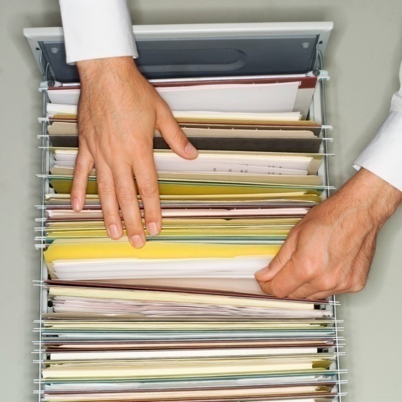
Training Records
Maintain TIME System training records of personnel, including level
TRAIN
Manual
https://www.wisdoj.gov/
Notes:
Manual (paper Security Awareness and LASO training) and AAIs should keep records too
TRAIN – use the Report Manager to run a certification report to check when your users need to recertify or to verify what their level of training is (this can also be done by individually checking user transcripts).

Slide 20
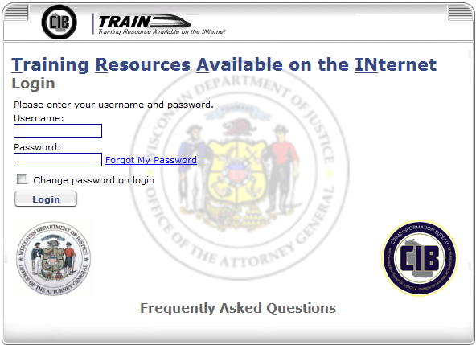
TRAIN Website
https://www.wisdoj.gov/
Notes:
EDGE browser in IE mode
Live Action of how to log in to TRAIN
Forgot My Password Link
Frequently Asked Questions
Manager Tab vs. Learner Tab
Register user via Catalog
Batch Register users
Report Manager
Review L9 TRAIN Intro: Also posted on www.wilenet.widoj.gov
What is TRAIN?
Accessing TRAIN
Home Page
Training
Certifications
Online Courses
Personalize home page
Registration for training/confirm registration and run reports
Also available: TAC, Validation, Inservice, LASO (some as CBT, some as in-classroom)

Slide 21
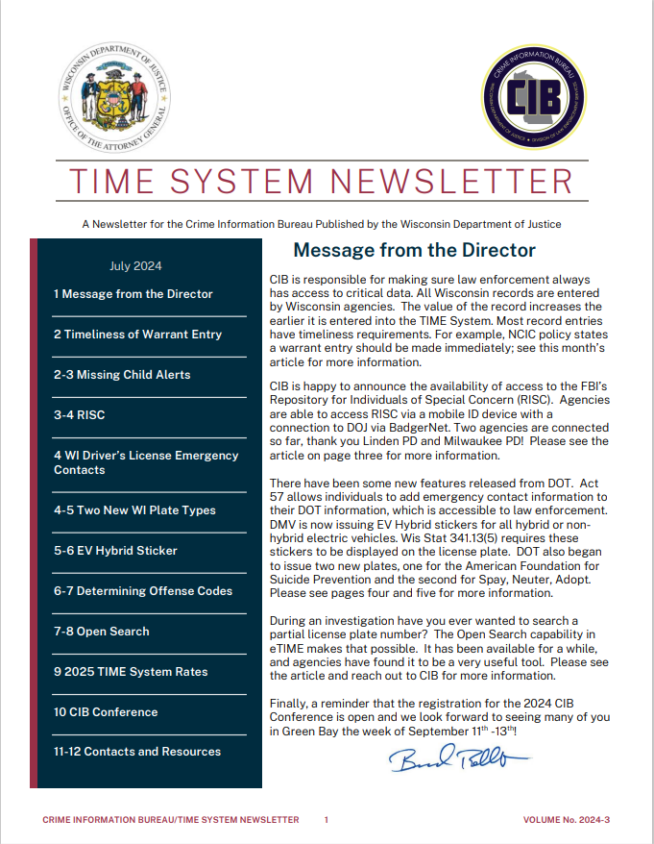
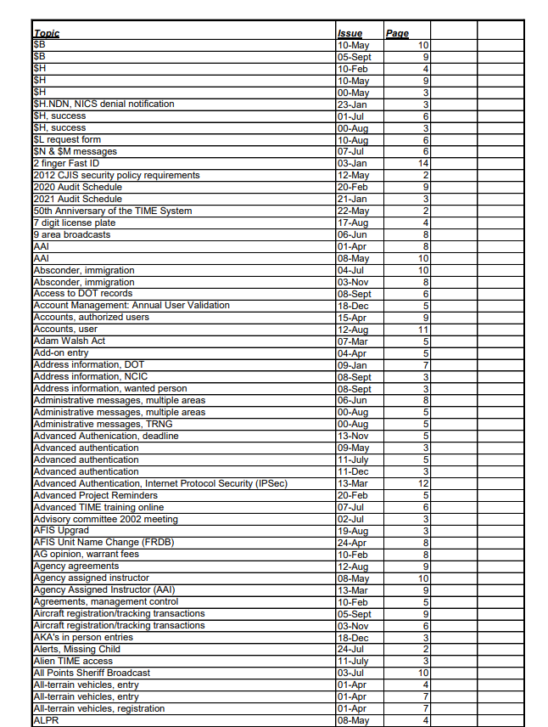


Newsletter
https://www.wisdoj.gov/
Notes:
Are there any topics you want to see added to the newsletter?
Produced routinely, every quarter. January, April, July, October (approximately)
Available online
INFO broadcast & emailed (based on WILEnet listserv) when available
Newsletter index- article topic are indexed for quick retrieval

Slide 22

CIB Forms
PSN Request Form
Message Recall Form
SENTRI Form
https://www.wisdoj.gov/
Notes:
Review R1 – R2, R2a (PSN Request Form, Message Recall Form, SENTRI Form (System Email Notification to Record Inquiry)
Reference SENTRI forms: If this information is queried by a Wisconsin agency you will be notified by email with the information pertaining to who ran the query, date, time and the agency name. This email notification occurs the day after the original inquiry of the TIME System as our logs for the day are created after midnight, so the current day’s information is not logged yet. This doesn’t have to come from a TAC. Anyone from the agency can send in these forms.

Slide 23
Agency Agreements
TIME Agency Agreement (with DOJ) – required from every agency accessing the TIME System – must be sent back to CIB with signature from proper signing authority – will also be signed by CIB Director
Agency Agreement (with other agencies) – required if you are sharing TIME System information with any other agency (that agency must have an active ORI – not retired) – we do not need copies.
Management Control Agreement – with Non-Criminal Justice governmental entities that perform Dispatch, Pre-Trial or I.T. functions for the agency – must be signed by the signing authority for the Criminal Justice Agency and the Non-CJA – CIB needs a copy
Security Addendums – Only signed by private companies/entities that will be accessing your physically secure location or network – (each individual from that private company/entity will need to sign) – we do not need copies.
https://www.wisdoj.gov/
Notes:
Review R3 – R7 (TIME Agency Agreement, Sample Agency Agreement, Management Control Agreement (new version),
TIME Agency Agreement and MCAs are updated/collected during your audit

Slide 24
Audits
Return of on-site audits
Audits have become more complex
Coordinate with appropriate personnel
Communicate with your auditor
Audits as a learning exercise
https://www.wisdoj.gov/
Notes:
TIME Agency Agreement and MCAs are updated/collected during your audit
2024 5 Audits
2025 10 audits
2026 15 in person ?

Slide 25

Policies
TIME System Use
Validation (if agency enters records or records are entered on their behalf)
Hit Confirmation / Locates
New Violent Person File (VPF) Sample policy available – not required, but recommended
https://www.wisdoj.gov/
Notes:
Review R8 (Sample Policy): Each department required to have a TIME System policy and ensure the required policies are current
CIB provides a sample TIME System policy on WILENet
New VPF Sample Policy for entry agencies – also mention the VPF Entry Guide
Uploaded VPF Sample Policy to the app

Slide 26
CJIS Technical Policies (Samples)
16 Policy Areas Outlined in the CJIS Security Policy
Sample policies can be obtained on WILENET TIME System Audits | WILENET (widoj.gov)
Available Samples: access control, auditing and accountability, awareness and training, configuration management, identification and authentication, incident response, maintenance, media protection, personnel security, physical and environmental protection, planning policy, risk assessment policy, system and communication protection policy, system and information integrity policy, and system and services acquisition policy
These policies must be reviewed and customized for your agency
https://www.wisdoj.gov/
Notes:
TIME System Audits | WILENET (widoj.gov)
CJIS Security SAMPLE Policies
Some policies are required now and are sanctionable if not in place currently; while some newer controls require policies to be in place by October 1st, 2027

Slide 27
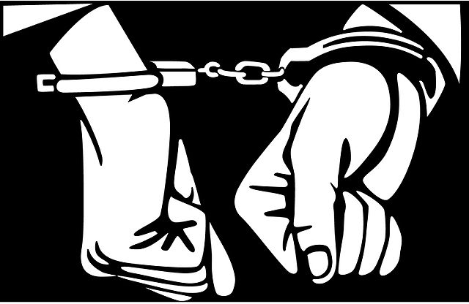
Criminal History Record Information (CHRI)
Purpose Codes
Attention Line
Public Access (WORCS)
https://www.wisdoj.gov/
Notes:
R9 (CHRI Purpose Codes)
Purpose codes- no substitutions (if it’s E, don’t use C)
Attention line: uniquely identify requestor and if room, reason
Justification for each inquiry (CHRI log) R10 (CHRI Log)
Secondary dissemination: Have to have an ORI and an agreement with that agency: run it under that person’s ORI then you aren’t disseminating it secondarily. If you do, document it on your secondary dissemination log
Public access: Don’t give it to them from the TIME System (WORCS)
http://wi-recordcheck.org (WORCS) – included L2

Slide 28
Additional Responsibilities
Notify CIB of any change in TAC position upon retirement, resignation, or reassignment – Provide CIB with replacement in a timely manner prior to leaving for smooth transition
Sharing TAC
Jurisdictions must be within the same county
Written agreement must exist with copy to CIB (contact CIBTrain for more information)
  Agreements must be approved by CIB
https://www.wisdoj.gov/
Notes:
Each agency having TIME System access must designate an individual employed by the criminal justice agency as TAC. Any exceptions must be coordinated with and approved by CIB.
TAC Sharing on the PPT.

Slide 29
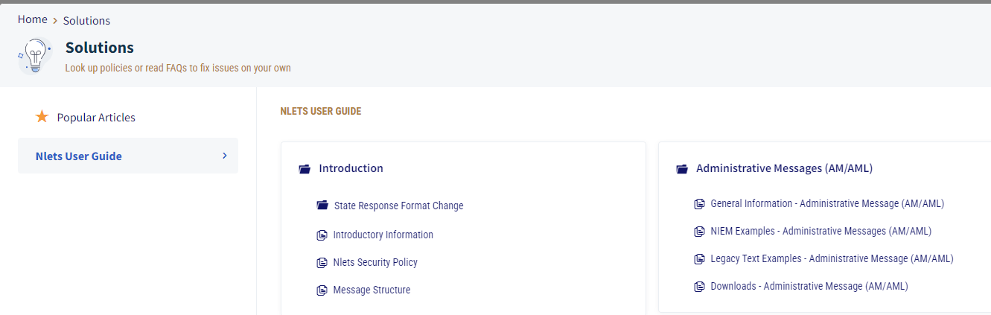
Resources: Nlets User Guide
https://www.wisdoj.gov/
Notes:
International Justice and Public Safety Network – (essentially an operating switch to share information from law enforcement databases between states)
https://service.nlets.org/support/home allows you to access the Nlets Website, Nlets Secure File Transfer, Message Key Maps and the Nlets User Guide
Provides information on different types of transactions (Alarm Exchange, Driver History, Driver License, HELP, Hit Confirmation, LEO Flying Armed, State Warrant, Vehicle Registration)
General Information, Legacy Text Examples

Slide 30
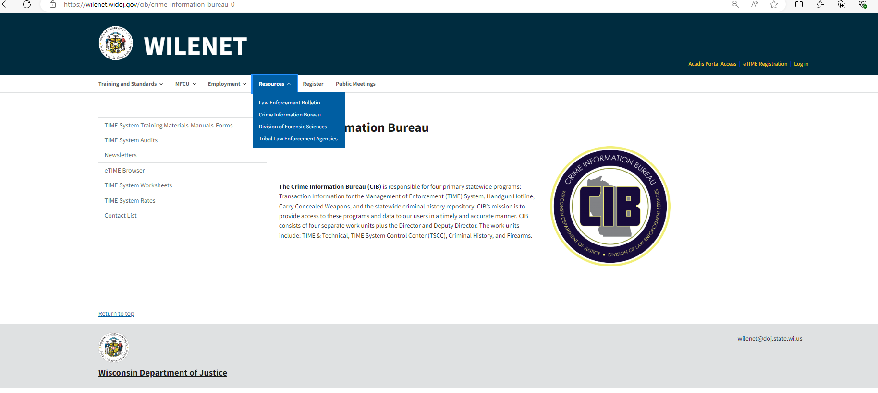
Resources: WILENET
https://www.wisdoj.gov/
Notes:
TIME System Training Materials – Manual – Forms: TIME Test Transactions, Link to TRAIN, Training options (handouts), Past presentations, License Plate Type Codes, NCIC Abbreviations, NCIC Code Manual, Portal Manual, PSN form, Recall Form, Visitor Access Log, CHRI log, etc.
TIME System Audits: link to CJIS Audit (Peak Performance website), link to the CJIS Security Policy, full Audit Process presentation from CIB Conference, Sample policies, Agreements, etc.
Newsletters: newsletters dating back to 2008 along with a newsletter index
eTIME Browser: link for eTIME registration and Multi-factor authentication instructions – provides guidance on how to get access to eTIME
TIME System Worksheets: PDFs of all the different types of worksheets we offer so agencies can put all documentation for entry in one place prior to entry – the worksheets do not count as documentation and are not required, but some agencies like to use them
TIME System Rates: provides information on what the current TIME System rates are along with previous rates
Contact List: List of CIB employees information including links to their emails

Slide 31

Question & Answer
Sarah Cook
608-261-7667
sarah.cook@wisdoj.gov
Ben Brandner
608-266-9341
benjamin.brandner@wisdoj.gov
Matthew Woodrum
608-261-5800
matthew.woodrum@wisdoj.gov
CIBTrain@wisdoj.gov
CIBAudit@wisdoj.gov
https://www.wisdoj.gov/
Notes:
Demos if possible – TRAIN unlikely due to the lack of VDI – but can show WILENET and Nlets User Guide
There should be plenty of time for Questions

Slide 32
Thank You!

