Slide 1

CIB – Portal XL Tips & Tricks
September, 2023

Slide 2
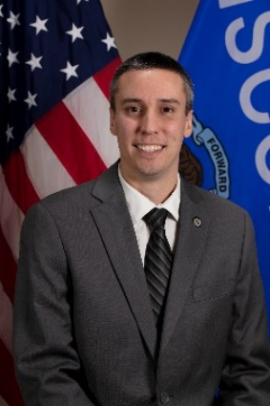
TIME & Tech Manager
Craig Thering
Craig returned to the TIME and Technical Unit in February 2023 to fill the TIME and Technical Manager position which was left vacant after Katie Schuh’s promotion to Deputy Director last year. Craig began his career with CIB in 2013 with the Firearms Unit and then in 2014, he joined the TIME and Technical Unit as a Program and Policy Analyst where he spent six years helping to keep the TIME System running. In December 2020, Craig accepted a new position as a Criminal History Unit Manager, working to ensure the criminal history repository was maintained in accordance with Wisconsin State Statute 165.83. Craig is excited to be back in the TIME and Technical Unit and welcomes any feedback or suggestions on how we can improve the TIME System.
https://www.doj.state.wi.us/
Notes:
Welcome and provide brief intros on staff

Slide 3
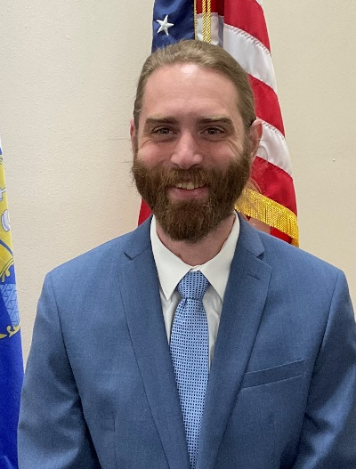
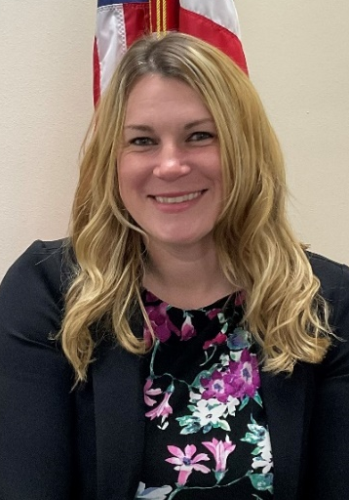
Trainers
Ben Brandner
Sarah Cook
Ben Brandner is a Training Officer with the Wisconsin Department of Justice. Ben joined the Wisconsin Department of Justice as Justice Program Associate in 2015. He has been with the TIME & Tech unit since 2021. Ben previously worked in the hospitality industry as a food safety trainer
Sarah Cook is a Training Officer with the Wisconsin Department of Justice and has been with the unit since 2021. Prior to that, Sarah worked for the Waukesha County Communications Center (911 dispatch center) as a dispatcher for over 14 years and trained new hires both on the job and in the classroom for 11 years.
https://www.doj.state.wi.us/

Slide 4
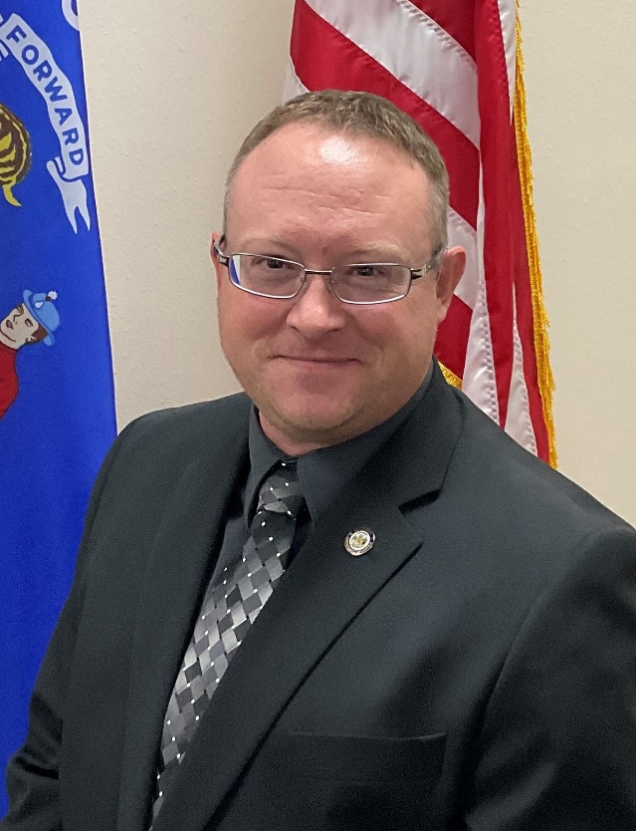
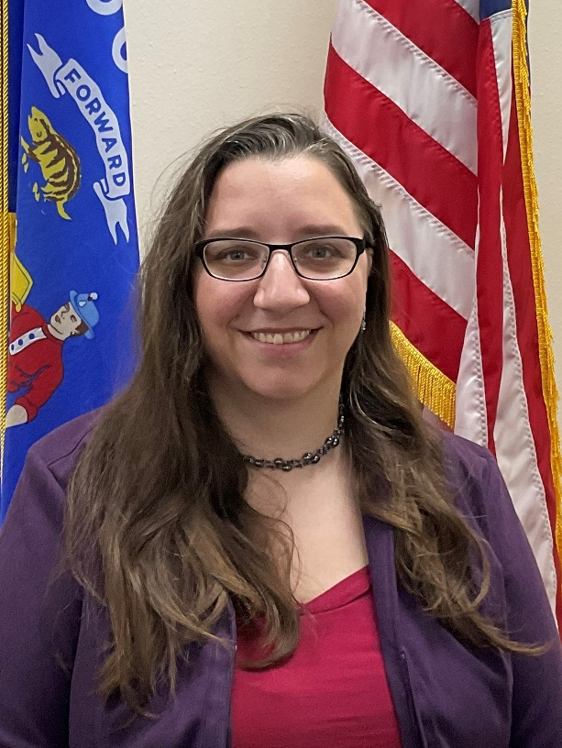
Program & Policy Analysts (PPAs)
Zach Polachek
Jeanette Devereaux-Weber
Zach is the Program & Policy Analyst-Advanced for the Crime Information Bureau at the Wisconsin DOJ. Zach started with WI DOJ in 2012 as a Firearms Unit LPPA. He transferred to the TIME & Tech Unit in 2015 as Program & Policy Analyst. Zach has been in the TIME & Tech Unit for 8 ½ years and has completed the FBI Level 1 Cyber Investigator Certification Program.
Jeanette Devereaux-Weber has been a Program & Policy Analyst for the TIME & Technical Unit since 2019. She started her WI DOJ career in the Criminal History Unit as a Criminal History Records Specialist in 2012.
https://www.doj.state.wi.us/

Slide 5
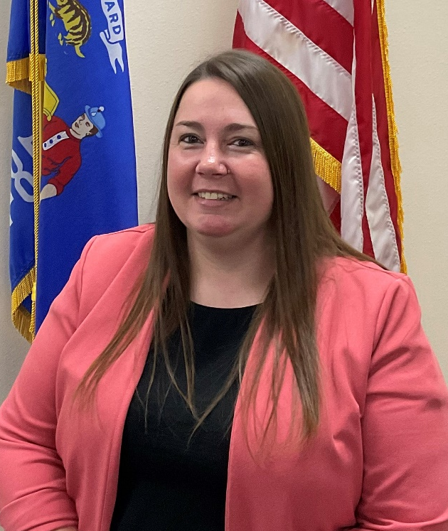
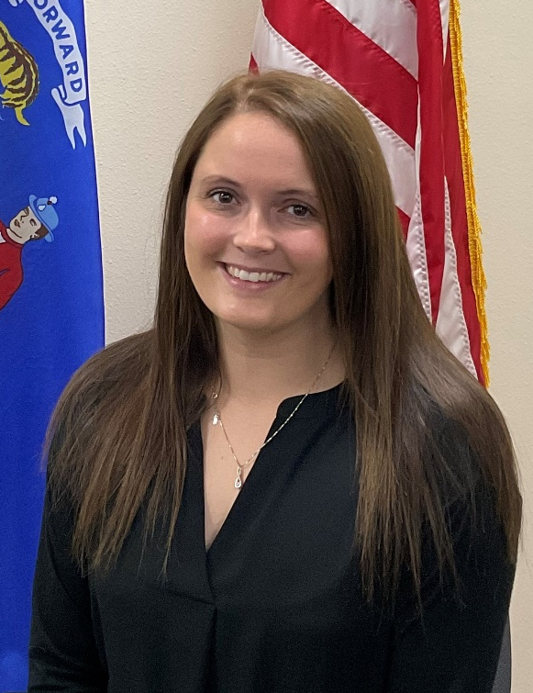
Program & Policy Analysts (PPAs) continued
Jennifer Virgin
Megan Smaby
Jenn started in CIB in 2017 as a member of the Firearms Unit. In March of 2018 she transferred to the Department of Revenue. Jenn returned to the Firearms Unit in January 2019 as a JPA Senior. In October 2021, Jenn was promoted to JPA Advanced. She has helped update training manuals, trained new hires, and has been a resource for other team members. In August 2023, she accepted a new role as a Program and Policy Analyst in the TIME and Technical Unit. Jenn is excited to learn more about the TIME System.
Megan joined the TIME and Tech unit in 2023. Megan Smaby started in CIB in 2016 has an LTE for the Firearms Unit. She has spent the last 7 years conducting background checks for Wisconsin Concealed Carry licenses, HR218 certifications, and handgun purchases. In addition, she assisted law enforcement agencies in completing their firearm return checks. She is leaving the Firearms Unit as an Advanced Justice Program Associate and is looking forward to her new role as a Program and Policy Analyst with the TIME and Technical Unit.
https://www.doj.state.wi.us/

Slide 6
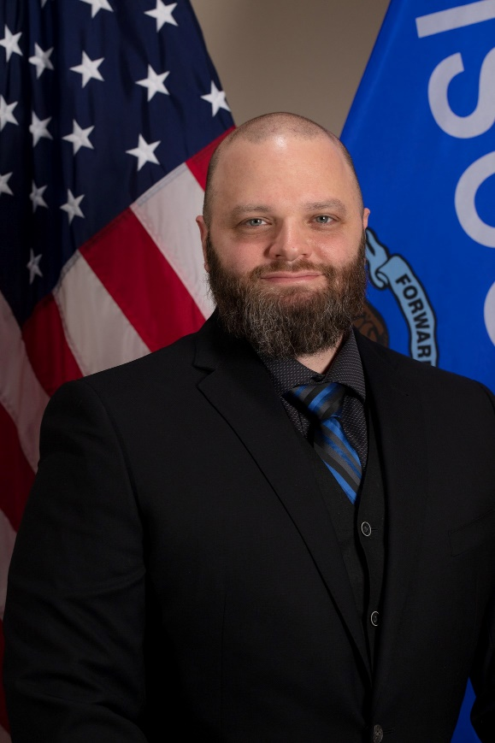
TIME System Operations Manager
Brian Kalinoski
Brian returned to DOJ in July of 2021, taking over the TSCC (TIME System Control Center) Operations Manager position. Brian has been with the State of Wisconsin for 18 years and has worked in the Department of Health Services, Department of Corrections, Department of Transportation, and most notably, 12 of those years in TSCC.
https://www.doj.state.wi.us/

Slide 7
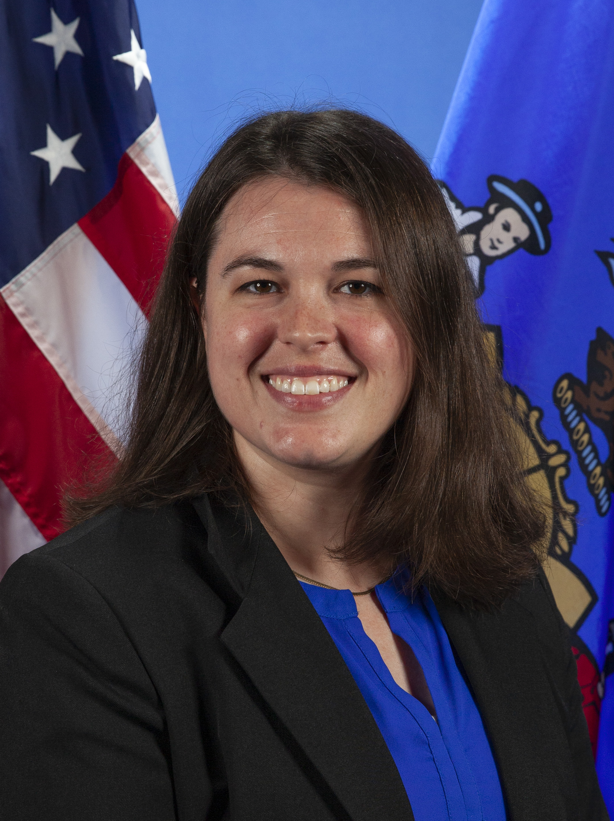

Recent Departures
Emily Freshcorn
Emily Freshcorn was the Senior Training Officer in the Crime Information Bureau of the Wisconsin Department of Justice and has been with the unit since 2016. She will be returning to her home state and will be missed!
https://www.doj.state.wi.us/

Slide 8
PXL Conversion Status Update
Converted | Partially Converted | Not Yet Converted
75 | 38 | 102
https://www.doj.state.wi.us/
Notes:
Survey the room – has your agency converted to PXL?

Slide 9
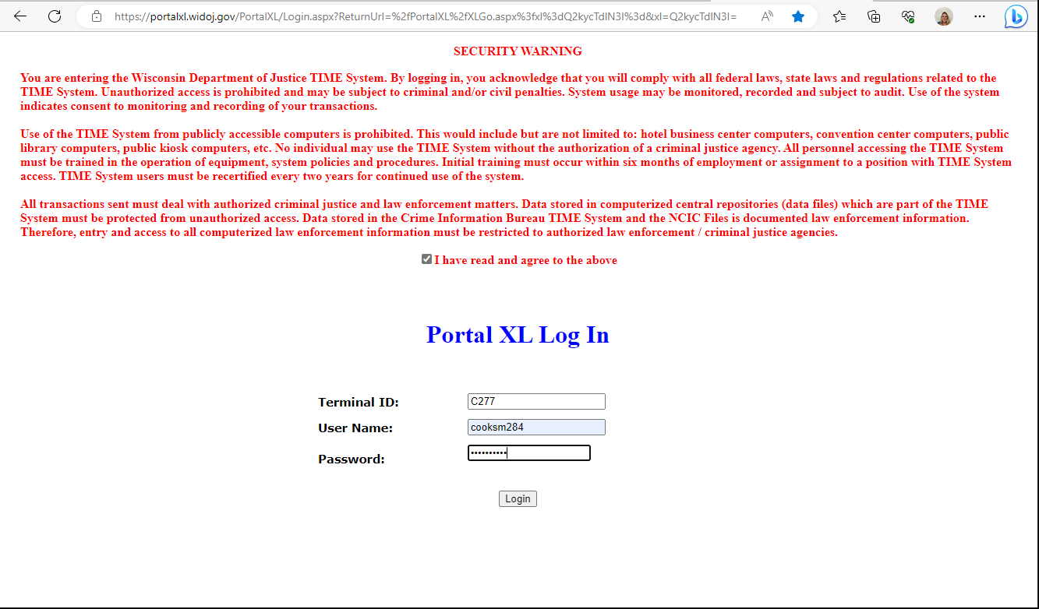
Log in Page
Portal XL is a browser-based application. It will work in Chrome, Edge and Firefox; however, Chrome usually works best.
As you can see, the log in screen looks very similar to Portal 100.
You will need to agree with the security warning at the top and then after verifying your terminal ID, enter your TRAIN username and your current password.
https://www.doj.state.wi.us/
Notes:
Currently, the “change password” function is still handled from the TRAIN log in page, but eventually it will be done through Acadis (once it goes live). When you attempt to change a password in Acadis, you will still be routed back to a screen that looks similar to the TRAIN log in page to do so.
There is also a Change Password option on the top left side of the menu once you are logged into Portal XL.
Users are not permitted to log into PXL multiple concurrent times within the same device.
The URL for PXLcan be bookmarked/favorited or IT can create a public desktop icon.

Slide 10
Browser Settings
Just a reminder that PXL will work in Chrome, Edge or Firefox, but Chrome usually works best!
If you are using Chrome or Edge, pop-up blockers will need to be allowed in order to see all pop-up displays.
If you are using Edge, be sure to disable Sleep mode.
If you are using Chrome, be sure to disable the memory saver.
https://www.doj.state.wi.us/
Notes:
So, if you are double clicking in a field and not seeing any results pop-up, verify that your pop-up blocker isn’t turned on.

Slide 11
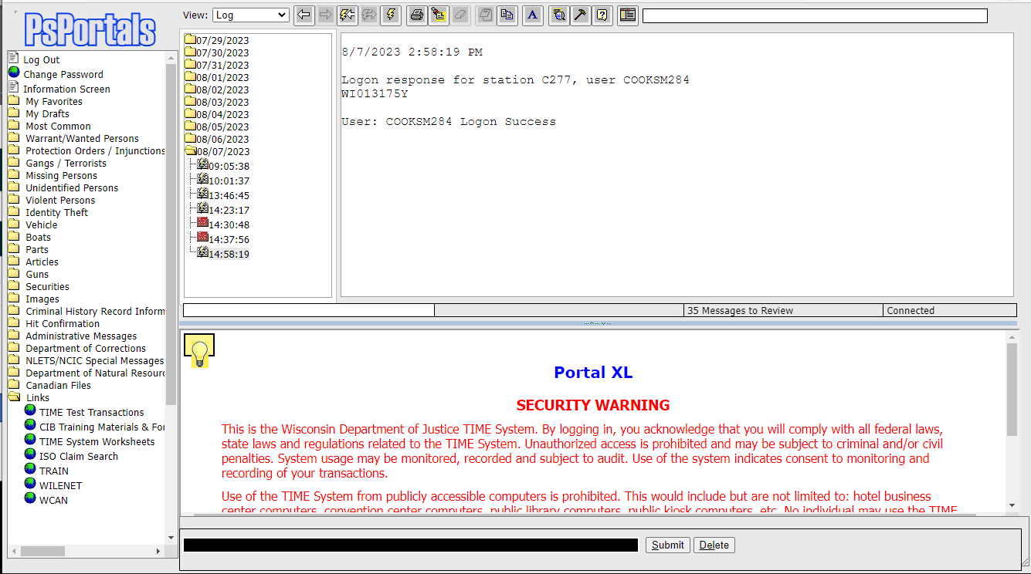
PXL Home Page
Once you are logged in, you will receive a message to indicate if your log in was successful or not.
Notice the tree menus on the left side look very similar to P100.
The links on the bottom left side are a little different than what you may have seen in P100.
https://www.doj.state.wi.us/
Notes:
The receive window is divided into two sections (the left side shows the message logs in chronological order and the right side is the actual message that has been selected).
The links folder in PXL do work and they are easy to modify, so if any agencies have any suggestions on links to add, notify CIB and we can potentially get those added.

Slide 12
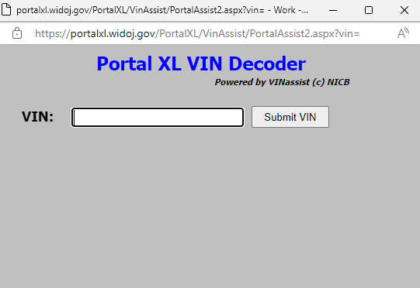
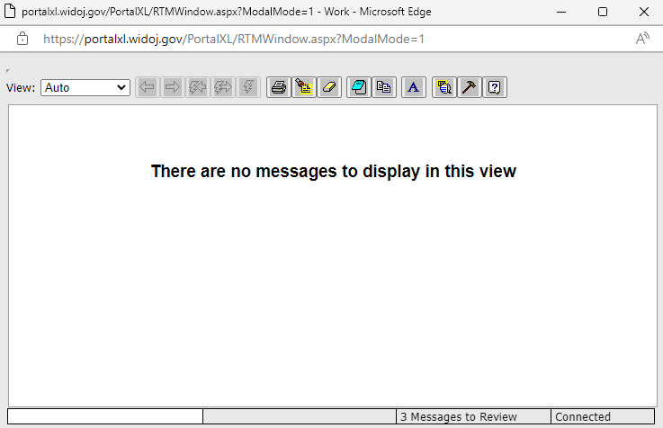
Toolbar Functions
https://www.doj.state.wi.us/
Notes:
There are two new icons and toolbar functions. The icon with the magnifying glass opens a VIN decoder. The icon that looks like the screen and panels opens a free floating message window.

Slide 13
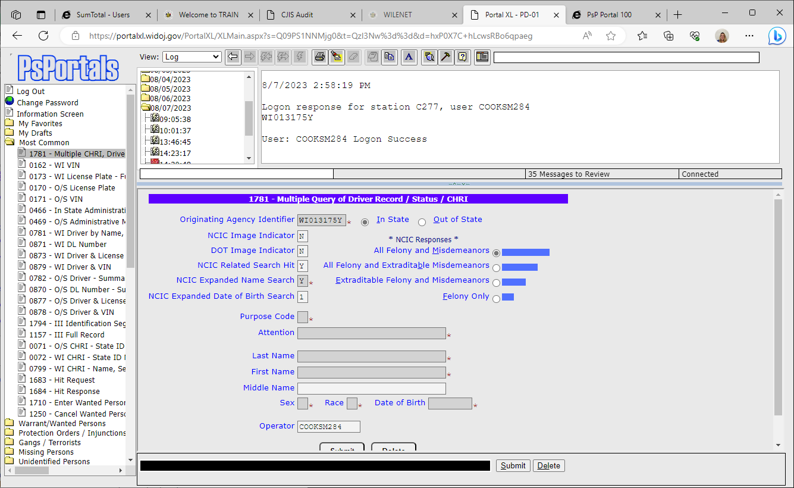
Accessing PXL Forms
Users can choose the form number from the tree menu on the left side (if this is done, the form will automatically display at the bottom of the main Portal screen).
If the user enters the form number in the black bar at the bottom of the screen or in the text bar at the top, it will open a separate window with the form.
https://www.doj.state.wi.us/
Notes:
There are three ways to access PXL forms. You can choose a form from the tree menu on the left side or you can manually enter the form number in the black bar at the bottom of the screen or in the white bar at the top of the screen.
Side note: The Default ORI that fills in for the Originating Agency Identifier is set by DOJ with PXL.
Additional ORIs configured on one workstation will automatically applied to all workstations.

Slide 14
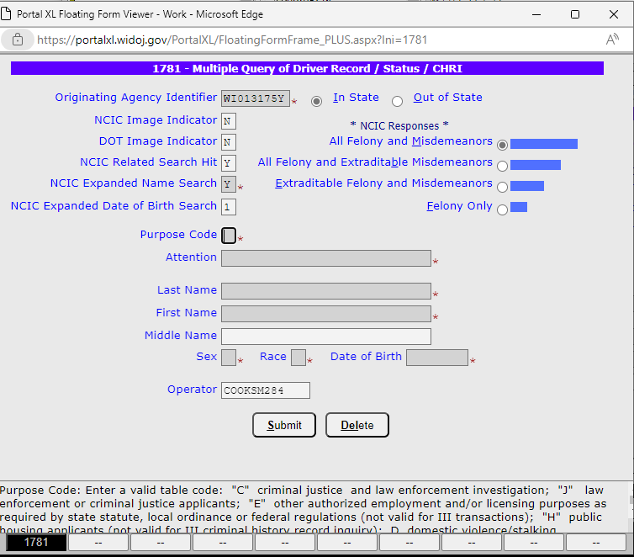
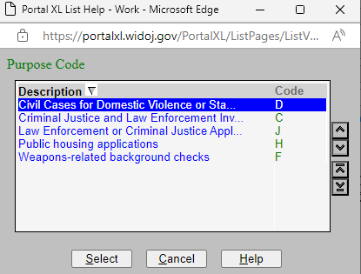

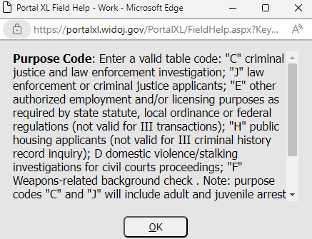
Free floating PXL Form
Make sure your pop-up blocker is turned off!
https://www.doj.state.wi.us/
Notes:
Notice that whichever field that you are highlighted on automatically provides the Help information at the bottom of the screen. If you double click on the field, a pop-up box will appear and will provide additional information for that field. There is a Help button at the bottom of the pop-up box so you can obtain additional information about that particular field.
If the form you entered is incorrect, you can right click on the form number at the bottom of the screen and choose to close the form(s) or you can re-type in the new message key.

Slide 15
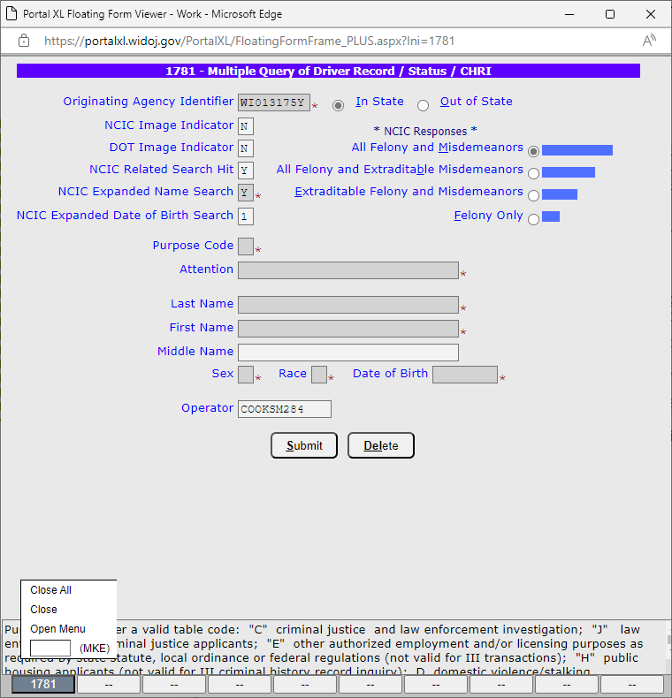
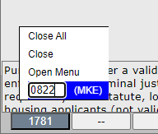
Free Floating PXL Form (continued)
Right click on the form number for an option to change to a different form number.
https://www.doj.state.wi.us/
Notes:
You can enter a new form number in the bottom floating form viewer by right clicking on the current form number and type the desired form number where it says “MKE”. PXL will transition you to the new form.

Slide 16
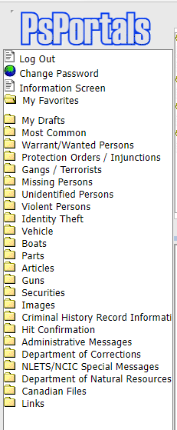
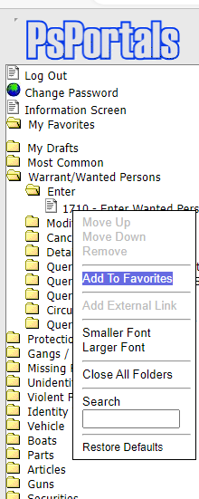
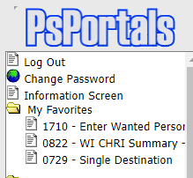
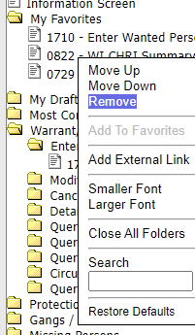
Favorites Menu
There is a “My Favorites” folder on the left sided tree menu. As you can see, it is currently empty.
Here are items that I have added to “My Favorites” folder.
To add a form to your favorites folder, right click on the item in the tree menu and choose “Add To Favorites.”
If you wish to remove an item from your favorites folder, just right click and choose “Remove”
https://www.doj.state.wi.us/

Slide 17
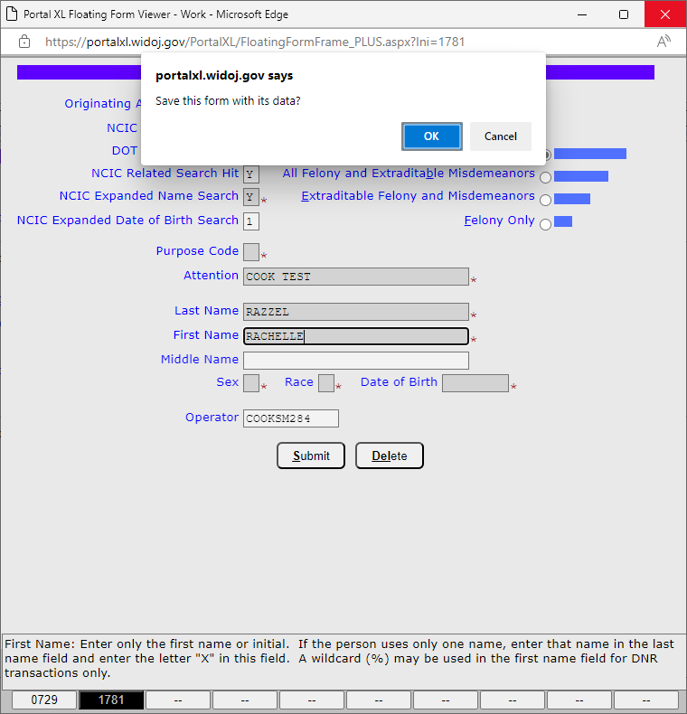
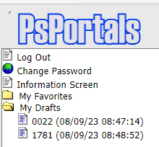
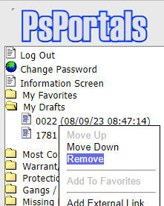
My Drafts
Users can begin filling out forms and save them for later if necessary.
The form will be saved to that Workstation rather than to the user.
If the user logs out, the next user that logs in will be able to access the partially filled in form from “My Drafts”.
To remove the form from “My Drafts”, right click on the form from the My Drafts folder and click “Remove.”
https://www.doj.state.wi.us/
Notes:
To save a form, the user will need to type Alt/Ctrl/S and then a message will pop up asking if you want to save it with data. If you choose “Ok”, the message will be saved for later.

Slide 18
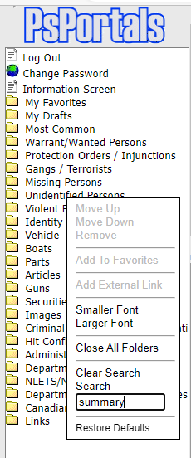
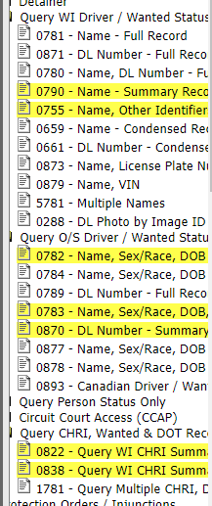
PXL Form Search
https://www.doj.state.wi.us/
Notes:
PXL allows you to search for forms by name if you don’t recall where in the tree menu it is located or what the form number is. To search, right click within the tree menu panel and a pop up box will appear to Search and you fill in the word you want to search for and hit enter.
Once you hit enter, the tree menu will highlight every time that word appears to narrow down the items in the tree menu.
The results will be available until the folders are closed or a new search is performed.

Slide 19
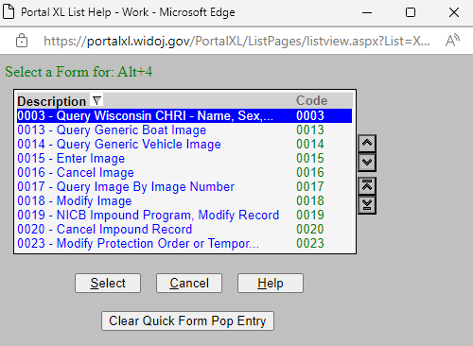
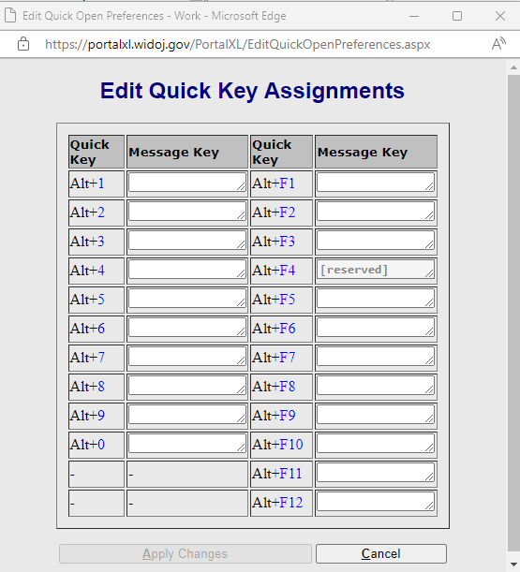
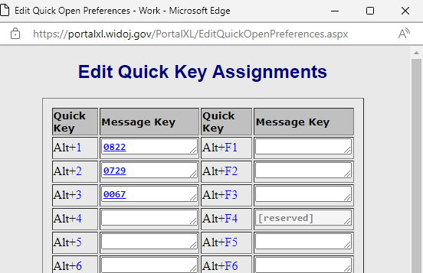
Quick Key Assignments
https://www.doj.state.wi.us/
Notes:
To Edit Quick Key assignments, click in the command line at the top right of the screen and hold down Alt & Shift.
Click on the blank box to choose from the option for the message keys.
A list of form numbers will pop up. You will need to choose the form you want to populate with quick keys you have chosen.
As a side note, F7 and F8 functionality have swapped.

Slide 20
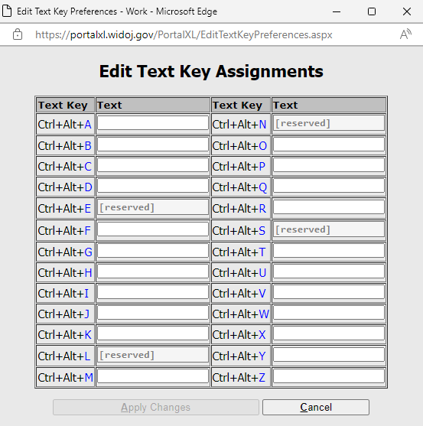
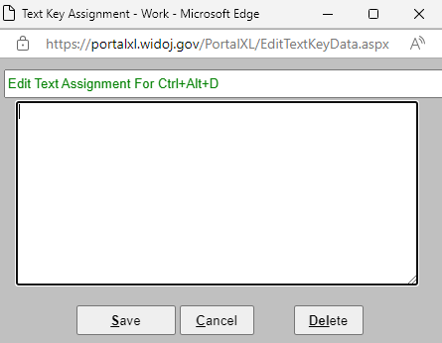
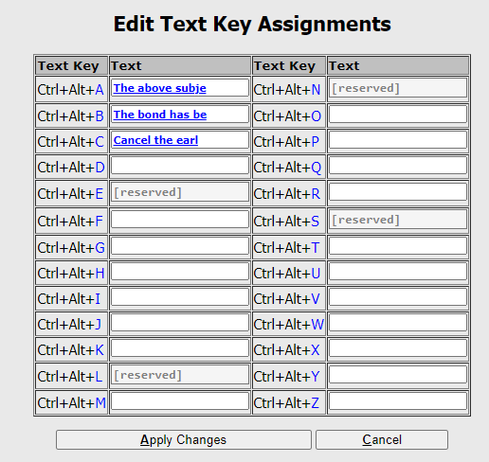
Text Key Assignments
https://www.doj.state.wi.us/
Notes:
To edit the quick text keys for commonly used texts, click on the command line on the top right side of PXL and hold down shift and control to edit the list.
Click on the text key you want to use and then fill in the text you would like to display when using those hot text keys. Hit save when finished.
Click on Apply changes after your text keys are set.

Slide 21
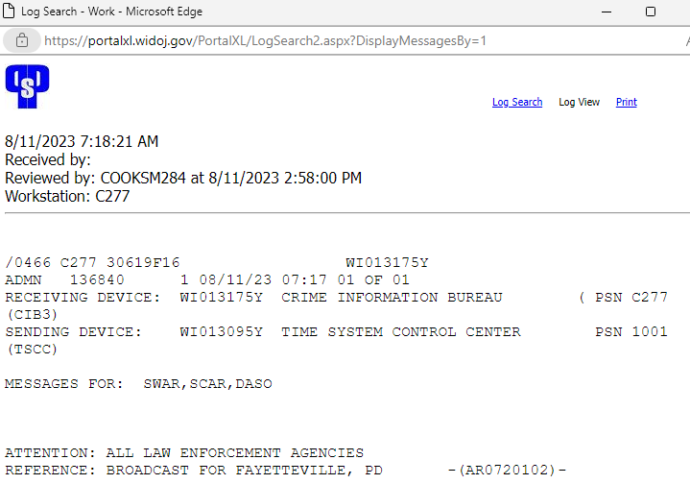
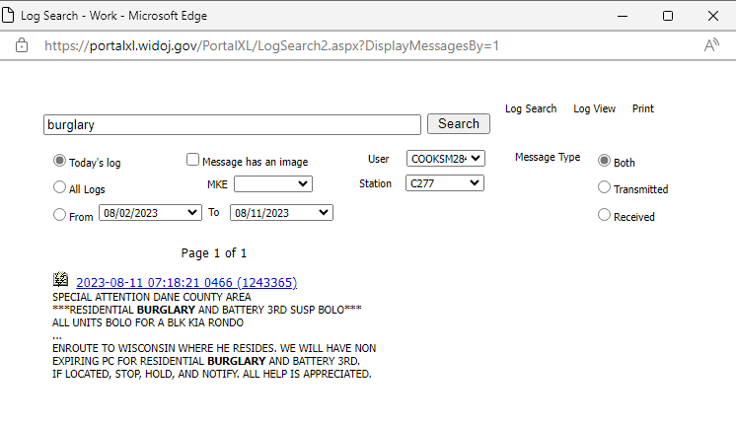
Log Search Functionality
https://www.doj.state.wi.us/
Notes:
Please be aware that PXL logs are only available for 10 days. In P100, they were available for about 30. If you need anything beyond the 10 days, you will need to contact CIB to perform a recall.
You will need to click on the icon to search the logs and then type in the word or number that you want to search and make sure to change the set of dates to search.
You can then click on the hyperlink to view the full message.

Slide 22
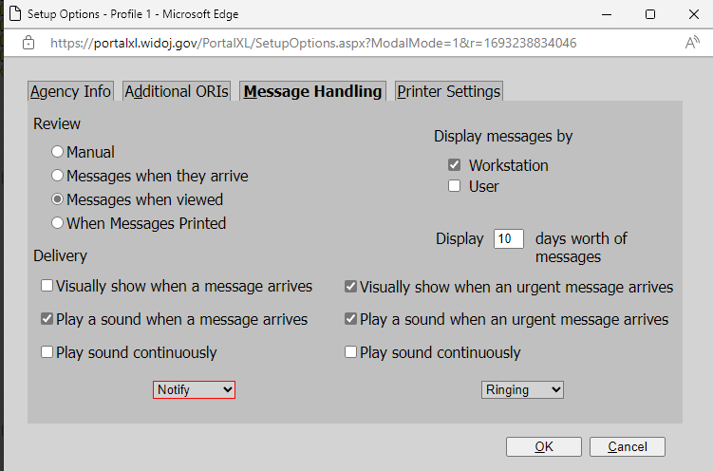
Display Message Option for New Users
    Display messages by Workstation is recommended vs display by user for brand new users
https://www.doj.state.wi.us/
Notes:
Messages (Unsolicited $, Hit Confirmations, Broadcast messages) sent to a terminal that is not currently connected will not see the messages upon logging in unless, the display messages by Workstation is selected.

Slide 23
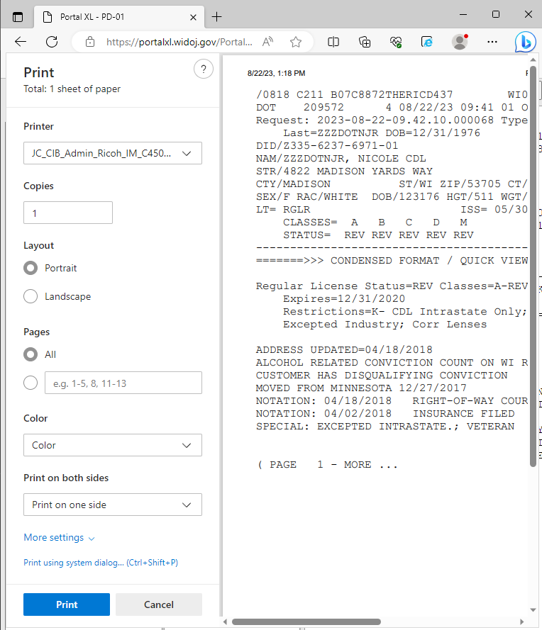
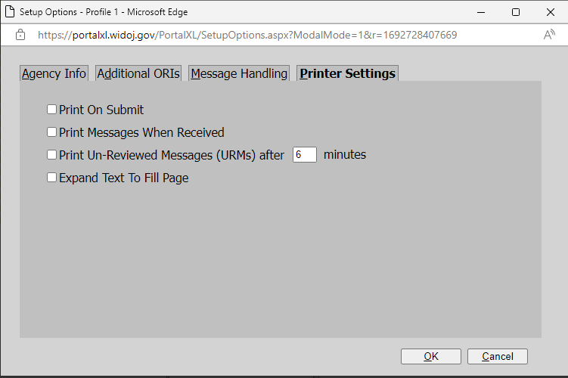
Printing From Portal XL
    Portal XL utilizes the web browser’s printer settings.
    The printer settings that are able to be adjusted from within Portal XL are shown below.
https://www.doj.state.wi.us/

Slide 24

Printing From Portal XL – Unattended Printing
    If you prefer to Print on Submit and Print Messages When Received, you’ll need to complete the following workaround to prevent the printer prompt needing to be acknowledged for every log response.
    1. Create a new Google Chrome shortcut and rename it to differentiate it from your regular Chrome shortcut. (This new shortcut will need to be the one used for Portal XL.)
        2. After creating the desktop shortcut, right click the shortcut and click "Properties".
    3. In the "Target" field after "...chrome.exe", type this:
    --kiosk-printing
    (Note there is a space after ”, then two hyphens)
    4. Click apply.
    Now, when you use this shortcut to Chrome, and print something, you will not be prompted with the pop up to print or cancel.
https://www.doj.state.wi.us/
Notes:
These instructions are specific to Chrome. There may be a similar workaround for Edge, which users can search and attempt.

Slide 25
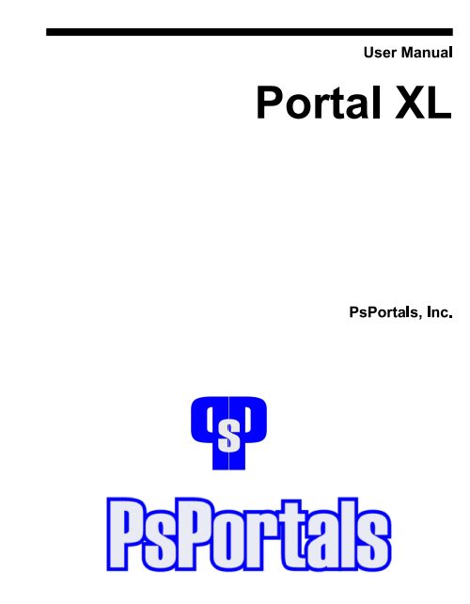

Portal XL User Manual
For more information, the Portal XL User manual is available on WILENET.
Just go to wilenet.widoj.gov, click on Resources, choose Crime Information Bureau, then click on TIME System Training Materials-Manuals-Forms. The manual is located under the Manuals section on that page.
TIME System Training Materials-Manuals-Forms | WILENET (widoj.gov)
https://www.doj.state.wi.us/

Slide 26

Question & Answer
Sarah Cook (Training Officer)
cooksm@doj.state.wi.us
608-261-7667
Ben Brandner (Training Officer)
brandnerb@doj.state.wi.us
608-266-9341
CIBTrain@doj.state.wi.us
Zach Polachek (Advanced PPA)
polachekzd@doj.state.wi.us
(608) 264-9470
Jeanette Devereaux-Weber (PPA)
devereauxweberjd@doj.state.wi.us
608-266-2426
Jennifer Virgin (PPA)
virginjm@doj.state.wi.us
608-266-7792
Megan Smaby (PPA)
smabymn@doj.state.wi.us
608-261-8135
https://www.doj.state.wi.us/
Notes:
The full contact list is available on WILENET

Slide 27
Thank You!

