Slide 1
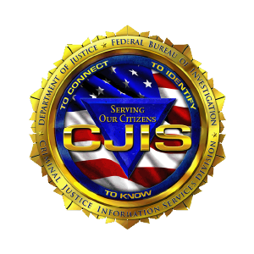


CJIS Security Policy Updates
CIB Conference September 16-19, 2025

Slide 2
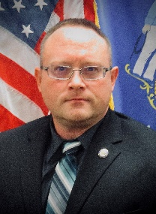
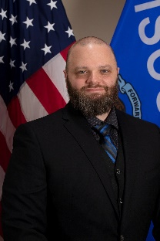
Welcome
Zach Polachek
Program & Policy Analyst - Advanced
TIME & Technical Unit
Brian Kalinoski
WI ISO
TIME System Operations Manager
https://www.wisdoj.gov/

Slide 3

CJIS Security Policy
Purpose and Scope
CJIS Security Policy integrates presidential directives, federal laws, FBI directives, the criminal justice community’s Advisory Policy Board (APB) decisions along with guidance from the National Institute of Standards and Technology (NIST) and the Compact Council.
The CJIS Security Policy provides agencies with the minimum set of security requirements to protect Criminal Justice Information (CJI).
The CJIS Security Policy applies to all agencies with access to CJI.
Adopt controls of higher tier agency if applicable/available.
https://www.wisdoj.gov/
Notes:
What’s it’s purpose?
If CJI isn’t involved, then the policy does not need to be applied.
Not just because the “FBI said so”…

Slide 4


CJIS Security Policy
TIME System Audits
Per CJISSECPOL requirements, the State CJIS Systems Agency (CSA) is required to audit all agencies that access the systems on a triennial basis.
WI DOJ is the CJIS Systems Agency for Wisconsin and the Crime Information Bureau Director is the designated CJIS Systems Officer (CSO).
As the CSO’s designated authority, CIB TIME & Tech Unit audits every agency in the state that accesses the TIME System/NCIC databases.
TIME System Audits consist of two questionnaires (CIB & Technical) in the online CJIS Audit application and an audit packet containing agreement copies, rosters, training certs, PSN list, Justice Directory authorizations, NCIC/ORION listings, and CHRI queries.
https://www.wisdoj.gov/

Slide 5
CJIS Security Policy
TIME System Audits
Questionnaires can be grouped into various tiers based on the following factors:
- ORI Assigned/Agency Type (i.e., PD/Sheriff, DA, Courts, Comm Ctr, NCJA, etc.)
- TIME Connections (i.e., Interface Host, Interface Client, eTIME/MACH only)
- Type & number of terminals (i.e., in-house workstation, MDC, dispatch)
All questionnaires in 2025 were updated to version 6.0 of CJISSECPOL.
CIB conducting field audits on-site for agencies, 10-15 agencies/year
- Randomly assigned unless agency has had moderate security incident that prompts an on-site audit as follow up.
- Agency size does not matter, can be 3000+ officers or 1 officer, all are subject
https://www.wisdoj.gov/

Slide 6
CJIS Security Policy
TIME System Audits
Audit questionnaires continue to be updated as new policy releases are published. The FBI will be conducting annual audits of WI/CSA.
IT that supports law enforcement should be prepared to assist with technical questionnaires.
Audits are scheduled on a 3-year schedule (may changed based on mitigating factors) as per the CJIS Security Policy requirements.
Sample policies are available on WILEnet and from CIB, please contact the CIB Audit email inbox for samples: cibaudit@doj.state.wi.us
https://www.wisdoj.gov/
Notes:
Agencies that have items of concern identified during the audits will be required to provide estimated timelines for addressing non-compliant items in their response back to CIB.

Slide 7
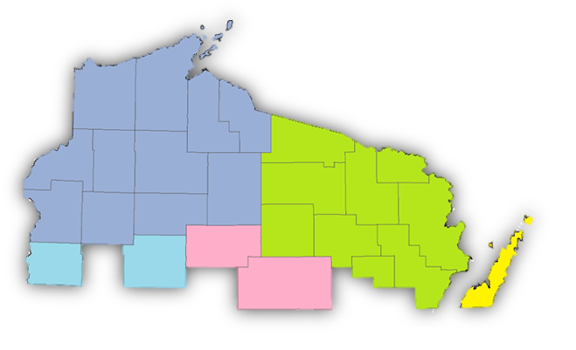
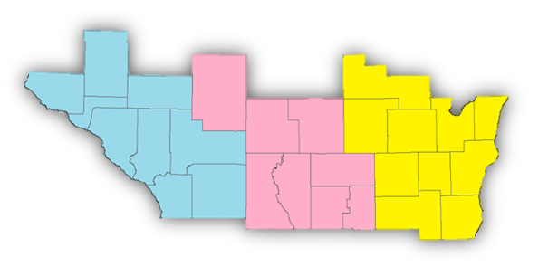
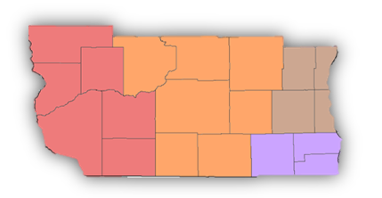
CJIS Security Policy
TIME System Audits
Map provided by
State Cartographer’s Office
Audits are done in a 3-year cycle
Mostly geographical by county
Exceptions:
- DA’s offices, DOC, DNR, State Patrol
- Other agencies located in multiple counties
- Agencies joining the TIME system
Currently in year 2 of WI cycle
On-site/field audits in effect!
3rd year
2nd year
1st year
https://www.wisdoj.gov/
Notes:
Agencies that have items of concern identified during the audits will be required to provide estimated timelines for addressing non-compliant items in their response back to CIB.

Slide 8
CJIS Security Policy
Training Changes
LASO training – Required annually
Security Awareness training – Required annually
Government IT/IS Agencies that directly support LE/Criminal Justice Agencies are required to sign a management control agreement (MCA) with the LE/CJA if not directly employed by the LE/CJA. Private IT/IS Vendors are required to sign Security Addendums (each person) and LE/CJA shall keep on file for length of service.
https://www.wisdoj.gov/
Notes:
LASO training is now required to be completed annually. CIB has online LASO training available as well as paper LASO training materials available on the WILEnet website.
Security Awareness training is now required on an annual basis and just like the LASO training, Security Awareness is available both on paper and digitally. However, there are different levels of Security Awareness training that are required based on the job duties of the person. TIME System users get Security Awareness as part of their biannual certification or recertification, but they will also now be required to take the stand-alone Security Awareness training on the opposite years from certification/recertification. Non-TIME System users will just need to take either the paper or digital Security Awareness training annually.
MCAs are required between all CJA’s and their IT/IS support if the IT/IS support is a separate government agency and not part of the CJA. MCAs will be requested by CIB from the CJA at time of audit so if the CJA does not have one, they will be required to get a current copy. The FBI Security Addendum is required for all private vendors that provide IT/IS support.

Slide 9
CJIS Security Policy
Criminal Justice Information (CJI) – Definition
Criminal Justice Information is the term used to refer to all FBI CJIS provided data necessary for law enforcement and civil agencies to perform their missions including, but not limited to biometric, identity history, biographic, property, and case/incident history data. The following categories of CJI describe the various data sets housed by the FBI CJIS architecture:
1. Biometric Data—data derived from one or more intrinsic physical or behavioral traits of humans typically for the purpose of uniquely identifying individuals from within a population. Used to identify individuals by fingerprints, palm prints, iris scans, and/or facial recognition data.
2. Identity History Data—textual data that corresponds with an individual’s biometric data, providing a history of criminal and/or civil events for the identified individual.
3. Biographic Data—information about individuals associated with a unique case and not necessarily connected to identity data. Biographic data does not provide a history of an individual, only information related to a unique case.
4. Property Data—information about vehicles and property associated with crime when accompanied by any personally identifiable information (PII).
5. Case/Incident History—information about the history of criminal incidents.
https://www.wisdoj.gov/
Notes:
Official definition.
In simple terms, any data obtained from the FBI.
Agencies could deem anything TIME System = CJI for consistency and easy of management.

Slide 10
CJIS Security Policy
Modernization of the CJIS Security Policy
Modernization efforts started in v5.9.1, October 1, 2022.
Current v6.0 (December 27, 2024), can be obtained online: https://le.fbi.gov/cjis-division/cjis-security-policy-resource-center
CJISSECPOL Companion Document – Highly Recommended!
- Contains dates/timeframes for auditing and sanctions.
All areas of the policy are sanctionable by October 1, 2027.
CIB continues to review the changes and is updating triennial audit questionnaires as applicable.
https://www.wisdoj.gov/
Notes:
Many of the updates to the CJIS Security Policy are based off NIST 800-53 and 800-63. If familiar with those publications, then you should have a good idea of what the majority of the new requirements are and their basis.
Modernization efforts have focused more on preventing access from both outside and insider threats and placing an emphasis on the multi-faceted approaches to security with long term goals and robust planning.

Slide 11
CJIS Security Policy
Priority Updates:
In CJISSECPOL version 5.9.5, CJIS identified 4 priority levels (P1, P2, P3, and P4) that different control areas will be categorized as based on current and emerging security threat analysis.
Priority 1 (P1) items are those specific controls which are required to be in place now and they were sanctionable upon the date of publication of v5.9.5 of the policy (as of 10/1/2024) unless otherwise specified in the CJISSECPOL Companion Document.
https://www.wisdoj.gov/

Slide 12
CJIS Security Policy
Priority Updates:
Priority 2, 3, and 4 (P2, P3, P4) modernized controls
Unless otherwise stated in the policy, control items in these categories will be required to be in place by the end of the zero-cycle if not already required under previous versions of the policy.
Some areas of the policy have not been updated as part of the modernization process and those existing areas or controls remain auditable and are currently sanctionable (ex. Mobile Devices section).
https://www.wisdoj.gov/
Notes:
The current zero-cycle goes from 10/1/2024 – 9/30/2027. All items in modernization will be auditable and sanctionable as of 10/1/2027.

Slide 13

CJIS Security Policy
Priority 1 Control Areas:
Access Control (AC)
1. Account Management – creation, maintenance, deactivation
2. Remote Access – Internal & External (server to squad; temporary remote access for support)
3. External Systems – Non-Agency owned/controlled (ex. ALPR)
https://www.wisdoj.gov/

Slide 14
CJIS Security Policy
Priority 1 Control Areas:
Identification & Authentication (IA)
1. Multi-Factor Authentication (MFA) – Organizational Users
2. Authenticator Management – Types, Public Key Based, Protection
Configuration Management (CM)
1. Baseline Configuration – in conjunction with network diagram
2. Restrictions, Settings, Least Functionality, System Component Inventory
https://www.wisdoj.gov/

Slide 15
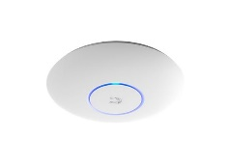
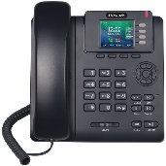
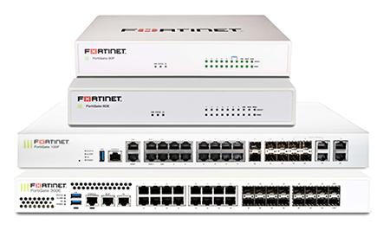

CJIS Security Policy
Priority 1 Control Areas:
Systems and Communications Protection (SC)
1. Boundary Protection – AP’s, External Telecom Services, Routing, PII
System and Information Integrity (SI)
1. Flaw Remediation
2. Malicious Code Protection
3. System Monitoring
4. Software/Firmware and Information Integrity
https://www.wisdoj.gov/

Slide 16
CJIS Security Policy
Priority 1 Control Areas:
Risk Assessment (RA)
1. Vulnerability Monitoring and Scanning
* All previously mentioned Priority 1 sections are those as defined by the APB for the CJIS Security Policy and agreed upon by all 50 states. The following areas may or may not be CJIS defined Priority 1 controls, but those areas that CIB would highly recommend that agencies also concentrate on updating/modernizing.
https://www.wisdoj.gov/

Slide 17
CJIS Security Policy
Topological Network Diagram:
Configuration Management(CM)
Agency topological network diagrams are required for every agency per CJISSECPOL regardless of agency size/audit requirements.
Network diagrams do not have to be complex but should give a general idea of where critical hardware is located on the network, depict all transmission routes for data, identify points of potential concern for vulnerability, and identify all portions of the agency network where CJI travels or resides.
https://www.wisdoj.gov/

Slide 18
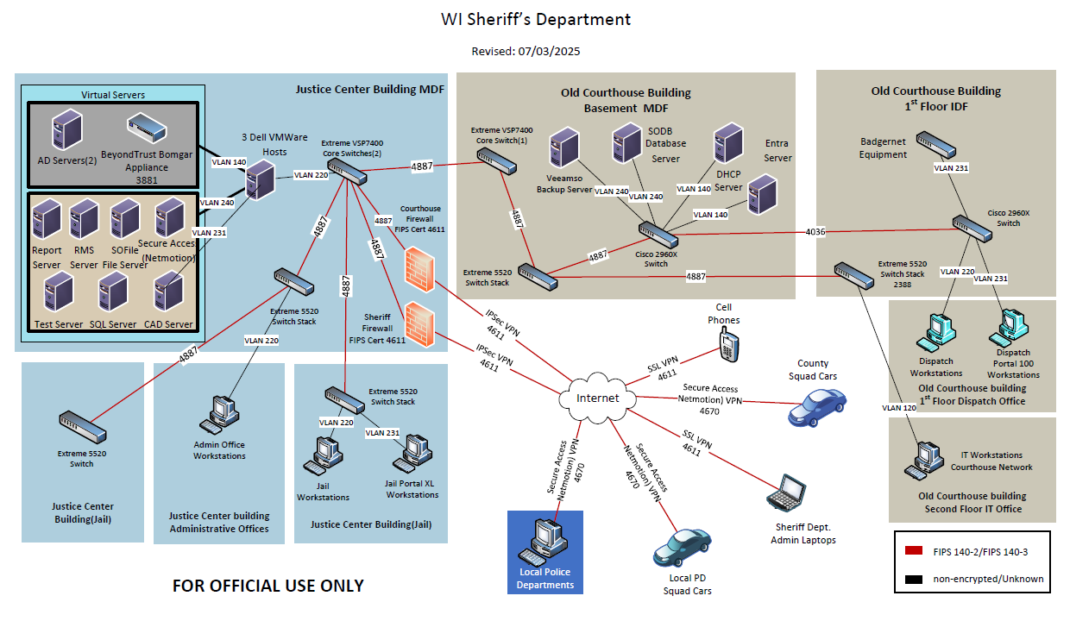
CJIS Security Policy
Topological Network Diagram:
https://www.wisdoj.gov/

Slide 19
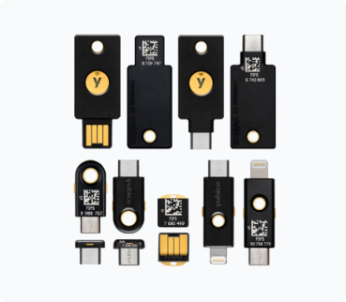
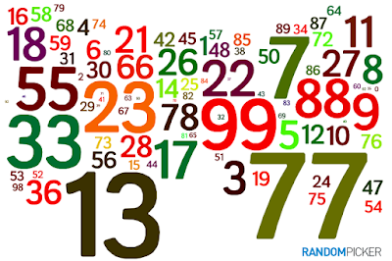
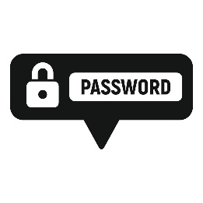

CJIS Security Policy
Multi-Factor Authentication
Formerly known as Advanced Authentication or 2-Factor Advanced Authentication (2FA).
Factor Types – 2 of 3 required for use with CJIS systems.
- “Something You Have” (e.g., physical token, OTP code, cryptographic cert.)
- “Something You Know” (e.g., a PIN, memorized secrets/passwords)
- “Something You Are” (e.g., biometrics) * * Cannot be used as primary factor, can only be used as an enhanced factor in addition to a “Have” and “Know” factor.
https://www.wisdoj.gov/
Notes:
If the multi-factor authentication process uses a combination of two single-factor authenticators, then it SHALL include a Memorized Secret authenticator and a possession-based authenticator.

Slide 20
CJIS Security Policy
Multi-Factor Authentication
Deployed as close to the access of CJI as possible*.
- Application login
- Device login
Current projections from cyber security intelligence sources say that at some point in the coming future, MFA will be required for ALL access and/or login gateways.
(consider SAML/OpenID/SSO-Federated)
* CJI storage location determines where MFA is deployed
https://www.wisdoj.gov/

Slide 21
CJIS Security Policy
Multi-Factor Authentication
Known compliant MFA products/companies in use in WI:
Microsoft Entra ID (P1/P2 packages), Cisco Duo, Fortinet, Google Authenticator, YubiKey, Okta, Entrust, Manage Engine, etc.
Compromised password lists & comparison
Salt & Hash for memorized secrets
Mobile apps*, software dashboards, physical tokens
* - May be deployed on personal devices if agency device not issued.
https://www.wisdoj.gov/

Slide 22
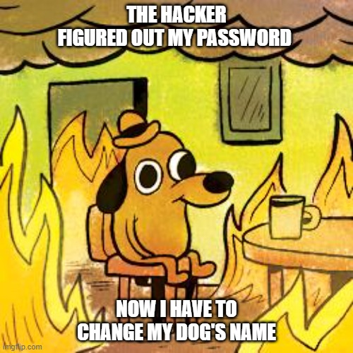
CJIS Security Policy
In 2024, polling data of adults in the US found that 39-40% of people who use memorized secrets (passwords) to login to computers or applications use their dog’s name as their password.
96% of common passwords can be cracked by hacking tools in less than one second.
https://www.wisdoj.gov/

Slide 23
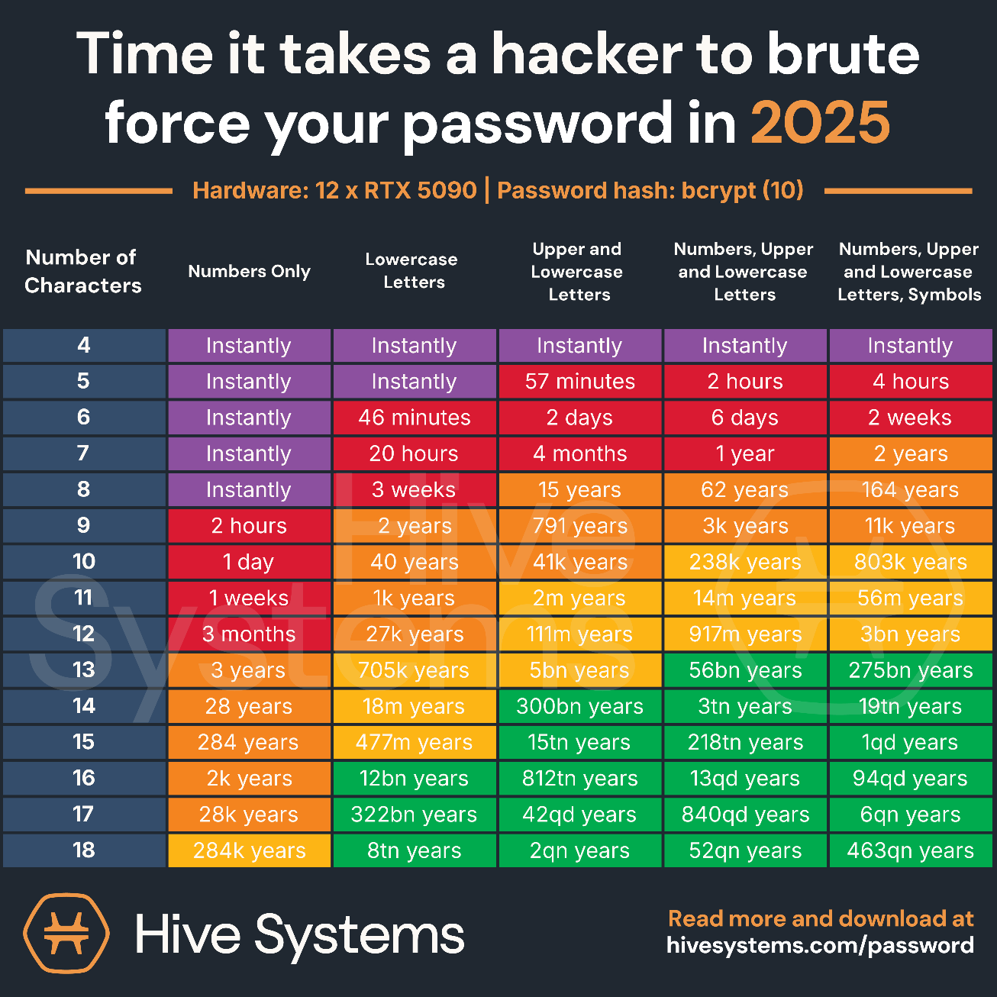
CJIS Security Policy
Why does the length and strength of passwords/memorized secrets matter?
* Non-Quantum based Encryption
https://www.wisdoj.gov/

Slide 24
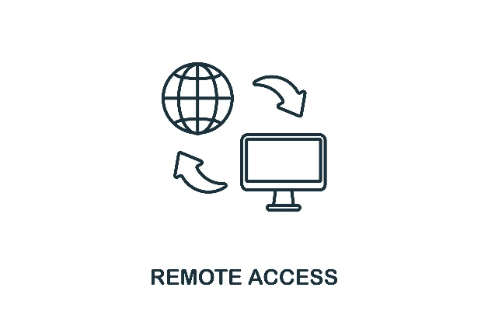
CJIS Security Policy
Remote Access
Defined as any access to organizational systems (or processes acting on behalf of users) that communicate through external networks (i.e., the Internet).
Includes internal applications used for communication between physically secure locations, and external applications that provide network/system support access for maintenance purposes.
Shall be encrypted to the requirements of the policy.
Shall be monitored and controlled by the agency.
https://www.wisdoj.gov/

Slide 25
CJIS Security Policy
Identity Proofing
Identity Proofing
- The sole objective of identity proofing is to ensure the applicant is who they claim to be to a stated level of certitude.
Identity Evidence shall be collected from applicants and the types of evidence collected must meet notional strength benchmarks as identified in section IA-12(3)(y) of the CJIS Security Policy.
Agencies should keep copies of ID evidence on file.
https://www.wisdoj.gov/

Slide 26
CJIS Security Policy
Identity Proofing
Agencies are required to identify and verify users, processes, and devices as a prerequisite to allowing access to system resources.
Applies to all organizational personnel and those non-organizational personnel that directly support the agency.
Agencies SHALL NOT hire or contract with any person not physically present within US or APB sponsored countries. (Systems & Remote Access servers are only authorized from CONUS)
https://www.wisdoj.gov/

Slide 27
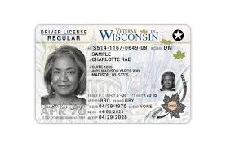
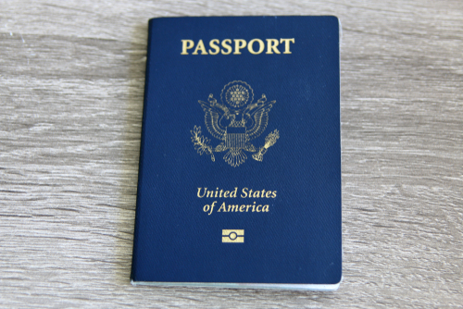
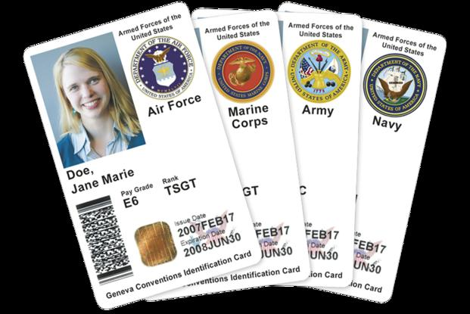

CJIS Security Policy
Identity Proofing
Identity Evidence is categorized into 5 different levels: Superior, Strong Plus, Strong, Fair, and Weak
Agencies will need to collect evidence that is equivalent to the minimum acceptable level of STRONG.
SUPERIOR SUPERIOR / STRONG + STRONG + / STRONG FAIR
https://www.wisdoj.gov/
Notes:
Examples of superior: US Passport/foreign E-Passport, PIV card, CAC
Examples of strong+: REAL ID cards, US Uniformed Services ID Cards
Examples of strong: DL or ID card that is not REAL ID compliant, Native American Tribal photo ID card.
Examples of fair: School ID card(w/photo), Utility account statement, credit card statement, bank statement.
Examples of weak: SSN, Birth Certificate

Slide 28
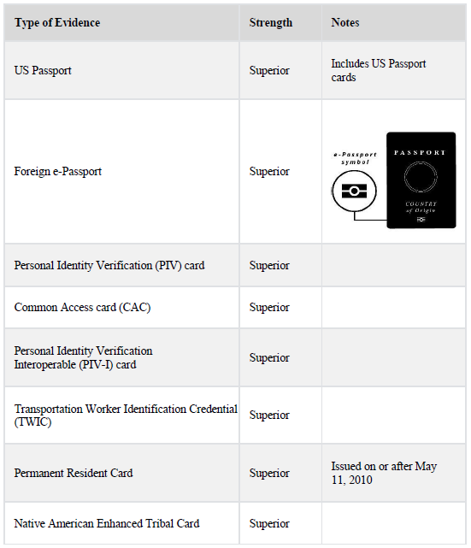
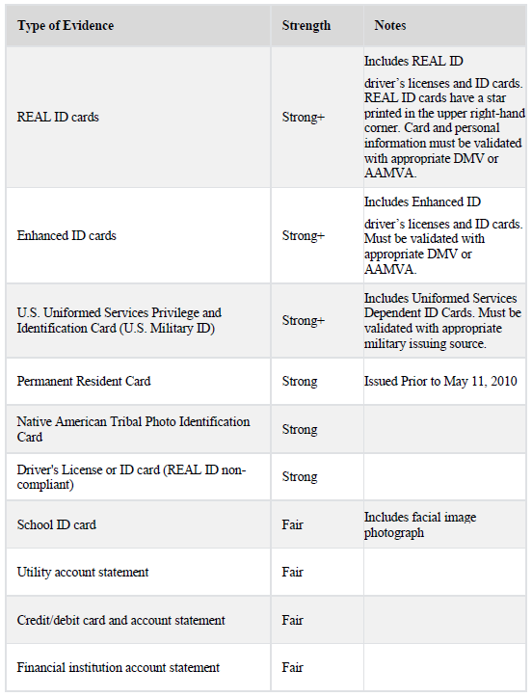
CJIS Security Policy
Identity Evidence – Acceptable Attributes
https://www.wisdoj.gov/
Notes:
In combo #1 the STRONG level mentioned is STRONG+ as it is not specifically stated, however it is mentioned in the policy diagrams.
Can be found in CJISSECPOL v6.0 starting on page 152, categories start on page 153.

Slide 29
CJIS Security Policy
Identity Evidence
Identity Evidence nominal strength combinations
1. One piece of SUPERIOR or STRONG evidence if the evidence’s issuing source, during its identity proofing event, confirmed the claimed identity by collecting two or more forms of SUPERIOR or STRONG evidence and the CSP validates the evidence directly with the issuing source; OR
2. Two pieces of STRONG evidence; OR
3. One piece of STRONG evidence plus two pieces of FAIR evidence
https://www.wisdoj.gov/
Notes:
In combo #1 the STRONG level mentioned is STRONG+ as it is not specifically stated, however it is mentioned in the policy diagrams.
Can be found in CJISSECPOL v6.0 starting on page 152, categories start on page 153.

Slide 30
CJIS Security Policy
Identity Proofing
Non-US Citizens
- The person has “permanent resident” status or holds a valid H1B (Work) Visa.
- The person submits to a national fingerprint check and has no disqualifying responses.
- The Agency performs an IPQ (Portal form 0926) and IAQ (Portal form 0650) NCIC query on the person and has no disqualifying responses.
- The Agency performs a DHS/USCIS eVerify check and no red flags.
- The person submits a verifiable work history, and the hiring supervisor contacts the previous employers.
https://www.wisdoj.gov/
Notes:
IPQ = Interpol query, IAQ = Immigration Alien Query, sent to LESC/ICE.

Slide 31

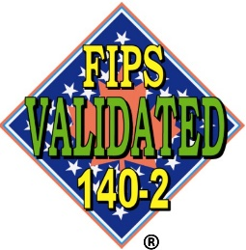
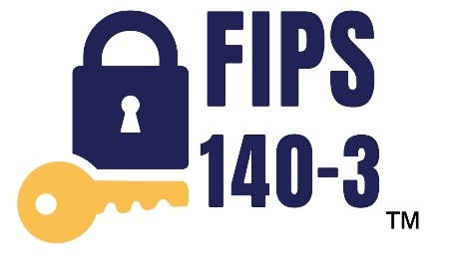
CJIS Security Policy
Encryption
FIPS 140-2 – Acceptable until 9/21/2026 (if already in use)
FIPS 140-3 – New deployments, upgrades, or all after 10/1/2026
Agencies shall employ FIPS 140-3 Certified encryption modules or “FIPS Compliant” encryption for protection of CJI if using FIPS validated algorithms for symmetric key encryption with a cipher key of at least 128-bit strength (in-transit) and 256-bit strength (at rest).
https://www.wisdoj.gov/

Slide 32
CJIS Security Policy
Incident Response
What is a security incident?
A security incident can be defined as any physical or logical security breach that negatively affects an agency’s devices, systems, and/or networks which connect to, store, or handle information traffic containing criminal justice information (CJI), CJIS data (obtained from TIME/NCIC), and/or any confidential information used for the administration of criminal justice & law enforcement.
https://www.wisdoj.gov/

Slide 33
CJIS Security Policy
Incident Response
Agencies are required to have up to date incident response policies.
Incident Response policies/procedures shall be updated annually and following any security incidents involving unauthorized access to CJI or systems used to process, store, or transmit CJI.
Training and testing of the incident response policies follow the same timeframe as above.
Cooperation with local, state, federal agencies is imperative and highly recommended.
https://www.wisdoj.gov/

Slide 34
CJIS Security Policy
Incident Response
Reporting/Notification of Incidents
LE/CJ Agencies are required to notify WI DOJ – CIB within 24 hours of initial discovery of a security incident and shall provide required details of the incident upon request from CIB so that determinations can be made as to any TIME/NCIC system effects.
LE/CJ Agencies are also required to notify the WI Statewide Intelligence Center/DCI (WI DOJ - Division of Criminal Investigation).
https://www.wisdoj.gov/
Notes:
DCI can provide regional CERT team response and assistance as well as provides intelligence to federal entities that are required to be notified as necessary (FBI, CISA, NSA, DOD, etc.)

Slide 35
CJIS Security Policy
Incident Response
Agencies are required to provide CIB with an initial report of incident to include:
the specific type of threat action observed/found (i.e., ransomware, phishing scam, etc.)
when the hostile threat was first observed on the agency network
who was initially notified and for what purpose (provide name, title, contact info)
what initial steps were performed to isolate or prevent extension of the threat
was any extension of the threat found/known prior to contacting higher agencies
what caused delays in notification to logically connected agencies and/or WI DOJ
was there any information found to have been harvested/collected by hostile threat actors
was there any TIME/NCIC system credential harvesting found
*** Regardless of what insurance or any involved legal counsel advise, those items shall be provided to WI DOJ per federal and state requirements to maintain any TIME/NCIC access and connections. Failure to provide all above items will result in total access and connection loss until CIB determines otherwise.***
https://www.wisdoj.gov/
Notes:
Since the TIME System is considered Critical Infrastructure of a National Security Nature, all related policies and requirements for reporting to WI DOJ supersedes those of local or private authority.

Slide 36
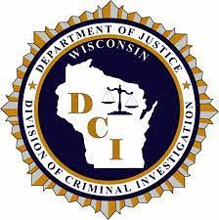
CJIS Security Policy
Incident Response
How do I contact WI DOJ?
CIB
- TIME System Control Center (TSCC), open 24/7/365 – 608-266-7633
- Brian Kalinoski, TIME Ops Manager/WI-ISO – 608-266-7394, brian.kalinoski@wisdoj.gov
- Zach Polachek, PPA-A, TIME & Tech Unit – 608-264-9470, zach.polachek@wisdoj.gov
- Craig Thering, TIME & Tech Manager – 608-261-0667, craig.thering@wisdoj.gov
- Katie Schuh, Deputy Director-TIME System – 608-266-0335, katie.schuh@wisdoj.gov
DCI / WI Statewide Intelligence Center
- 888-324-9742, wsic@doj.state.wi.us
Online form: https://wifusion.widoj.gov/form/cyber-incident-reporting
https://www.wisdoj.gov/

Slide 37
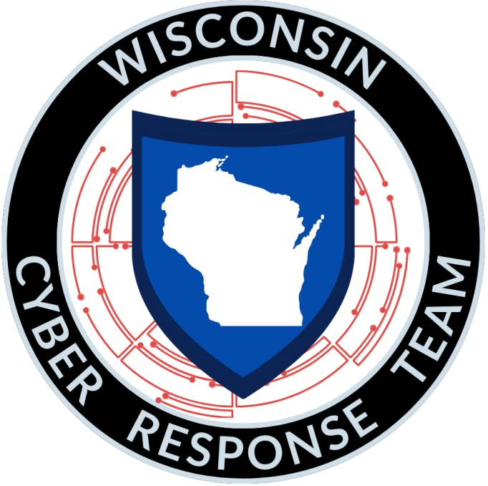
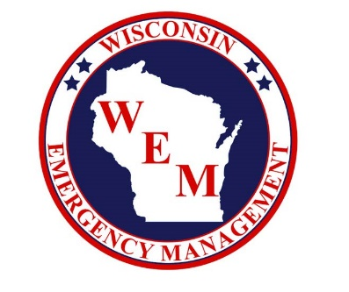

CJIS Security Policy
Incident Response
Wisconsin Cyber Response Team (CRT) - Statewide, all-volunteer network of highly qualified cybersecurity and IT professionals.
To report a cyber incident, call: 1-800-943-0003, option 2
For more information on the CRT, email: crt@widma.gov
https://www.wisdoj.gov/

Slide 38
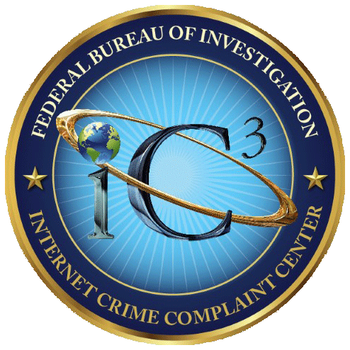
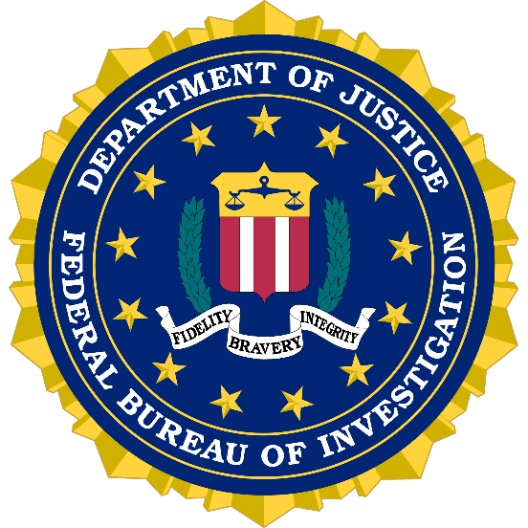
CJIS Security Policy
Incident Response
FBI
Internet Crime Complaint Center (IC3) https://www.ic3.gov/
FBI - Milwaukee Field Office Call: (414) 276-4684 option 7
https://www.wisdoj.gov/

Slide 39
CJIS Security Policy
System & Services Acquisition
Replace system components when support for the components are no longer available from the manufacturer, developer, and/or vendor. *** Windows 10 is EOL/EOS on 10/14/2025 ***
Budget, Budget, Budget! IS Systems and programs are not cheap, but with proper planning you can save money in the long run.
Failure to keep system components up to date is one of the biggest reasons for cyber security breaches as hackers are always looking to exploit vulnerabilities in the systems. Insurance denials for failure to patch, update, and or replace are possible.
https://www.wisdoj.gov/
Notes:
With Encryption standards now moving to FIPS 140-3, agencies should be keeping an eye out to replace their aging infrastructure which may or may not be eligible for upgrades or replacements. The same applies with Windows OS and server updates and upgrades.

Slide 40
CJIS Security Policy
TIME System Misuse
CJISSECPOL section 4.2 - Improper access, use or dissemination of CHRI and NCIC Non-Restricted Files information is serious and may result in administrative sanctions including, but not limited to, termination of services and state and federal criminal penalties.
FOR OFFICIAL USE ONLY! Curiosity checks are prohibited!
Agencies sign access agreements with WI DOJ to access TIME/NCIC.
All queries in the TIME System/NCIC are logged by CIB and FBI.
https://www.wisdoj.gov/

Slide 41
CJIS Security Policy
TIME System Misuse
CJISSECPOL controls: AC-2(3)(c) and AC-2(13) require agencies to disable accounts within 1 week and 30 minutes, respectively.
All potential or found cases of misuse shall be reported to CIB.
Any users found to have committed an intentional misuse of the system will have their TIME access removed. Violations may result in permanent ban of TIME System access and agencies may pursue possible criminal charges on state and/or federal level (depending on nature of violation).
WI ss. 943.70(2); or 28 CFR 20.25
https://www.wisdoj.gov/

Slide 42
CJIS Security Policy
More Resources
NIST – Considerations for Implementing MFA to Protect Criminal Justice Information
- https://www.nccoe.nist.gov/sites/default/files/2024-05/mfa-webinar-05-17-24-presentation.pdf
IJIS Institute (In coordination with FBI CJIS)
CJIS Security Policy Working Group Publications
- https://ijis.org/publications/
CJIS Security Policy Modernization Updates
- Version 5.9.1 - https://ijis.org/community-resources/cjis-security-policy-webinars/#Wby3oQAfnxc
- Version 5.9.2 - https://ijis.org/community-resources/cjis-security-policy-webinars/#KGFvvngYGtI
- Version 5.9.3 - https://ijis.org/community-resources/cjis-security-policy-webinars/#MMJGaoKoUj4
- Version 5.9.4 - https://ijis.org/community-resources/cjis-security-policy-webinars/#JNI0Nfn_CJ8
- Version 5.9.5 - https://ijis.org/community-resources/cjis-security-policy-webinar/#V_yNwWcZjtE
- Version 6.0 - https://ijis.org/community-resources/cjis-security-policy-webinar/#Jg-OBwQ8h_Q
https://www.wisdoj.gov/

Slide 43
CJIS Security Policy
More Resources
NIST SP 800-53 Security and Privacy Controls for Information Systems and Organizations - https://nvlpubs.nist.gov/nistpubs/SpecialPublications/NIST.SP.800-53r5.pdf
NIST SP 800-63-3 Digital Identity Guidelines - https://doi.org/10.6028/NIST.SP.800-63-3
NIST SP 800-63A Enrollment & Identity Proofing - https://doi.org/10.6028/NIST.SP.800-63a
NIST SP 800-63B Authentication & Lifecyle Management - https://doi.org/10.6028/NIST.SP.800-63b
NIST SP 800-63C Federation & Assertions - https://doi.org/10.6028/NIST.SP.800-63c
NIST SP 800-88 Guidelines for Media Sanitization - https://nvlpubs.nist.gov/nistpubs/SpecialPublications/NIST.SP.800-88r1.pdf
DOD National Industrial Security Program Operating Manual (NISPOM), 32 CFR 117 - https://www.ecfr.gov/current/title-32/subtitle-A/chapter-I/subchapter-D/part-117
https://www.wisdoj.gov/

Slide 44

Audit Questions?
https://www.wisdoj.gov/
Notes:
For a copy of this PowerPoint you can contact me.

Slide 45
Questions, Comments, Concerns?
Contact the TIME & Technical Unit and/or TSCC
CIBTRAIN@WISDOJ.GOV
CIBPSN@WISDOJ.GOV
ETIME@WISDOJ.GOV
TIMEBILLING@WISDOJ.GOV
CIBAUDIT@WISDOJ.GOV
TSCC@WISDOJ.GOV
https://www.wisdoj.gov/
Notes:
For a copy of this PowerPoint you can contact me.

Slide 46
Thank You!

