Slide 1


CIB Audits
September 2023

Slide 2
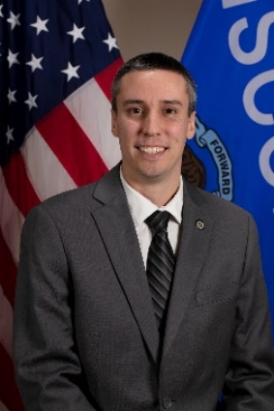
TIME & Tech Manager
Craig Thering
Craig returned to the TIME and Technical Unit in February 2023 to fill the TIME and Technical Manager position which was left vacant after Katie Schuh’s promotion to Deputy Director last year. Craig began his career with CIB in 2013 with the Firearms Unit and then in 2014, he joined the TIME and Technical Unit as a Program and Policy Analyst where he spent six years helping to keep the TIME System running. In December 2020, Craig accepted a new position as a Criminal History Unit Manager, working to ensure the criminal history repository was maintained in accordance with Wisconsin State Statute 165.83. Craig is excited to be back in the TIME and Technical Unit and welcomes any feedback or suggestions on how we can improve the TIME System.
https://www.doj.state.wi.us/
Notes:
Welcome and provide brief intros on staff

Slide 3
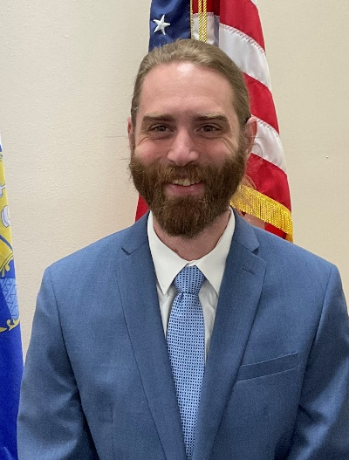
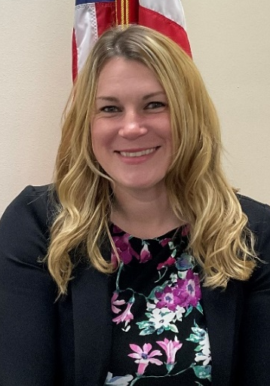
Trainers
Ben Brandner
Sarah Cook
Ben Brandner is a Training Officer with the Wisconsin Department of Justice. Ben joined the Wisconsin Department of Justice as Justice Program Associate in 2015. He has been with the TIME & Tech unit since 2021. Ben previously worked in the hospitality industry as a food safety trainer
Sarah Cook is a Training Officer with the Wisconsin Department of Justice and has been with the unit since 2021. Prior to that, Sarah worked for the Waukesha County Communications Center (911 dispatch center) as a dispatcher for over 14 years and trained new hires both on the job and in the classroom for 11 years.
https://www.doj.state.wi.us/

Slide 4
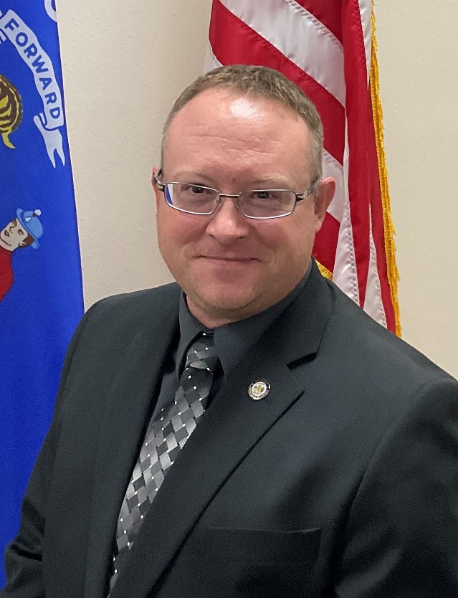
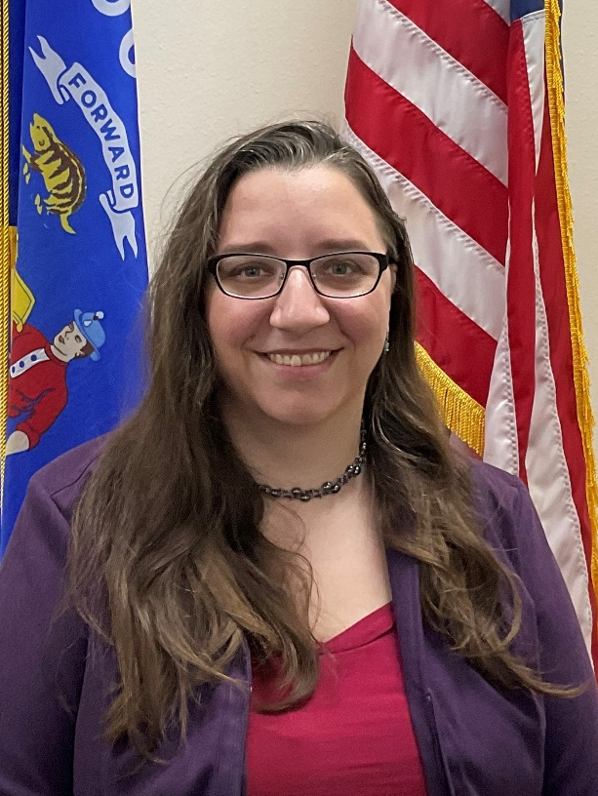
Program & Policy Analysts (PPAs)
Zach Polachek
Jeanette Devereaux-Weber
Zach is the Program & Policy Analyst-Advanced for the Crime Information Bureau at the Wisconsin DOJ. Zach started with WI DOJ in 2012 as a Firearms Unit LPPA. He transferred to the TIME & Tech Unit in 2015 as Program & Policy Analyst. Zach has been in the TIME & Tech Unit for 8 ½ years and has completed the FBI Level 1 Cyber Investigator Certification Program.
Jeanette Devereaux-Weber has been a Program & Policy Analyst for the TIME & Technical Unit since 2019. She started her WI DOJ career in the Criminal History Unit as a Criminal History Records Specialist in 2012.
https://www.doj.state.wi.us/

Slide 5
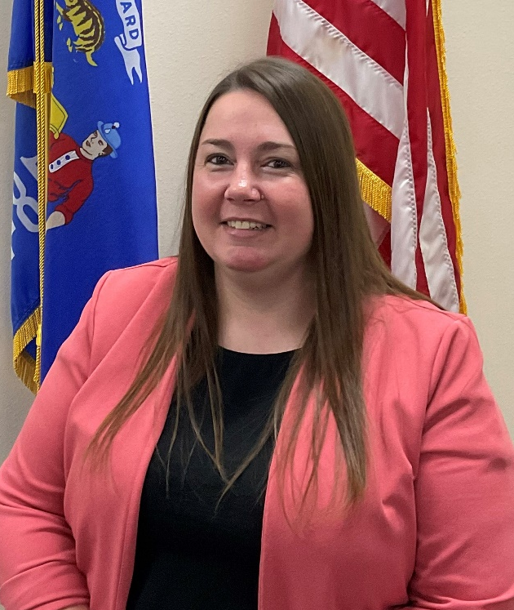
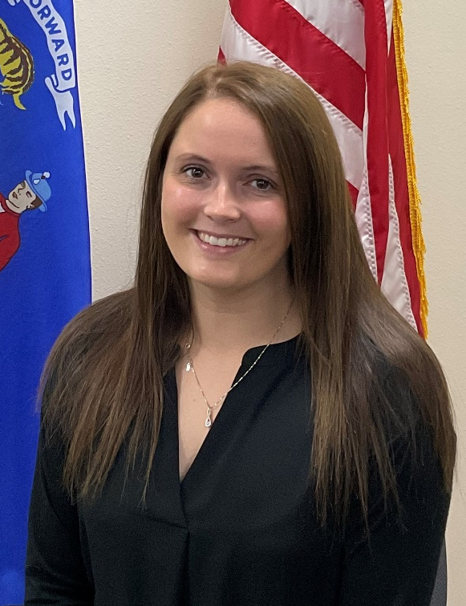
Program & Policy Analysts (PPAs) continued
Jennifer Virgin
Megan Smaby
Jenn started in CIB in 2017 as a member of the Firearms Unit. In March of 2018 she transferred to the Department of Revenue. Jenn returned to the Firearms Unit in January 2019 as a JPA Senior. In October 2021, Jenn was promoted to JPA Advanced. She has helped update training manuals, trained new hires, and has been a resource for other team members. In August 2023, she accepted a new role as a Program and Policy Analyst in the TIME and Technical Unit. Jenn is excited to learn more about the TIME System.
Megan joined the TIME and Tech Unit in 2023. Megan Smaby started in CIB in 2016 has an LTE for the Firearms Unit. She has spent the last 7 years conducting background checks for Wisconsin Concealed Carry licenses, HR218 certifications, and handgun purchases. In addition, she assisted law enforcement agencies in completing their firearm return checks. She is leaving the Firearms Unit as an Advanced Justice Program Associate and is looking forward to her new role as a Program and Policy Analyst with the TIME and Technical Unit.
https://www.doj.state.wi.us/

Slide 6
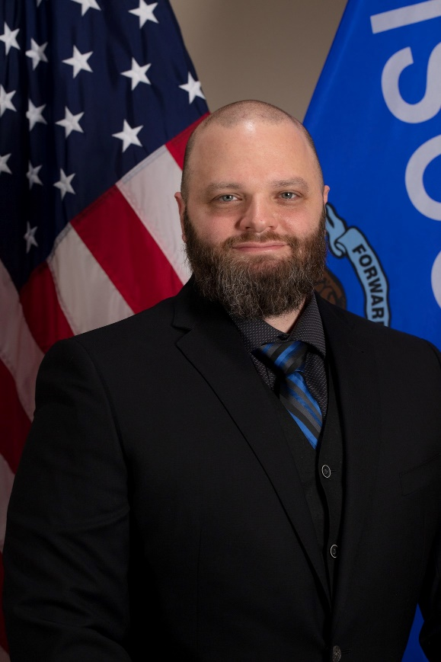
TIME System Operations Manager
Brian Kalinoski
Brian returned to DOJ in July of 2021, taking over the TSCC (TIME System Control Center) Operations Manager position. Brian has been with the State of Wisconsin for 18 years and has worked in the Department of Health Services, Department of Corrections, Department of Transportation, and most notably, 12 of those years in TSCC.
https://www.doj.state.wi.us/

Slide 7
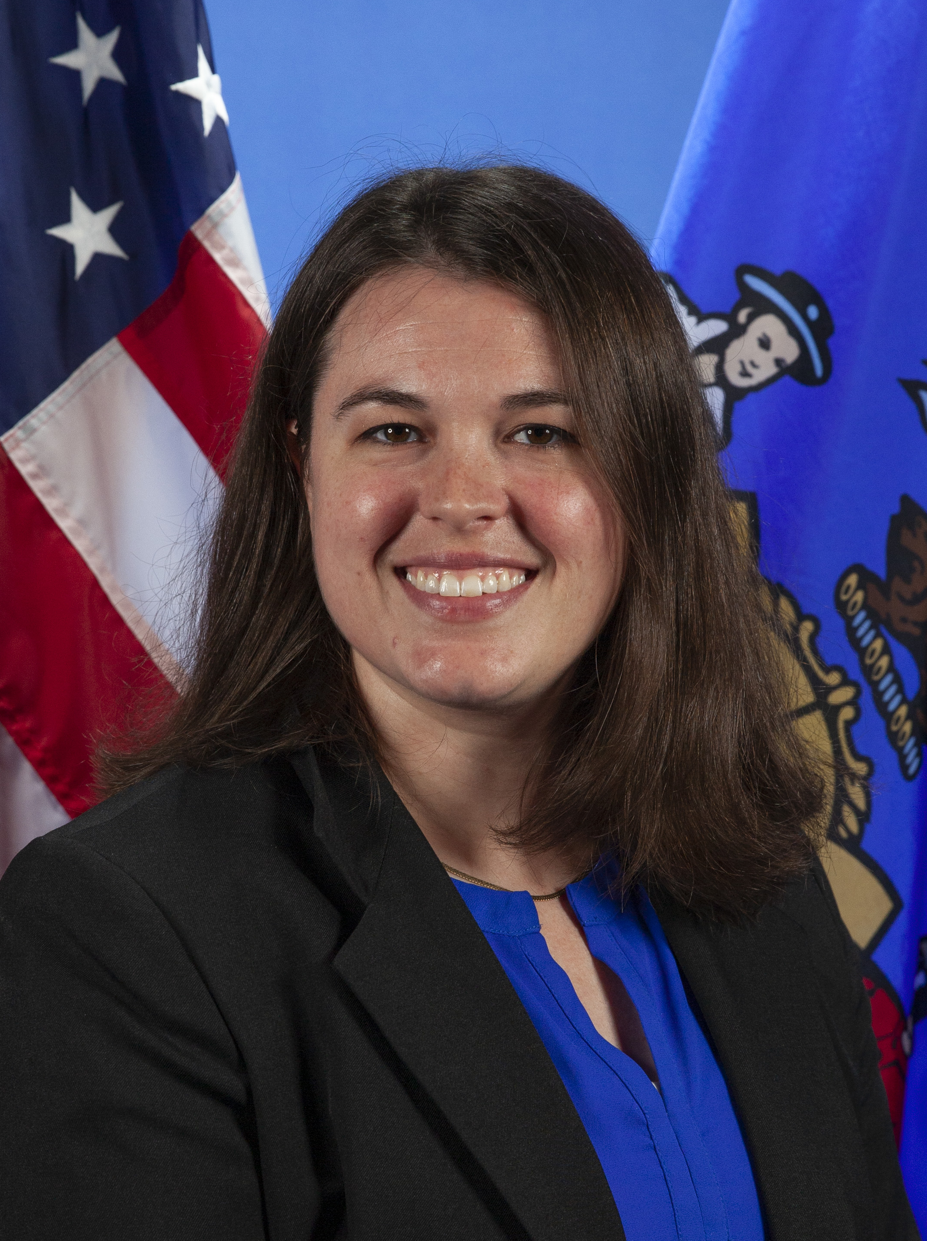

Recent Departures
Emily Freshcorn
Emily Freshcorn was the Senior Training Officer in the Crime Information Bureau of the Wisconsin Department of Justice and has been with the unit since 2016. She will be returning to her home state and will be missed!
https://www.doj.state.wi.us/

Slide 8
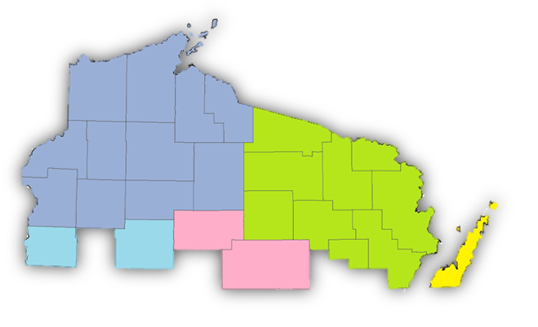
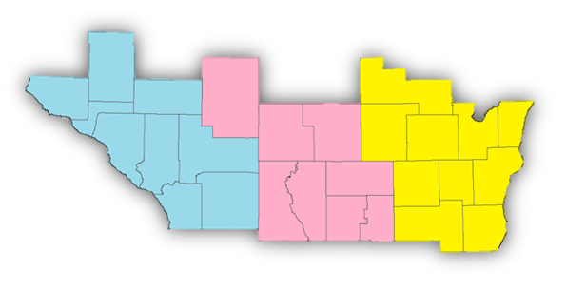
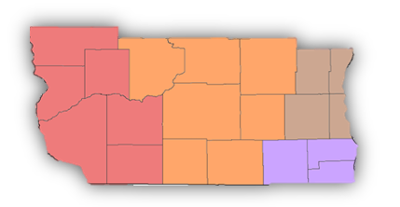
Audit Cycle
3 Year Cycle
Map provided by
State Cartographer’s Office
Audits are done in a 3-year cycle
Mostly geographical by county
DA’s offices, DOC, DNR, State Patrol
other agencies in multiple counties
Agencies joining the TIME system
Currently in year 3 of cycle
Next cycle is 2024-2026
3rd year
2nd year
1st year
https://www.doj.state.wi.us/
Notes:
When scheduling your agencies audit, we try to keep you in the same month you were in the previous audit. It doesn’t always work out that way.
We start with the counties within that section of the state and then find all other agencies within that same county and attempt to audit them in the same month.
The county sheriff office audits are split up between the 3 training officers. If your agency enters records, a training officer will also handle your audit.
Any agency that only queries the TIME system via Portal or eTIME will be audited by either a Training Officer or a Program and Policy Analyst.

Slide 9

Audit Process Overview
Overview
Agencies are audited by CIB on a triennial basis (every 3 years)
Audits are primarily done online now via Peak Performance; however, CIB reserves the right to conduct on-site audits at any time
Audit questionnaires and packet
Technical Security Questionnaires
https://www.doj.state.wi.us/
Notes:
Agencies are audited by CIB on a triennial basis to make sure they are in compliance with the requirements of the CJIS Security Policy. Currently, we are in the last year of the cycle and will be starting a new cycle in 2024.
Audits are primarily done online now via Peak Performance; however, CIB has completed on site audits in the past and may be returning to that in the near future.
Agencies will receive 1-2 audit questionnaires depending on the type of agency they work for (DA offices and S ORI agencies usually only get 1, while all other agencies receive a TIME questionnaire as well as a Technical questionnaire).
Auditors will put together a packet of information that includes items such as agency rosters, PSN (physical station number) list, CHRI query lists, different types of agreements, etc.
The TIME And Tech unit uses the most current version of the CJIS Security Policy (currently 5.9.2) to create the questions in the Technical Security Questionnaire to ensure agencies are staying compliant with all of the requirements. Some of those requirements may be future requirements (for example: there are several requirements in the current technical questionnaire that must be met by October of 2023, while others will not need to be met/implemented until October 2024).

Slide 10
What is the CJIS Security Policy?
Criminal Justice Information Services Security Policy
What is CJI (Criminal Justice Information)?
Law enforcement needs
CJIS Security Policy contents (requirements, guidelines, and agreements)
Premise of the CJIS Security Policy
Policy assists agencies
Updated regularly by Advisory Policy Board (APB)
https://www.doj.state.wi.us/
Notes:
What is CJI? Criminal Justice Information is the abstract term used to refer to all of the FBI CJIS provided data necessary for law enforcement agencies to perform their mission and enforce the laws, including but not limited to: biometric, identity history, person, organization, property (when accompanied by any personally identifiable information), and case/incident history data. In addition, CJI refers to the FBI CJIS-provided data necessary for civil agencies to perform their mission; including, but not limited to data used to make hiring decisions. The following type of data are exempt from the protection levels required for CJI: transaction control type numbers (e.g., ORI, NIC, UCN, etc.) when not accompanied by information that reveals CJI or PII.
Law enforcement agencies need to be able to access the services that provide them information to assist in stopping and reducing crime in a timely and secure manner.
The CJIS Security Policy contains information security requirements, guidelines and agreements reflecting the will of law enforcement and criminal justice agencies for protecting the sources, transmission and generation of Criminal Justice Information.
The premise of the policy is to provide appropriate controls to protect the full lifecycle of CJI (at rest or in transit.) The CJIS Security Policy provides guidance for the creation, viewing, modification, transmission, dissemination, storage, and destruction of CJI. This Policy applies to every individual—contractor, private entity, noncriminal justice agency representative, or member of a criminal justice entity—with access to, or who operate in support of, criminal justice services and information.
The security criteria assists agencies with designing and implementing systems to meet the security requirements, while keeping current technology and potential security threats in mind.
The policy is updated regularly to comply with advancements in technology and new risk information. The most recent version of the policy (5.9.2) was released in December of 2022, but prior to that 5.9.1 was just released in October of 2022. The policy is currently undergoing a major overhaul and the formatting of it is changing. The CJIS Division works with the Advisory Policy Board (APB), which is comprised of heads of agencies all over the nation who vote on policy changes at regular meetings.

Slide 11
Why Every 3 Years?
CJIS Security Policy 5.9.2 Section 5.11.1
CJIS Security Policy requirement!
CIB audits every agency with TIME access
3 years as a minimum
Can be conducted more frequently
Keeping up with the times
https://www.doj.state.wi.us/
Notes:
Review section 5.11.2 of the CJIS Security Policy for what the FBI requires of CIB.
Audits may be conducted on a more frequent basis if the audit reveals that the agency has not complied with applicable statutes, regulations and policies.
The State Identification Bureau (SIB) and CJIS Systems Agency (CSA) = Crime Information Bureau (CIB) are audited by the FBI to ensure they are in compliance; therefore, CIB audits each agency every 3 years to ensure individual agency compliance.
Agencies are audited due to their access to CJI (Criminal Justice Information) and the FBI requires all agencies who have access to that information to properly protect it and to follow all applicable statutes and FBI requirements.
Technology is ever-changing and it is important to stay ahead of current threats.

Slide 12
Who Performs Your Audits
Crime Information Bureau – TIME & Technical Staff
The members of the TIME and Technical Unit involved in your audit are as follows:
TIME & Technical Manager
3 Training Officers
4 Program & Policy Analysts
TIME Systems Operations Manager
When necessary, the Deputy Director & Director of CIB will get involved
https://www.doj.state.wi.us/

Slide 13
Audit Cycle
3 Year Cycle
Map provided by
State Cartographer’s Office
Audits are done in a 3-year cycle
Mostly geographical by county
DA’s offices, DOC, DNR
other agencies in multiple counties
Agencies joining the TIME system
Currently in year 3 of cycle
Next cycle is 2024-2026
3rd year
2nd year
1st year
https://www.doj.state.wi.us/
Notes:
When scheduling your agencies audit, we try to keep you in the same month you were in the previous audit. It doesn’t always work out that way.
We start with the counties within that section of the state and then find all other agencies within that same county and attempt to audit them in the same month.
The county sheriff office audits are split up between the 3 training officers. If your agency enters records, a training officer will also handle your audit.
Any agency that only queries the TIME system via Portal or eTIME will be audited by either a Training Officer or a Program and Policy Analyst.

Slide 14
Online vs. In Person Audits
How Audits are Done…
Prior to 2017, audits were either done via mail or in person.
In 2017, the auditing software (Peak Performance / CJIS Audit) was deployed.
COVID pandemic impact on how audits are done
On-site audits will begin again and can be done as needed currently
2022 FBI Audit
Security Incidents impact on audits
https://www.doj.state.wi.us/
Notes:
Audits use to be done either via mail or in person
In 2017, the auditing software (Peak Performance / CJIS Audit) was deployed; however, CIB still performed on-site audits.
When Peak Performance was deployed in 2017, this allowed for CIB to launch audit questionnaires online and for agencies to send their responses back the same way. Although this was a great option, CIB continued to perform in-person / on-site audits.
Due to the COVID pandemic, the online questionnaires took over in 2020 and on-site audits were put on hold until further notice.
Although on-site audits were temporarily halted, they will be continuing in the near future and can be done on an as-needed basis now.
The FBI did go out and do some on-site audits for several agencies in 2022
If an agency experiences a cyber security incident, there is a high likelihood that they will receive a field audit from either CIB or potentially the FBI.

Slide 15
Audit Details & Audit Materials
What to Expect
Two emails from a CIB Auditor
Audit Details and Audit Materials
TIME vs. Technical Questionnaires
Audit categories
30 days to respond to questionnaires and return materials
Many updates to CJIS Security Policy
CJIS SP available at fbi.gov/cjis
Follow-up emails from CIB Auditor
https://www.doj.state.wi.us/
Notes:
The agency head or TAC will receive 2 emails from a CIB auditor (either a Training Officer or Program & Policy Analyst).
One email will have the audit details while the other will contain a packet with audit materials. The audit details email will have the link to access CJIS Audit / Peak Performance. It also provides the password to access the encrypted audit material packet that will be available in the audit materials email.
The level of TIME System access your agency has will determine what kind of audit your agency will receive as well as what items will be included in the audit materials.
District Attorney’s offices get one questionnaire for their TIME System access and then DAIT handles the Technical Questionnaire for all DA’s offices. S ORI agencies (parking enforcement agencies) get one questionnaire.
eTIME is the agency with the least amount of access that gets 2 questionnaires. eTIME agencies have no PSNs (physical station numbers) and have fewer technical requirements necessary, so they have less questions they have to answer.
Agencies that have PSNs, but don’t host their own interface will receive the Standard Technical questionnaire. If they enter records, they will receive an Entry TIME questionnaire; but if they only query records, they will receive a Query TIME questionnaire.
Agencies that host their own interface will receive the longest technical questionnaire as there are many requirements with regards to the CJIS Security Policy. This questionnaire is where you will see many new questions/updates.
Your agency has 30 days to send the initial questionnaire back in along with the audit materials
CJIS Division — LE (fbi.gov) Click on the CJIS Security Policy Resource Center to access the most recent version of the policy as well as some other links (NIST where you can check on FIPS certificates) and the CJIS Security Policy companion document
You should be in regular contact with your auditor and send emails if you have questions. Once the initial questionnaire is sent back, the auditor will respond and then your agency will be responsible for responding / acknowledging the response items from the auditor.

Slide 16
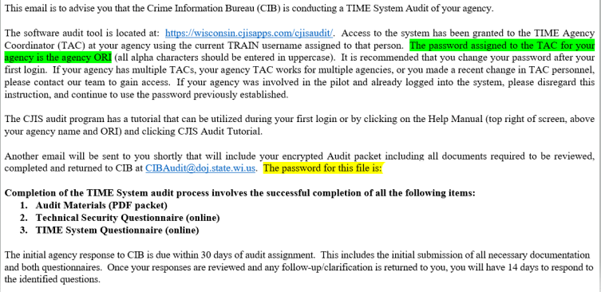
Audit Details Email
https://www.doj.state.wi.us/
Notes:
This first email advises the agency that they are being audited and alerts them as to what documents to expect as well as the CJIS Audit website and the password for logging into the materials packet that they will receive in a separate email.

Slide 17
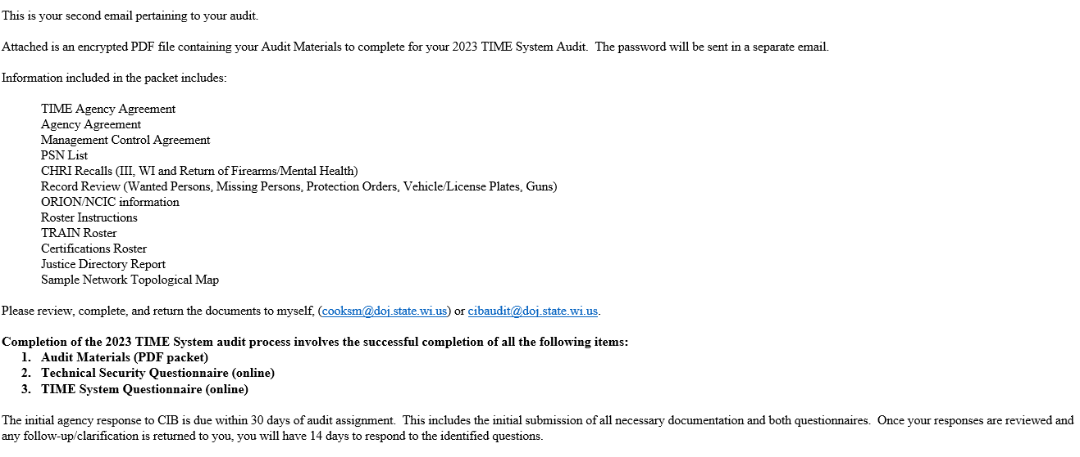
Audit Materials Email
https://www.doj.state.wi.us/
Notes:
This email will give you a run down of what materials will be included in the audit and further instructions on what needs to be completed as well as a timeframe. The packet of materials will be attached to this email.
The packets typically include the following items:
CIB Agency agreement (which is required to be signed)
Management Control Agreement (only required if you have a private IT company or the IT department is not part of the police/sheriff’s office, or if you have a separate dispatch center or pre-trial services) – This must be signed by the agency as well as the non-criminal justice agency before being returned
PSN List (not all agencies have Physical Station Numbers – PSNs) Agencies who are eTIME only will not receive this document, but if you have even just one PSN, you will be required to fill out the form and indicate if it is active or inactive and sign it.
CHRI Recalls (III, WI & Return of Firearm/Mental Health Records) – CIB staff will take a sampling of 25 queried recalls in each category to determine if your agency is properly filling out attention line, using proper purpose codes, asking the reason for the query and ultimately what is done with it. Agencies must provide responses to these spreadsheets and CIB will provide feedback if necessary
Record Review (If your agency enters records, CIB trainers will request that you answer applicable questions in the questionnaire for up to 10 wanted persons, up to 5 missing persons, up to 10 vehicles/plates, up to 5 protection orders and up to 5 stolen/recovered/lost gun records).
ORION/NCIC information – This document does not have to be sent back unless there are changes that need to be made to the agency’s address or phone number(s), etc.
Roster & Roster Instructions – CIB Staff will use TRAIN to determine what personnel are all on your agency’s roster and send back a spreadsheet. Your agency must indicate if each person is active or inactive and this sheet MUST BE SIGNED.
Certification Roster – CIB staff will run a certification report for the agency. This will assist the agency in determining if anyone’s certification has lapsed, but also will show if anyone is still showing on the roster that should no longer be on it. The agency does not need to send this back unless there are changes that need to be made. If someone’s certification has lapsed, the TAC can go ahead and register the user and have the user take the recertification as soon as possible.
Justice Directory Report – CIB staff prepares this to show agencies what rights each individual user has for the agency. If a user has too many rights or need rights to be added, they can contact CIB directly to get that information updated. This document does not have to come back to CIB though.
Sample Network Diagram – CIB provides a sample network diagram so that agencies have a better understanding of what at minimum is required for a network drawing and it might help an agency determine if they are missing something from their network. Not all agencies will have to submit one. Agencies that are eTIME only will not need to submit one.

Slide 18
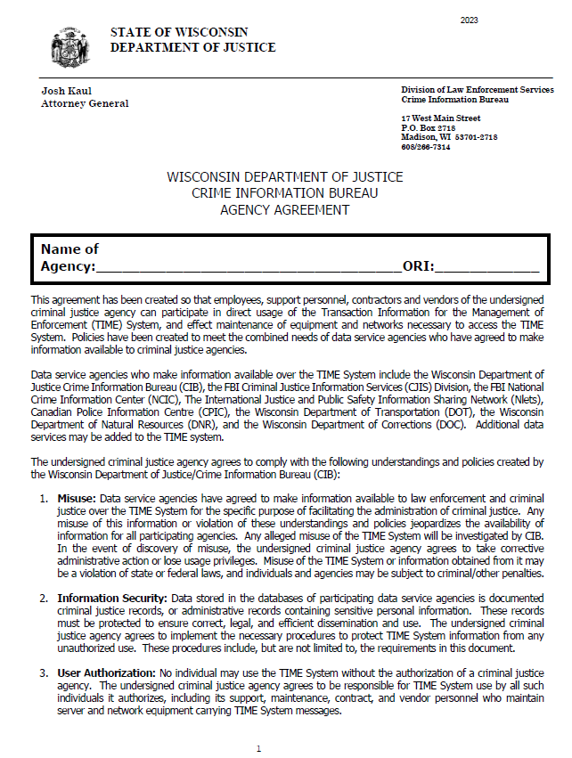
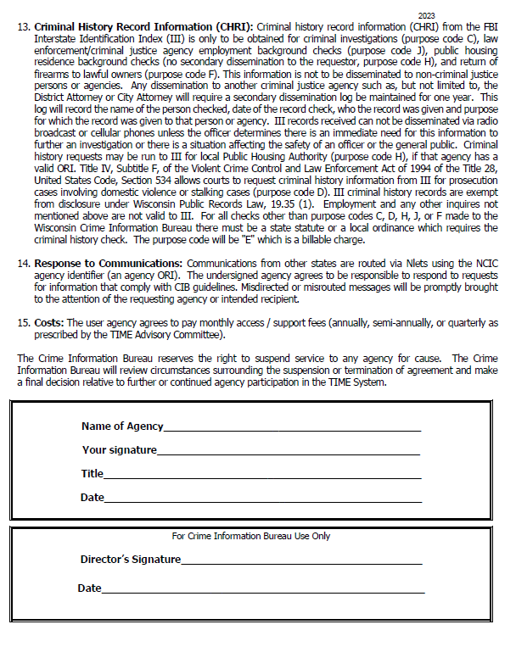
TIME/CIB Agency Agreement
https://www.doj.state.wi.us/
Notes:
The TIME/CIB Agency agreement goes over a summary of CIB’s requirements of all agencies and the agency must agree to comply with those requirements in order to have access to the TIME system.
This document is required to be signed and returned.
This is a 4-page document and all pages must be returned to CIB.
The first page requires the name of the agency and the agency’s ORI.
The last page requires the name of the agency, a signature by whomever has “signing authority” with the agency, their title and the date it was signed.
S ORI agencies will receive a different looking agreement.

Slide 19
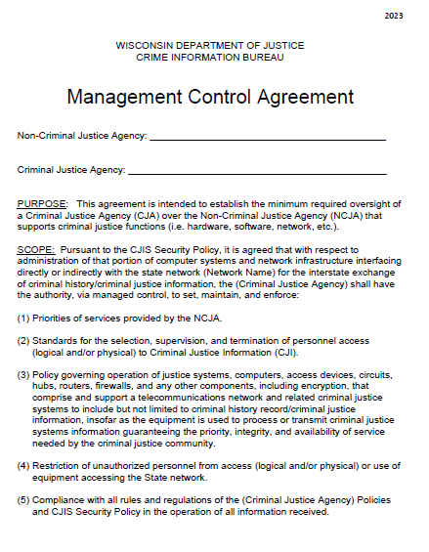
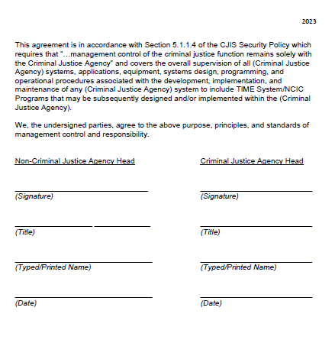
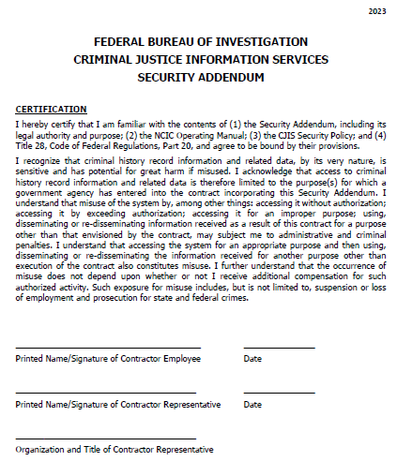
Management Control Agreements
https://www.doj.state.wi.us/
Notes:
Management Control Agreements (MCAs) are only required if you have a private IT company or the IT department is not part of the police/sheriff’s office, or if you have a separate dispatch center or pre-trial services – basically any non-criminal justice agency that you are sharing CJI with.
This must be signed by the agency as well as the non-criminal justice agency before being returned.
This document will not apply to all agencies. Perhaps your agency doesn’t use any outside IT vendors or your dispatch center is part of your police or sheriff’s office. If that is the case, this document does not apply to you and does not need to be signed.
If the document does apply to your agency, the name of the Non-Criminal Justice Agency (IT Vendor, outside dispatch center, etc.) will need to go in the first line. Your agency name will go in the second line.
This document is only 2 pages. On the second page, the Non-Criminal Justice agency head (dispatch center director or manager, head of IT or IT company owner) will need to add their signature, title, print their name and date the left side of the document. The signing authority for the criminal justice agency will need to add their signature, title, printed name and date to the right side of the document.
If the MCA (Management Control Agreement) applies to your agency, both pages will need to be filled out and returned to your CIB auditor.
Attached to the MCA is a 3-page security addendum. If your agency is working with any non-criminal justice agencies, EVERY person from that agency that has access to your system is required to sign the Security Addendum. Your agency should keep a copy of those signed security addendums, but they do not need to be returned to CIB.

Slide 20
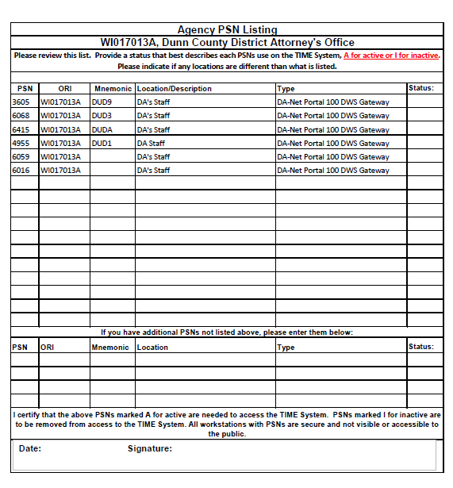
Physical Station Number (PSN) list
The agency must indicate the status of the PSN (A = Active or I = Inactive) in the column on the right.
The document must be signed and dated as well.
https://www.doj.state.wi.us/
Notes:
PSN List (not all agencies have Physical Station Numbers – PSNs)
Agencies who are eTIME only will not receive this document.
Agencies that have either a mobile computer or access to Portal, will receive this document.
Even if your agency has just one PSN, you will still be required to fill out the form and indicate if it is active or inactive, sign and date it and return it to CIB staff.

Slide 21
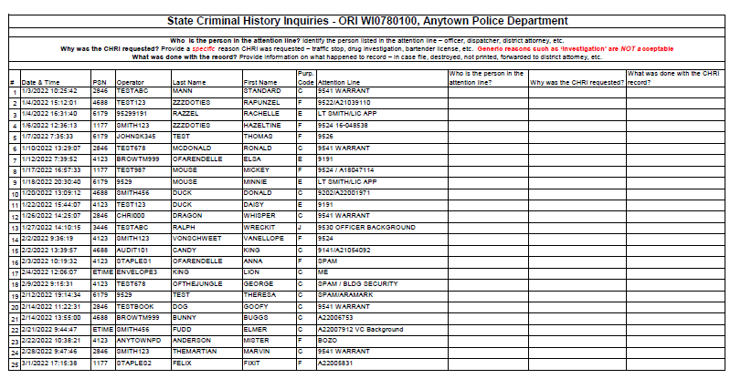
CHRI Queries / Recalls
https://www.doj.state.wi.us/
Notes:
CHRI Recalls (III, WI & Return of Firearm/Mental Health Records) –
CIB staff will take a sampling of 25 queried recalls in each category to determine if your agency is properly filling out attention line, using proper purpose codes, etc.
The agency must identify the person in the attention line and must provide the reason for the query and ultimately what is done with it.
Agencies must provide responses to these spreadsheets and CIB will provide feedback if necessary.

Slide 22
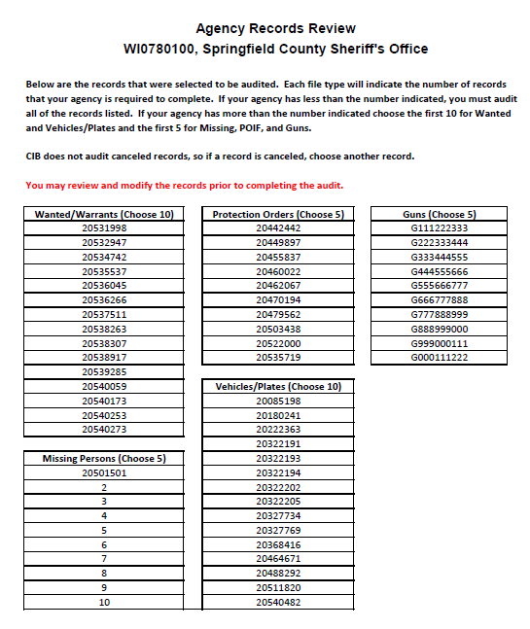
Records for Review
https://www.doj.state.wi.us/
Notes:
Record Review (If your agency enters records, CIB trainers will request that you answer applicable questions in the questionnaire for up to 10 wanted persons, up to 5 missing persons, up to 10 vehicles/plates, up to 5 protection orders and up to 5 stolen/recovered/lost gun records). You may pick your “best records” and you can also if you encounter errors, you can update them before CIB reviews the records.

Slide 23
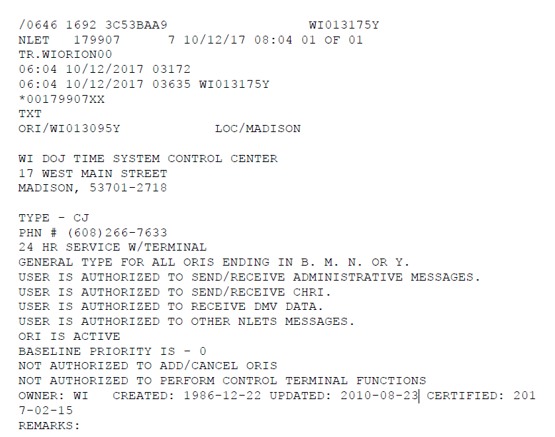
NCIC / ORION File Verification
https://www.doj.state.wi.us/
Notes:
ORION/NCIC information – This document does not have to be sent back unless there are changes that need to be made to the agency’s address or phone number(s), etc.

Slide 24
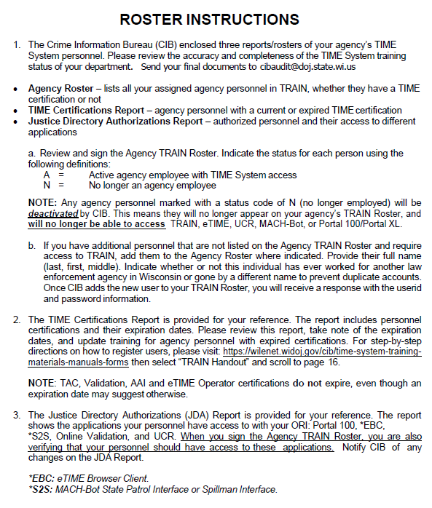
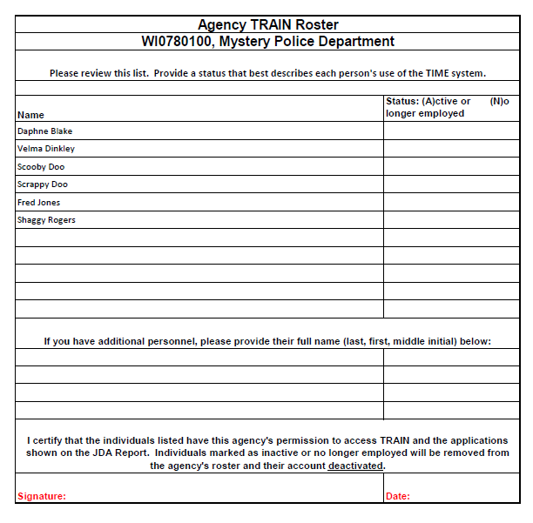
Agency TRAIN Roster & Instructions
https://www.doj.state.wi.us/
Notes:
Roster & Roster Instructions – CIB Staff will use TRAIN to determine what personnel are all on your agency’s roster and send back a spreadsheet. Your agency must indicate if each person is active or inactive and this sheet MUST BE SIGNED and dated.
The roster instructions provides instructions for the certifications reports and justice directory authorizations as well.

Slide 25
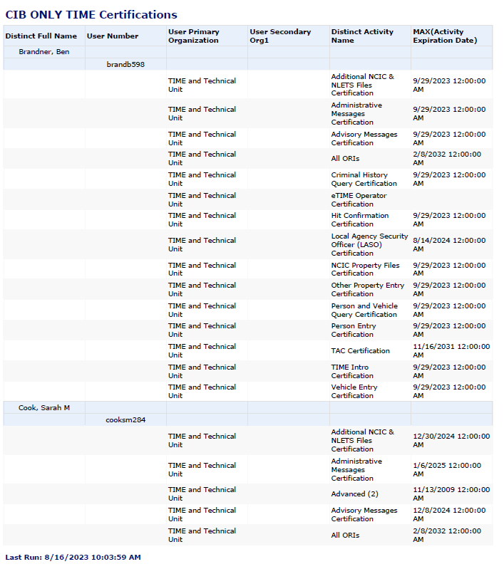
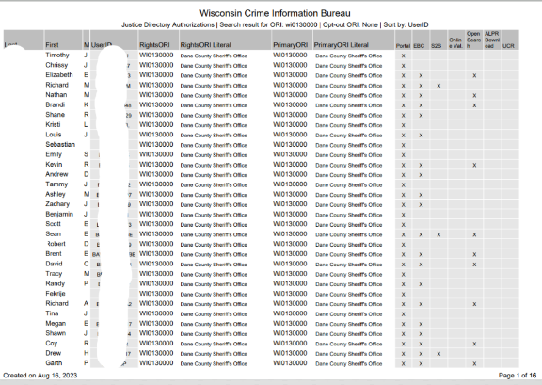
Certifications Roster & JDA Report
https://www.doj.state.wi.us/
Notes:
Certification Roster – CIB staff will run a certification report for the agency. This will assist the agency in determining if anyone’s certification has lapsed, but also will show if anyone is still showing on the roster that should no longer be on it. The agency does not need to send this back unless there are changes that need to be made. If someone’s certification has lapsed, the TAC can go ahead and register the user and have the user take the recertification as soon as possible.
Justice Directory Report – CIB staff prepares this to show agencies what rights each individual user has for the agency. If a user has too many rights or need rights to be added, they can contact CIB directly to get that information updated. This document does not have to come back to CIB though.

Slide 26
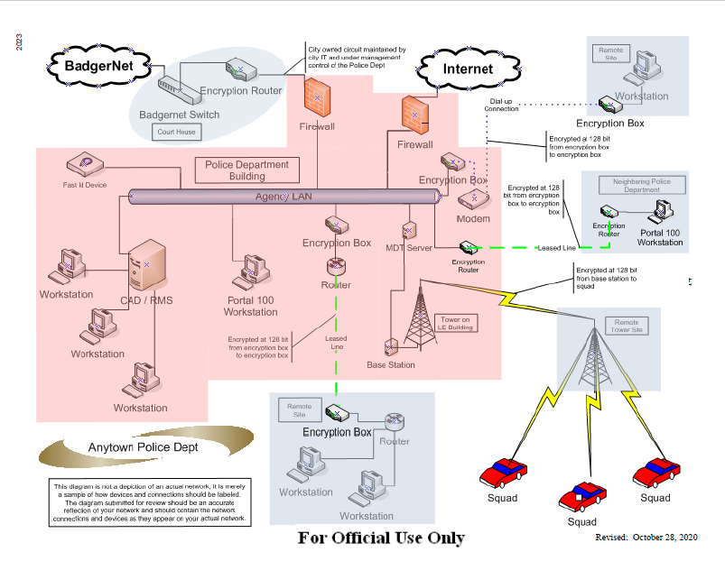
Sample Network Diagram
https://www.doj.state.wi.us/
Notes:
Diagram – CIB provides a sample network diagram so that agencies have a better understanding of what at minimum is required for a network drawing and it might help an agency determine if they are missing something from their network. Not all agencies will have to submit one. Agencies that are eTIME only will not need to submit one.

Slide 27
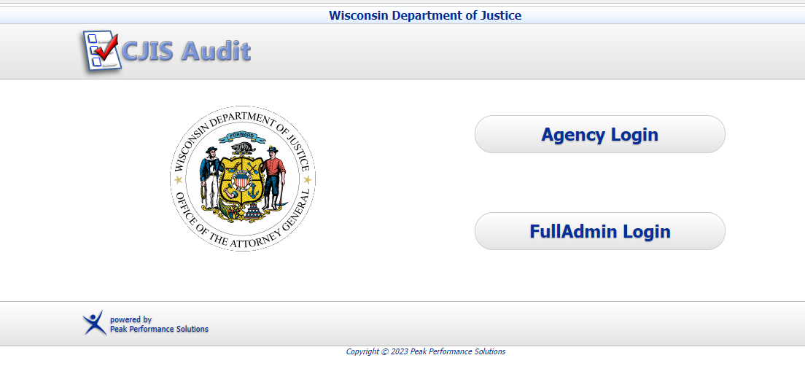
Peak Performance / CJIS Audit
Agencies will need to use the “Agency Login” to access their questionnaires.
Agencies can access the Peak Performance site via the following URL:
https://wisconsin.cjisapps.com/cjisaudit/.
https://www.doj.state.wi.us/

Slide 28
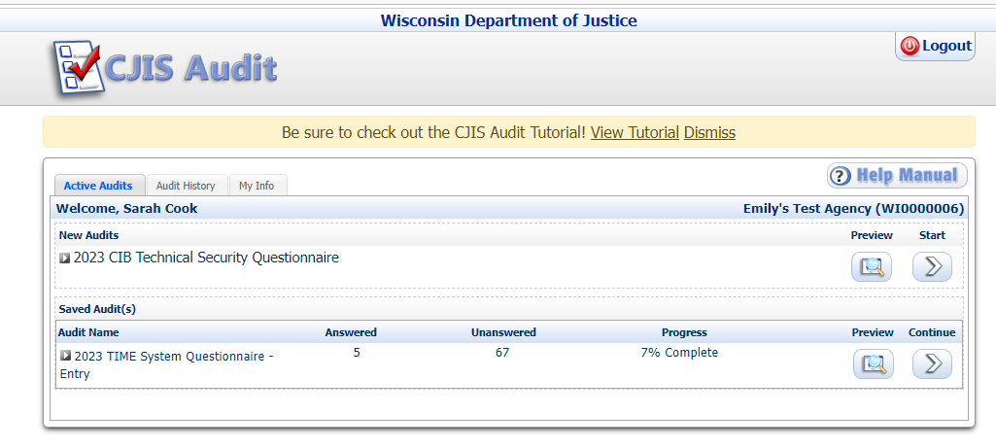
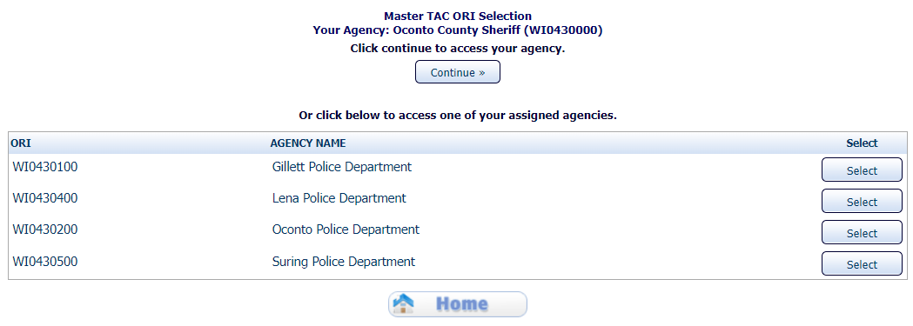
Peak Performance Agency Login
https://www.doj.state.wi.us/
Notes:
Once the user logs in using their TRAIN log in and the assigned password, they will be taken to their CJIS Audit home page and be able to see their Active Audits.
Note: If an individual is a shared TAC, they will see a list of the different agencies they can answer for and will have to select that agency first.
In the above example, the agency has a Technical Security Questionnaire that has not been started yet listed under “New Audits” and then any audits that have been started will be listed under “Saved Audit(s).
For any audits not started, an agency can first “preview” the audit before starting it.
For any audits that have been started, the agency can see their progress percentage as well as how many questions have been answered vs unanswered. The user can preview the progress or continue on with the questions.
Note that there is a Tutorial available for CJIS Audit. You can click on “View Tutorial” in the yellow bar at the top. There are multiple training tutorials available including how to perform an audit, viewing audit results, managing information, new features, etc.

Slide 29
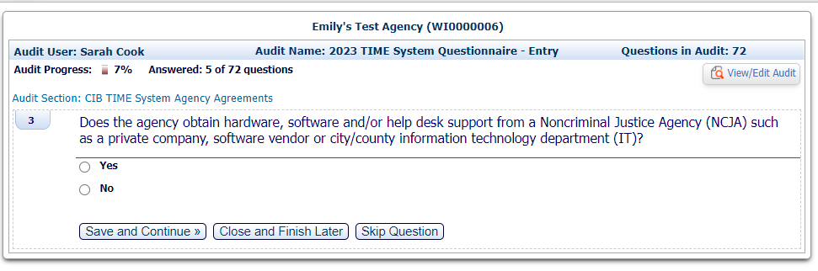
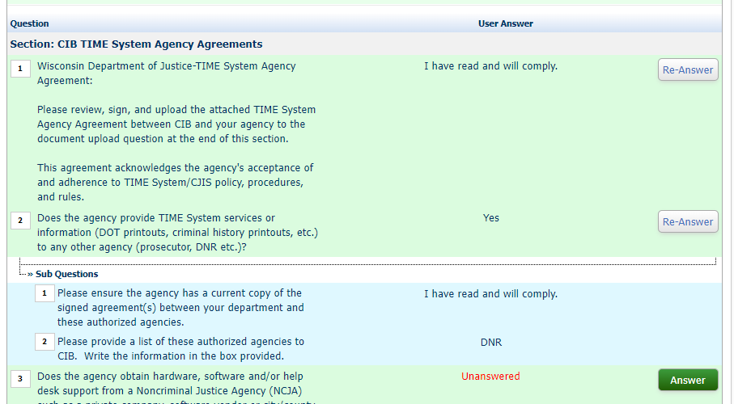
Audit Questionnaires in CJIS Audit
Peak Performance users can choose to answer a question (save & continue), close and finish later or skip the question.
If the user wants to view the whole audit, they can click on the View/Edit Audit button on the top right.
https://www.doj.state.wi.us/

Slide 30
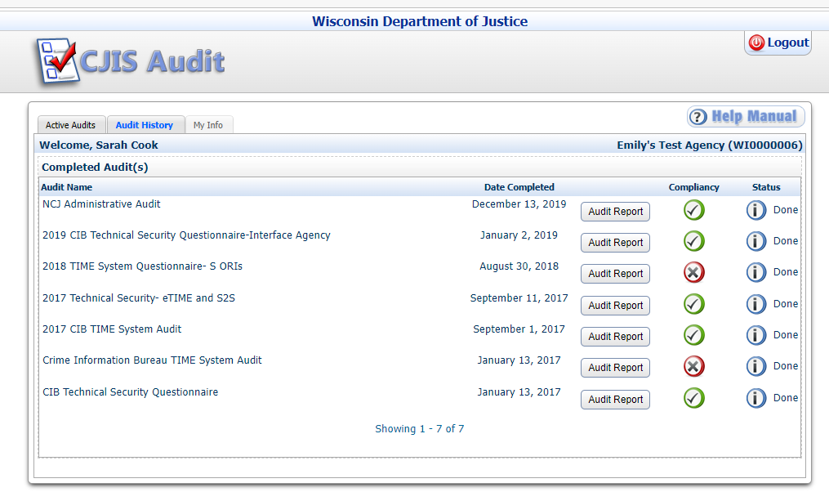
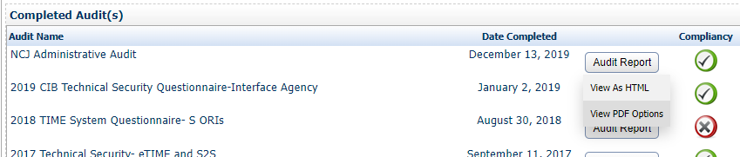
Audit History
https://www.doj.state.wi.us/
Notes:
Agencies can click on the second tab over (Audit History) and view their previous audits. This can be a helpful tool in determining how questions were answered on previous audits.
The user can right click on the Audit report button and click on View PDF options to view and print out the previous audit.

Slide 31
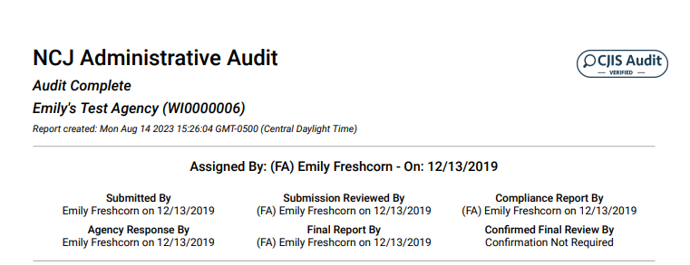
Audit Report
https://www.doj.state.wi.us/
Notes:
The PDF Report of the previous audit will show who submitted the audit when it was received by and who the CIB Auditor was.

Slide 32
Common Non-Compliant Items
Fingerprint-based background checks
Security Incident Response Policy
Advanced Authentication / Multi-factor Authentication (MFA)
Intrusion Detection Systems
CJI Encryption
Network Diagrams
Missing max data for record entry
No follow-up with court/complainant for validation
https://www.doj.state.wi.us/
Notes:
Many agencies fail to perform the necessary fingerprint-based background checks. Sworn officers and jailers are required to have fingerprints submitted to Training and Standards for the DOJ-LE 303 form but this does not meet the requirements for the CJIS Security Policy. Sworn officers and jailers should have two sets of prints taken, one for Training and Standards, and one for the Crime Information Bureau (CIB). Civilian personnel, vendors, and contractors must have one set of fingerprints submitted to CIB. Once these prints are submitted, CIB will run them through the Wisconsin Criminal History Repository and forward them to the FBI. All results will be returned to the agency’s Wisconsin Online Record Check System (WORCS) account for review. A review of the results must take place before unescorted access can be granted. Agencies should have at least one person designated as the WORCS administrator, with the capability to log in to WORCS and pull the results from the site for review.
All agencies that access the TIME System or store Criminal Justice Information (CJI) are required to have a security incident response policy. Each year we ask if agencies have a policy and agencies respond “no”. Agencies are required to have this policy in effect in their agency and all personnel, contractors, and vendors are required to know the policy and to whom they should report any suspicious activity. The security incident response policy should include elements such as adequate preparation, detection, analysis, containment, recovery, and user response activities. Agencies are also required to track, document, and report incidents to CIB.
Agencies that access CJI outside of the physically secure location(s) or controlled area(s) must have Advanced Authentication, also called Multifactor Authentication (MFA) deployed. Any device that accesses CJI from outside the physically secure location or controlled area must have MFA deployed. This can be on laptops, smartphones, tablets, or desktops, etc. The LASO should determine what the physically secure location(s) and/or controlled area(s) of the agency are. Then, the agency can determine whether any devices fall outside of those boundaries to deploy MFA on those devices. There is a possibility that future updates to the CJIS Security Policy will change this requirements to all devices requiring MFA.
Another area where agencies are not compliant with the requirements of the CJIS Security Policy are intrusion detection systems (IDS) and their requirements. All agencies are required to have network-based or host-based intrusion detection or prevention tools deployed on their network where CJI is accessed, processed, transmitted, or stored. Agencies must also maintain current intrusion detection or prevention signatures, monitor inbound and outbound communications for unusual or unauthorized activities, and employ automated tools to support near-real-time analysis of events in support of detecting system-level attacks. Agencies must send intrusion detection logs to a central logging facility where correlation and analysis can take place. This can be to a Security Incident Event Management (SIEM) or other software/product that can analyze the logs, not necessarily sent out to a third party. Agencies must review intrusion detection or prevention logs weekly or implement automated event notification. Many agencies were found to be out of compliance with encryption of CJI. When CJI is transmitted electronically, it must be encrypted with a FIPS 140-2 certified encryption algorithm if the CJI leaves the physically secure location. Many agencies’ responses to the audit indicate that they do not encrypt electronic transmission of CJI or the encryption is “FIPS compliant”, both of which do not meet the FIPS 140-2 certified standard that is required. If your agency currently has encryption, you should reach out to the vendor and ask for the FIPS 140-2 certificate that covers the encryption. If one cannot be produced, the agency must find a FIPS 140-2 certified method of encryption to deploy. If your agency has not yet implemented encryption, be sure to get the FIPS 140-2 certificate that covers the encryption you plan to implement prior to purchasing it to ensure it is compliant. Temporary remote access is access to an agency’s network or systems that is outside of the agency’s physically secure location. This can be done by the agency, IT, or vendor/contractor personnel on a temporary basis for maintenance or troubleshooting. Any temporary remote access must meet certain requirements to ensure it complies with the CJIS Security Policy. All temporary remote access must be done in a manner that is FIPS 140-2 certified encrypted. “FIPS compliant” is not enough to satisfy this requirement. Temporary remote personnel must be either virtually escorted or have Multifactor Authentication implemented. Virtual escorting is a means by which an agency verifies the temporary remote personnel. It includes meeting these criteria: 1. The session must be monitored at all times by an authorized escort. 2. The escort shall be familiar with the system/area in which the work is being performed. 3. The escort shall have the ability to end the session at any time. 4. The remote administrative personnel connection shall be via an encrypted (FIPS 140-2 certified) path. 5. The remote administrative personnel shall be identified prior to access and authenticated prior to or during the session. This authentication may be accomplished prior to the session via an Advanced Authentication (or MFA) solution or during the session via active teleconference with the escort throughout the session. All requirements of virtual escorting must be met to be considered virtual escorting. If this cannot be done, then Multifactor Authentication must be used during the session. It is possible for an agency to not use temporary remote access at all on their network. This would require that all maintenance and troubleshooting be done on-site at the agency.
State auditors have found that agencies do not have a network diagram or the network diagram does not include all required information. Network diagrams are missing the name of agency, date of creation, or “For Official Use Only” markings. Diagrams are also missing key pieces of infrastructure including labeled firewalls, servers, virtual environment, wireless access points, or FIPS 140-2 certificates added to corresponding encryption devices and connections.
Review of records entered by Wisconsin agencies identify that records are not entered using all available data, including data from CHRI, DOT, DNR, DOC, and in-house records.
Agencies were also found to not be contacting the court or complainant to ensure the entry is still valid (warrant is still outstanding, missing person still missing, property still missing/stolen, etc.).

Slide 33
Non-Compliance
What do I do if I am out of compliance?
ALWAYS answer honestly
CIB is here to help!
Work with your I.T. department or vendor
Provide a plan and a timeline
https://www.doj.state.wi.us/

Slide 34
Audit Benefits
Prevents / minimizes liability
Safeguarding our data
Teaches agencies compliance
Everyone on the same page
Better understanding of the TIME System
Learn from other people’s mistakes and experiences
Mitigate risks before they cause problems
Improve understanding of rights and responsibilities
Prevent things from “slipping through the cracks”
Ensuring operational goals continue to be met
Continued access to the TIME system means your agency is complete and compliant with the audit!
https://www.doj.state.wi.us/
Notes:
Also, it's a set of clear expectations for policies, procedures, and best practices that can be used to train new people and explain to non CJ personnel about the time, effort, and expense of doing things the right way - for budgets, personnel, etc.

Slide 35

Question & Answer
Sarah Cook (Training Officer)
cooksm@doj.state.wi.us
608-261-7667
Ben Brandner (Training Officer)
brandnerb@doj.state.wi.us
608-266-9341
CIBTrain@doj.state.wi.us
CIBAudit@doj.state.wi.us
Zach Polachek (Advanced PPA)
polachekzd@doj.state.wi.us
(608) 264-9470
Jeanette Devereaux-Weber (PPA)
devereauxweberjd@doj.state.wi.us
608-266-2426
Jennifer Virgin (PPA)
virginjm@doj.state.wi.us
608-266-7792
Megan Smaby (PPA)
smabymn@doj.state.wi.us
608-261-8135
https://www.doj.state.wi.us/
Notes:
The full contact list is available on WILENET

Slide 36
Thank You!

