Slide 1
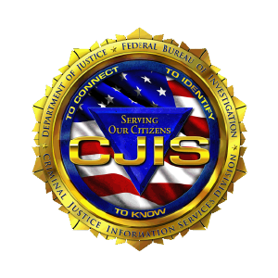
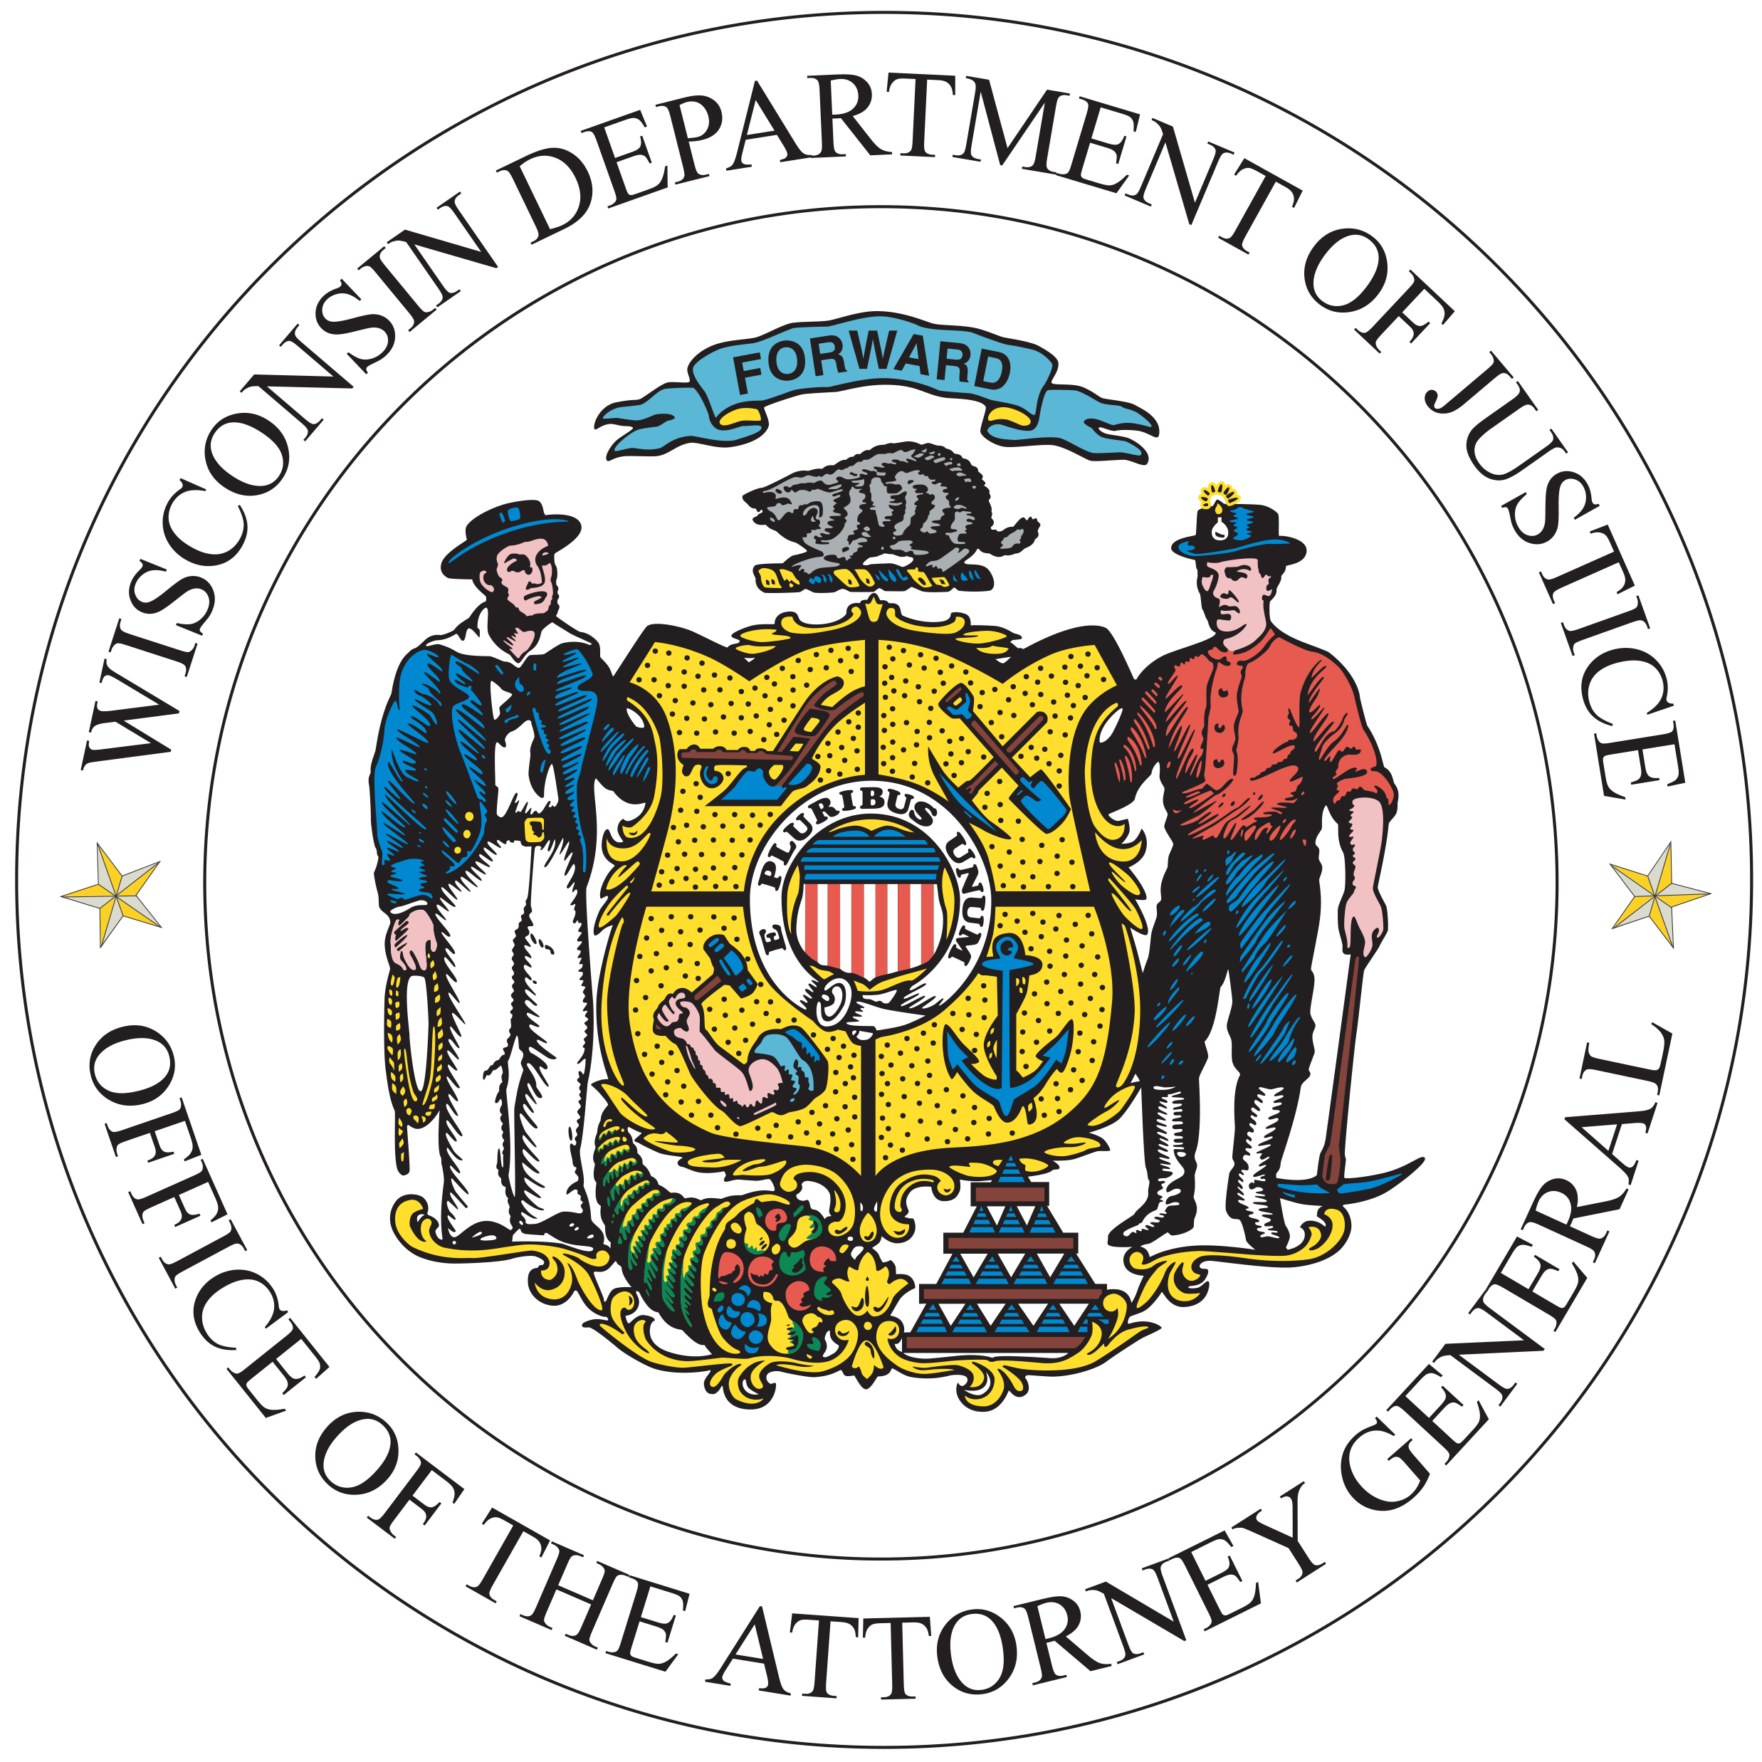

CJIS Security Policy Modernization Updates
CIB Conference, September 10-13

Slide 2
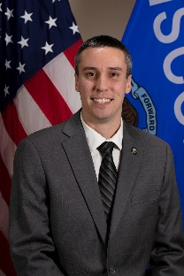
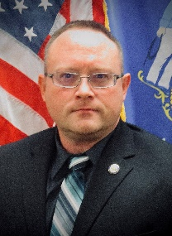
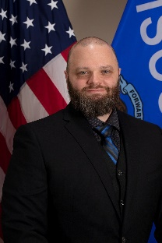
Welcome
Craig Thering
Justice Program Supervisor
TIME & Technical Unit
Zach Polachek
Program & Policy Analyst - Advanced
TIME & Technical Unit
Brian Kalinoski
WI ISO
TIME System Operations Manager
https://www.doj.state.wi.us/

Slide 3

CJIS Security Policy
1.1 Purpose and 1.2 Scope
The CJIS Security Policy provides agencies with the minimum set of security requirements to protect CJI.
The CJIS Security Policy applies to any and all agencies with access to CJI.
CJIS Security Policy integrates presidential directives, federal laws, FBI directives, the criminal justice community’s Advisory Policy Board (APB) decisions along with guidance from the National Institute of Standards and Technology (NIST) and the Compact Council.
https://www.doj.state.wi.us/
Notes:
What’s it’s purpose?
If CJI isn’t involved, then the policy does not need to be applied.
Not just because the “FBI said so”…

Slide 4
CJIS Security Policy
4.1 Criminal Justice Information (CJI) – Definition
Criminal Justice Information is the term used to refer to all FBI CJIS provided data necessary for law enforcement and civil agencies to perform their missions including, but not limited to biometric, identity history, biographic, property, and case/incident history data. The following categories of CJI describe the various data sets housed by the FBI CJIS architecture:
    1. Biometric Data—data derived from one or more intrinsic physical or behavioral traits of humans typically for the purpose of uniquely identifying individuals from within a population. Used to identify individuals, to include: fingerprints, palm prints, iris scans, and facial recognition data.
2. Identity History Data—textual data that corresponds with an individual’s biometric data, providing a history of criminal and/or civil events for the identified individual.
3. Biographic Data—information about individuals associated with a unique case, and not necessarily connected to identity data. Biographic data does not provide a history of an individual, only information related to a unique case.
4. Property Data—information about vehicles and property associated with crime when accompanied by any personally identifiable information (PII).
5. Case/Incident History—information about the history of criminal incidents.
https://www.doj.state.wi.us/
Notes:
Official definition.
In simple terms, any data obtained from the FBI.
Agencies could deem anything TIME System = CJI for consistency and easy of management.

Slide 5
CJIS Security Policy
Modernization of the CJIS Security Policy
Modernization efforts started in v5.9.1, October 1, 2022.
Currently at v5.9.5, can be obtained online:
https://le.fbi.gov/cjis-division/cjis-security-policy-resource-center
CJIS is actively working on updating/modernizing the policy and expects to release the final version (v6.0), sometime in 2025.
All areas of the policy are sanctionable by October 1, 2027.
CIB continues to review the changes and is updating triennial audit questionnaires as applicable.
https://www.doj.state.wi.us/
Notes:
Many of the updates to the CJIS Security Policy are based off NIST 800-53 and 800-63. If familiar with those publications, then you should have a good idea of what the majority of the new requirements are and their basis.
Modernization efforts have focused more on preventing access from both outside and insider threats and placing an emphasis on the multi-faceted approaches to security with long term goals and robust planning.

Slide 6
CJIS Security Policy
Priority Updates:
As of version 5.9.5, CJIS has identified 4 priority levels (P1, P2, P3, and P4) that different control areas will be categorized as based on current and emerging security threat analysis.
Priority 1 (P1) items are those specific controls which are required to be in place immediately and they are sanctionable upon the date of publication of the policy (5.9.5 was published July 9th, 2024) unless otherwise specified in the security policy companion document.
https://www.doj.state.wi.us/

Slide 7
CJIS Security Policy
Priority Updates:
Priority 2, 3, and 4 (P2, P3, P4) modernized controls
Unless otherwise stated in the policy, control items in these categories will be required to be in place by the end of the zero-cycle if not already required under previous versions of the policy.
Some areas of the policy have not been updated as part of the modernization process and those existing areas or controls remain auditable and are currently sanctionable.
https://www.doj.state.wi.us/
Notes:
The current zero-cycle goes from 10/1/2024 – 9/30/2027. All items in modernization will be auditable and sanctionable as of 10/1/2027.

Slide 8
CJIS Security Policy
Priority 1 Control Areas:
Access Control (AC)
        1. Account Management – creation, maintenance, deactivation
        2. Remote Access – Internal & External (server to squad; temporary remote access for support)
        3. External Systems – Non-Agency owned/controlled
https://www.doj.state.wi.us/

Slide 9
CJIS Security Policy
Priority 1 Control Areas:
Identification & Authentication (IA)
1. Multi-Factor Authentication (MFA) – Organizational Users
2. Authenticator Management – Types, Public Key Based, Protection
Configuration Management (CM)
1. Baseline Configuration – in conjunction with network diagram
2. Restrictions, Settings, Least Functionality, System Component Inventory
https://www.doj.state.wi.us/

Slide 10
CJIS Security Policy
Priority 1 Control Areas:
Systems and Communications Protection (SC)
1. Boundary Protection – AP’s, External Telecom Services, Routing, PII
System and Information Integrity (SI)
  1. Flaw Remediation
  2. Malicious Code Protection
  3. System Monitoring
  4. Software/Firmware and Information Integrity
https://www.doj.state.wi.us/

Slide 11
CJIS Security Policy
Priority 1 Control Areas:
Risk Assessment (RA)
1. Vulnerability Monitoring and Scanning
* All previously mentioned Priority 1 sections are those as defined by the APB for the CJIS Security Policy and agreed upon by all 50 states. The following areas may or may not be CJIS defined Priority 1 controls, but those areas that CIB would highly recommend that agencies also concentrate on modernizing.
https://www.doj.state.wi.us/

Slide 12
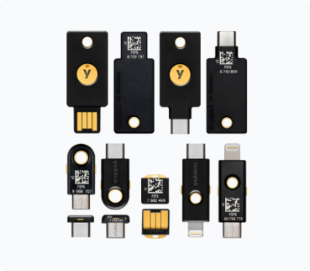
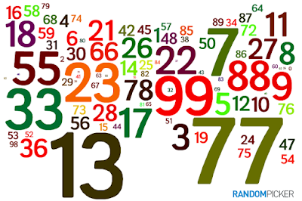
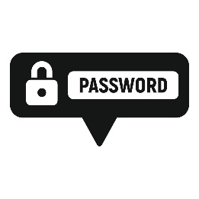

CJIS Security Policy
Multi-Factor Authentication (Priority 1)
Formerly known as Advanced Authentication or 2-Factor Advanced Authentication (2FA).
Factor Types – 2 of 3 required for use with CJIS systems.
  - “Something You Have” (e.g., physical authenticator/token)
  - “Something You Know” (e.g., a PIN, memorized secret)
  - “Something You Are” (e.g., biometrics) *
  * Cannot be used as primary factor, can only be used as an enhanced factor in addition to a “Have” or “Know” factor.
https://www.doj.state.wi.us/

Slide 13
CJIS Security Policy
Multi-Factor Authentication (Priority 1)
Deployed as close to the access of CJI as possible*.
- Application login
- Device login
Current projections from cyber security intelligence sources say that at some point in the coming future, MFA will be required for ALL access and/or login points. (consider SAML/OpenID/SSO)
* CJI storage location determines where MFA is deployed
https://www.doj.state.wi.us/

Slide 14
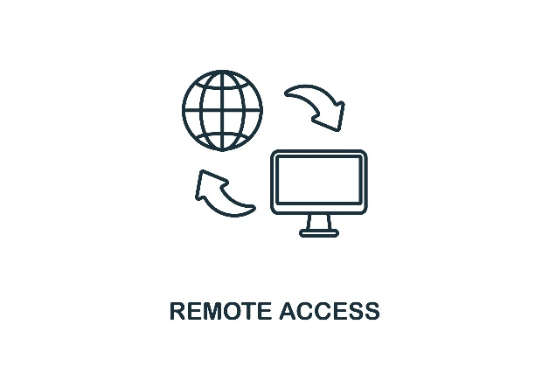
CJIS Security Policy
Remote Access
Defined as any access to organizational systems (or processes acting on behalf of users) that communicate through external networks (i.e., the Internet).
Includes internal applications used for communication between physically secure locations, and external applications that provide network/system support access for maintenance purposes.
Shall be encrypted to the requirements of the policy.
Shall be monitored and controlled by the agency.
https://www.doj.state.wi.us/

Slide 15
CJIS Security Policy
Identification and Authentication (Priority 1)
Agencies are required to identify and verify users, processes, and devices as a prerequisite to allowing access to system resources.
Applies to all organizational personnel and those non-organizational personnel that directly support the agency.
Agencies will not hire or contract with any person not physically present within US.
https://www.doj.state.wi.us/

Slide 16
CJIS Security Policy
Identification and Authentication (Priority 1)
Identity Proofing (Priority 2)
- The sole objective of identity proofing is to ensure the applicant is who they claim to be to a stated level of certitude.
Identity Evidence shall be collected from applicants and the types of evidence collected must meet notional strength benchmarks as identified in section IA-12(3)(y) of the CJIS Security Policy.
https://www.doj.state.wi.us/

Slide 17
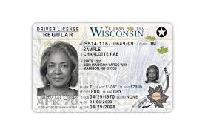
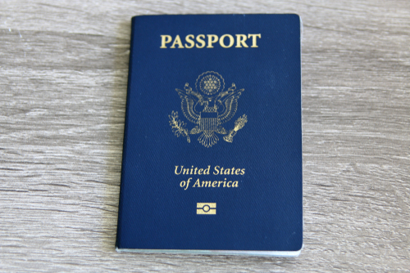
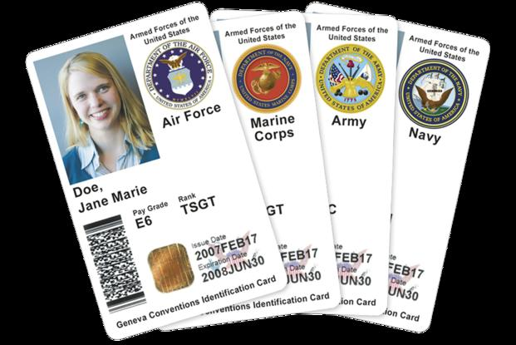

CJIS Security Policy
Identification and Authentication (Priority 1)
Identity Evidence is categorized into 5 different levels: Superior, Strong Plus, Strong, Fair, and Weak
Agencies will need to collect evidence that is equivalent to the minimum acceptable level of STRONG.
SUPERIOR SUPERIOR / STRONG + STRONG + / STRONG FAIR
https://www.doj.state.wi.us/
Notes:
Examples of superior: US Passport, PIV card, CAC
Examples of strong+: REAL ID cards, US Uniformed Services ID Cards
Examples of strong: DL or ID card that is not REAL ID compliant, Native American Tribal photo ID card.
Examples of fair: School ID card(w/photo), Utility account statement, credit card statement, bank statement.
Examples of weak: SSN, Birth Certificate

Slide 18
CJIS Security Policy
Identification and Authentication (Priority 1)
Identity Evidence nominal strength combinations
1. One piece of SUPERIOR or STRONG evidence if the evidence’s issuing source, during its identity proofing event, confirmed the claimed identity by collecting two or more forms of SUPERIOR or STRONG evidence and the CSP validates the evidence directly with the issuing source; OR
2. Two pieces of STRONG evidence; OR
3. One piece of STRONG evidence plus two pieces of FAIR evidence
https://www.doj.state.wi.us/

Slide 19
CJIS Security Policy
Identification and Authentication (Priority 1)
Non-US Citizens
- The person has “permanent resident” status or holds a valid H1B (Work) Visa.
- The person submits to a national fingerprint check and has no disqualifying responses.
- The Agency performs a IPQ (Portal form 0926) and IAQ (Portal form 0650)
NCIC query on the person and has no disqualifying responses.
- HR performs a USCIS eVerify check with no red flags.
- The person submits a verifiable work history, and the hiring supervisor contacts the previous employers.
https://www.doj.state.wi.us/
Notes:
IPQ = Interpol query, IAQ = Immigration Alien Query, sent to LESC/ICE.

Slide 20

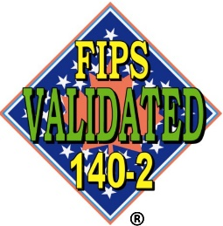
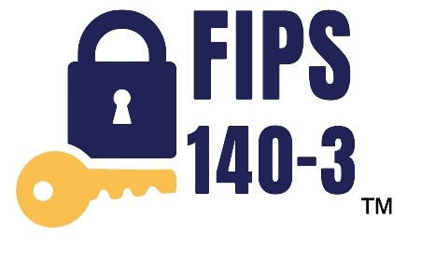
CJIS Security Policy
Encryption (Priority 2)
FIPS 140-2 – not acceptable for use after 9/21/2026
FIPS 140-3 – Shall be employed by 10/1/2026
Agencies shall employ FIPS 140-3 Certified encryption modules or “FIPS Compliant” encryption for protection of CJI if using FIPS validated algorithms for symmetric key encryption with a cipher key of at least 128-bit strength (in-transit) and 256-bit strength (at rest).
https://www.doj.state.wi.us/

Slide 21
CJIS Security Policy
Incident Response (Priority 2)
What is a security incident?
A security incident can be defined as any physical or logical security breach that negatively affects an agency’s devices, systems, and/or networks that connect to, store, or handle information traffic with criminal justice information (CJI), CJIS data (obtained from TIME/NCIC), and/or any confidential information used for the administration of criminal justice or law enforcement.
https://www.doj.state.wi.us/

Slide 22
CJIS Security Policy
Incident Response (Priority 2)
Policies and Procedures
Incident Handling
Incident Response Plans
  - Both Physical and Logical Security Incidents
Although a Priority 2 area, due to the rising security threats against public safety infrastructure agencies should place a higher emphasis on ensuring those above items are up to date and in-place.
https://www.doj.state.wi.us/

Slide 23
CJIS Security Policy
Incident Response (Priority 2)
Notification of Incidents
Agencies are required to notify WI DOJ – CIB & DCI within 24 hours of initial discovery of a security incident and shall provide required details of the incident upon request from CIB so that determinations can be made as to any TIME/NCIC system effects.
Agencies are also required to notify the WI Statewide Intelligence Center/DCI (WI DOJ - Division of Criminal Investigation).
https://www.doj.state.wi.us/
Notes:
DCI can provide regional CERT team response and assistance as well as provides intelligence to federal entities that are required to be notified as necessary (FBI, CISA, NSA, DOD, etc.)

Slide 24
CJIS Security Policy
Incident Response (Priority 2)
Agencies will be required to provide CIB with an initial report of incident to include:
  the specific type of malware/virus or hostile application
  when the hostile actor was first observed on the network
  who was initially contacted and for what purpose
  what initial steps were performed to isolate or prevent extension
  was any extension known or found prior to contacting higher agencies
  what caused delays in notification to logically connected agencies
  was there any information found to have been harvested by hostile actors
  was there any credential harvesting found
Regardless of what insurance or any involved legal counsel advise, those items shall be provided to WI DOJ per federal and state requirements to maintain any TIME System access and connections. Failure to provide those items will result in total access and connection loss until CIB determines otherwise.
https://www.doj.state.wi.us/
Notes:
Since the TIME System is considered Critical Infrastructure of a National Security Nature, all related policies and requirements for reporting to WI DOJ supersedes those of local or private authority.

Slide 25
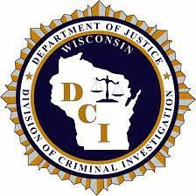
CJIS Security Policy
Incident Response (Priority 2)
How do I contact WI DOJ?
CIB
    - TIME System Control Center (TSCC), open 24/7/365 – 608-266-7633
    - Brian Kalinoski, TIME Ops Manager/WI-ISO – 608-266-7394, kalinoskibt@doj.state.wi.us
    - Zach Polachek, PPA-A, TIME & Tech Unit – 608-264-9470, polachekzd@doj.state.wi.us
    - Craig Thering, TIME & Tech Manager – 608-261-0667, theringcd@doj.state.wi.us
    - Katie Schuh, Deputy Director-TIME System – 608-266-0335, schuhkr@doj.state.wi.us
    DCI/WI Statewide Intelligence Center
    - 888-324-9742, wsic@doj.state.wi.us
    Online form: https://wifusion.widoj.gov/form/cyber-incident-reporting
https://www.doj.state.wi.us/

Slide 26
CJIS Security Policy
System & Services Acquisition (Priority 2)
Replace system components when support for the components are no longer available from the manufacturer, developer, and/or vendor.
Budget, Budget, Budget! This stuff is not cheap, but with proper planning you can save money in the long run.
Failure to keep system components up to date is one of the biggest reasons for cyber security breaches as hackers are always looking to exploit vulnerabilities in the systems.
https://www.doj.state.wi.us/
Notes:
With Encryption standards now moving to FIPS 140-3, agencies should be keeping an eye out to replace their aging infrastructure which may or may not be eligible for upgrades or replacements. The same applies with Windows OS and server updates and upgrades.

Slide 27


CJIS Security Policy
TIME System Audits
Audit questionnaires continue to be updated as new policy releases are published.
IT that supports law enforcement should be prepared to assist with technical questionnaires.
Audits are scheduled on a 3-year schedule (may changed based on mitigating factors) as per the CJIS Security Policy requirements.
Sample policies are available on WILEnet and from CIB, please contact the CIB Audit email inbox for samples: cibaudit@doj.state.wi.us
https://www.doj.state.wi.us/
Notes:
Agencies that have items of concern identified during the audits will be required to provide estimated timelines for addressing non-compliant items in their response back to CIB.

Slide 28
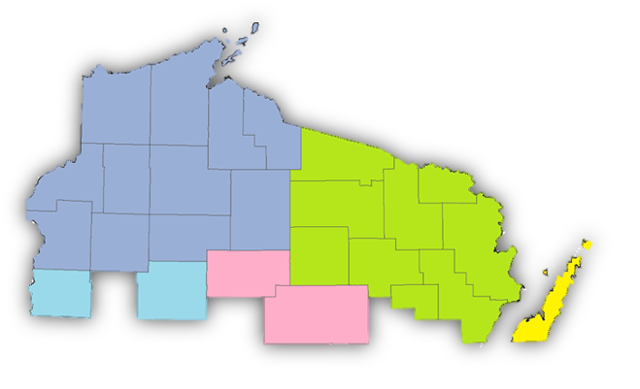
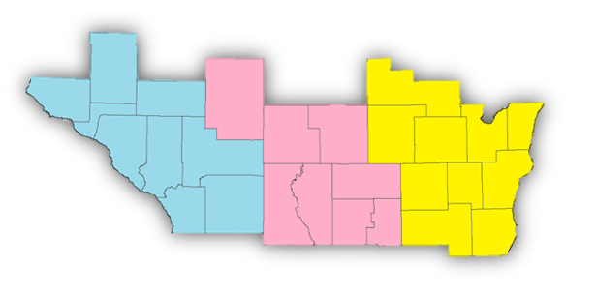
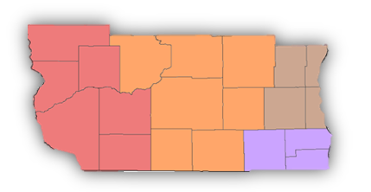
CJIS Security Policy
Map provided by
State Cartographer’s Office
TIME System Audits
Audits are done in a 3-year cycle
Mostly geographical by county
Exceptions:
          - DA’s offices, DOC, DNR, State Patrol
          - Other agencies located in multiple counties
          - Agencies joining the TIME system
  Currently in year 1 of WI cycle
  FBI auditing WI in 2025
3rd year
2nd year
1st year
https://www.doj.state.wi.us/
Notes:
Agencies that have items of concern identified during the audits will be required to provide estimated timelines for addressing non-compliant items in their response back to CIB.

Slide 29
CJIS Security Policy
Training Changes
LASO training – Required annually
Security Awareness training – Required annually
IT/IS sections that directly support LE/Criminal Justice Agencies are required to sign a management control agreement (MCA) with the LE/CJA if not directly employed by the LE/CJA.
https://www.doj.state.wi.us/
Notes:
LASO training is now required to be completed annually. CIB has online LASO training available as well as paper LASO training materials available on the WILEnet website.
Security Awareness training is now required on an annual basis and just like the LASO training, Security Awareness is available both on paper and digitally. However, there are different levels of Security Awareness training that are required based on the job duties of the person. TIME System users get Security Awareness as part of their biannual certification or recertification, but they will also now be required to take the stand-alone Security Awareness training on the opposite years from certification/recertification. Non-TIME System users will just need to take either the paper or digital Security Awareness training annually.
MCAs are required between all CJA’s and their IT/IS support is the IT/IS support is not part of the CJA. This applies for both public and private entities. MCAs will be requested by CIB from the CJA at time of audit so if the CJA does not have one, they will be required to get a current copy with IT/IS support if they are not directly part of the CJA.

Slide 30
CJIS Security Policy
TIME System Misuse
CJISSECPOL 4.2.5.2- Improper access, use or dissemination of CHRI and NCIC Non-Restricted Files information is serious and may result in administrative sanctions including, but not limited to, termination of services and state and federal criminal penalties.
FOR OFFICIAL USE ONLY! Curiosity checks are prohibited!
Agencies sign access agreements with WI DOJ to access TIME/NCIC.
All queries in the TIME System/NCIC are logged by CIB and FBI.
https://www.doj.state.wi.us/

Slide 31
CJIS Security Policy
TIME System Misuse
CJISSECPOL controls: AC-2(3)(c) and AC-2(13) require agencies to disable accounts within 1 week and 30 minutes respectively.
All potential misuse is investigated by CIB and any users found to have committed an intentional violation will have their TIME access removed. Continued violations may result in permanent ban of TIME System access and criminal charges on state and/or federal level (depending on nature of violation) may be pursued.
https://www.doj.state.wi.us/

Slide 32
CJIS Security Policy
More Resources
NIST – Considerations for Implementing MFA to Protect Criminal Justice Information
  - https://www.nccoe.nist.gov/sites/default/files/2024-05/mfa-webinar-05-17-24-presentation.pdf
IJIS Institute (In coordination with FBI CJIS)
CJIS Security Policy Modernization Updates
- Version 5.9.1 - https://ijis.org/community-resources/cjis-security-policy-webinars/#Wby3oQAfnxc
- Version 5.9.2 - https://ijis.org/community-resources/cjis-security-policy-webinars/#KGFvvngYGtI
- Version 5.9.3 - https://ijis.org/community-resources/cjis-security-policy-webinars/#MMJGaoKoUj4
- Version 5.9.4 - https://ijis.org/community-resources/cjis-security-policy-webinars/#JNI0Nfn_CJ8
https://www.doj.state.wi.us/

Slide 33

Questions?
Contact the TIME & Technical Unit or TSCC
      CIBTRAIN@DOJ.STATE.WI.US
CIBPSN@DOJ.STATE.WI.US
ETIME@DOJ.STATE.WI.US
TIMEBILLING@DOJ.STATE.WI.US
CIBAUDIT@DOJ.STATE.WI.US
TSCC@DOJ.STATE.WI.US
https://www.doj.state.wi.us/

Slide 34
Thank You!

